Slide 1
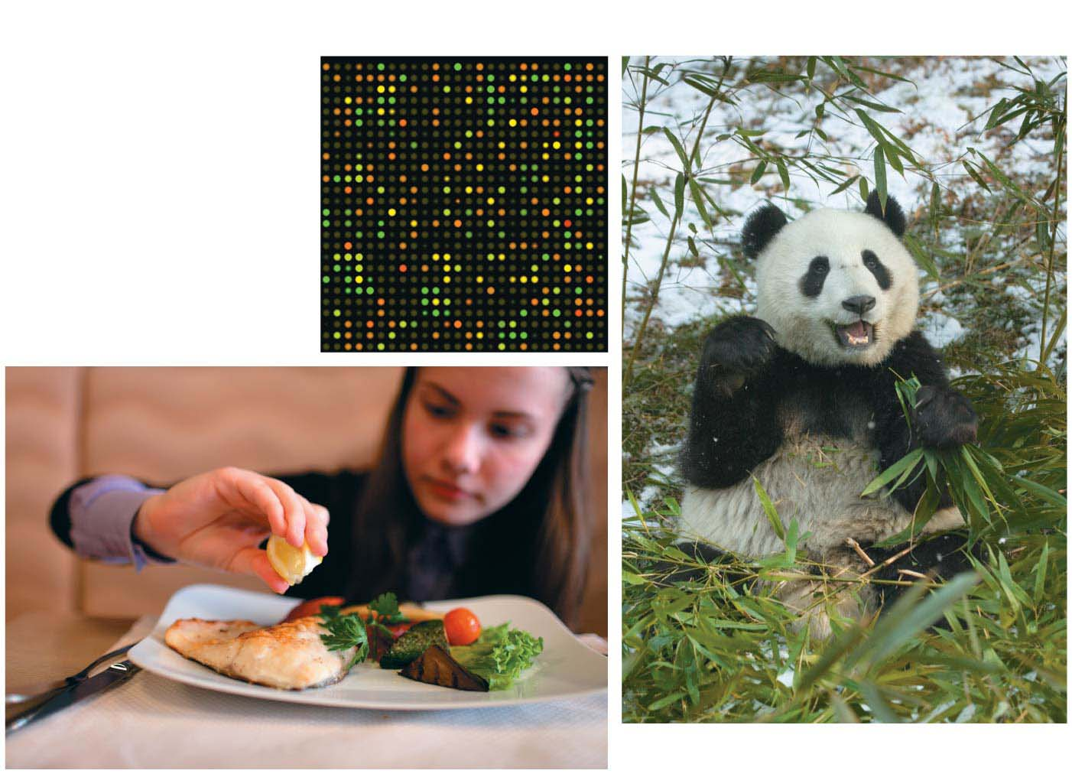
Chapter 11 pdf
How Genes are Controlled
10/22/18
Chaffey BIOL-12

Slide 2
Chapter Outline
Gene Expression and Regulation
Regulation in Bacteria
Regulation in Eukaryotes
Cloning in Plants and Animals
Genetics of Cancer

Slide 3
Biology and Society: Breast Cancer
The Bad News
  about one in eight women will develop breast cancer
  Biol-12 has ~ 48 student, 24 are women, 24/8...
  Statistically speaking, three woman in this classroom will develop breast cancer at some point in their life...
The Good News
  Nearly 100 % survival after five years if detected early,
  and treatment is targeted...
Notes:
3

Slide 4
Biology and Society: Breast Cancer
  Treatment: Surgery, chemotherapy, radiation
  Treatments are not without costs
  nausea, heart disease, other cancers...
  Cancer specialists decide what the right treatment plan
  They look at the type of gene that is mutated
  Many cancer-associated genes encode proteins that turn other genes on or off (cell cycle regulators).
  Knowing the what kind of mutation causes the cancer can inform the treatment
Notes:
4
Cancer specialists traditionally determine whether a woman should have chemotherapy by using clinical factors, such as the size of her tumor and how many lymph nodes had cancer cells in them. As an analogy, suppose that you knew a car with no brakes was headed toward a cliff. Should you shoot out the tires? Is the intervention worth the risk? The clinical factors are like looking at how far the car is from the edge of the cliff. The closer to the edge, the more it makes sense to use an extreme intervention. However, a woman may have a large tumor and several affected lymph nodes because she has had a slow-growing cancer for a long time. Her risk may actually be low. Giving her chemo- therapy might be an unnecessary intervention, like shooting out the tires on a car that is never going to reach the cliff.

Slide 5
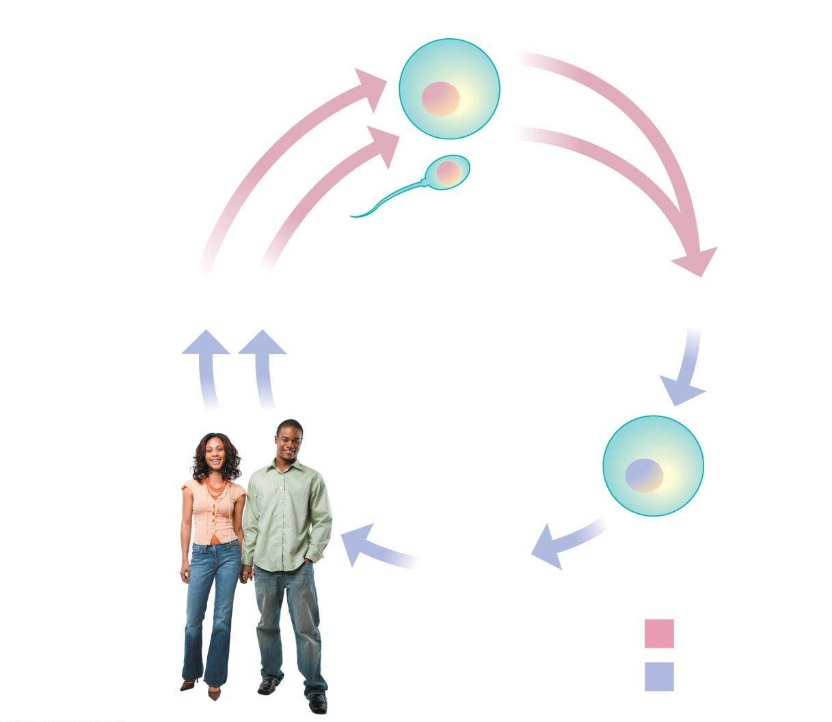
Figure 8.12
Haploid gametes (n = 23)
somatic cell vs
germline sex cells.
n
Egg cell
n
Sperm cell
MEIOSIS
FERTILIZATION
Multicellular
diploid adults
(2n = 46)
Diploid
zygote
(2n = 46)
2n
MITOSIS
and development
Key
Haploid (n)
Diploid (2n)
Notes:
Figure 8.12 The human life cycle

Slide 6
How and Why Genes Are Regulated
Mitosis
  produces every cell in your body
  starting from the zygote, the original cell that formed after fusion of sperm and egg
Key Point! – every cell in your body has the same DNA!
  every somatic (body) cell contains two copies of every gene, all cells identical.
  every gamete cell contains one copy of every gene
Notes:
6
Student Misconceptions and Concerns
1. The broad concept of selective “reading” of the genetic code associated with differentiation and types of cellular activity can be missed when concentrating on the extensive details of regulation. Analogies, noted in the text and below in the teaching tips, can help students relate this overall selective process to their own experiences. Students already understand the selective reading of relevant chapters in textbooks and the selective referencing of product manuals to get answers to different questions. These experiences are similar in many ways to the broad processes of gene regulation.
2. The many levels of gene regulation in eukaryotic cells can be confusing and frustrating. The water pipe analogy depicted in Figure 11.3 can be a helpful reference to organize the potential sites of regulation.
Teaching Tips
1. Cellular differentiation is analogous to buying a book about how to build birdhouses and reading only the plans needed to build one particular model. Although the book contains directions to build many different birdhouses, you read and follow only the directions for the particular birdhouse you choose to build. The pages and directions for the other birdhouses remain intact. When cells differentiate, they read, or express, only the genes that are needed in that particular cell type.
2. A key advantage of an operon system is the ability to turn off or on a set of genes with a single “switch.” You can demonstrate this relationship in your classroom by turning off or on a set of lights with a single switch.
3. The authors develop an analogy between the regulation of transcription and the series of water pipes that carry water from your local water supply, perhaps a reservoir, to a faucet in your home. At various points, valves control the flow of water. Similarly, the expression of genes is controlled at many points along the process. Figure 11.3 illustrates the “flow” of genetic information from a chromosome—a reservoir of genetic information—to an active protein that has been made in the cell’s cytoplasm. The multiple mechanisms that control gene expression are analogous to the control valves in water pipes. In the figure, a possible control knob indicates each gene expression “valve.” In the figure, the large size of the transcription control knob highlights its crucial role.
4. Just as a folded map is difficult to read, DNA packaging tends to prevent gene “reading” or expression.
5. Just as boxes of your things that will be little used are packed deeper into a closet, attic, or basement, chromatin that is not expressed is highly compacted and is stored away.
6. Alternative RNA splicing is like remixing music to produce a new song or re-editing a movie for a different ending. You could have a little fun by challenging students to identify which category of the Academy Awards is most like alternative RNA splicing. (Answer: the award for best editing.)
7. The action of an extracellular signal reaching a cell’s surface is like pushing the doorbell at a home. The signal is converted to another form (pushing a button rings a bell) and activities change within the house as someone comes to answer the door.
8. Students might wonder why a patch of fur on the cat’s skin is all the same color in Figure 11.4, if every cell has an equal chance of being one of the two color forms. The answer is that X chromosome inactivation occurs early in development. Thus, the patch of one color represents the progeny of one embryonic cell after X chromosome inactivation.
9. Homeotic genes are often called “master control genes.” The relationship between homeotic genes and structural genes is like the relationship between a construction supervisor and the workers. Major rearrangements can result from a few simple changes in the directions for construction.
10. There is much hope for the use of DNA microarrays to refine cancer therapies. In the past, a diagnosis of cancer was too often met with general treatments that benefited only a fraction of the patients. Physicians were left to wonder why some people with breast cancer or lung cancer responded to therapy while others did not. DNA microarrays enable us to identify differences between patients with the same apparent type of cancer (breast, lung, prostate, and so on). Consider sharing this important avenue of hope. It is likely that some of your students will soon have a family member facing these battles.
Active Lecture Tips
1. The lactose operon is turned on by removing the repressor—a sort of double negative. Students might enjoy various analogies to other situations. Ask students in lecture to work in small groups to develop their own examples from life in which something occurs by a double negative. Share with them the common example “When the cat's away, the mice will play.” Then challenge them to each create a couple more. (Another example to consider: “Like a cat watching mice, if a mom keeps her kids away from cookies, but somebody occupies her attention, kids can sneak by and snatch some cookies. Thus, the person occupying Mom’s attention functions most like lactose binding to the repressor.”)

Slide 7
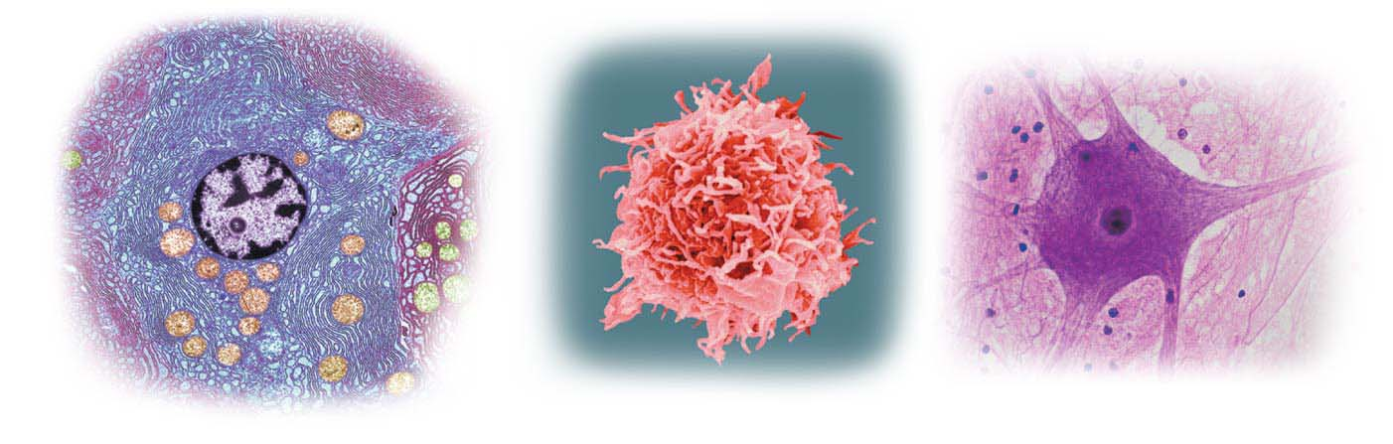
How and Why Genes Are Regulated
However, the cells in your body are specialized in structure and function
Cells differentiate into many different types of cells...
Pancreas cell
White blood cell
Nerve cell
Notes:
7

Slide 8
Does every somatic cell have the same DNA?
yes
So then, how do we have so many different kinds of cells?
Rene regulation
    Cells with the same genetic information can develop into different types of cells through gene regulation
    mechanisms that turn on certain genes while other genes remain turned off.

Slide 9
What does it mean to say that genes are turned on or off?
  Genes determine the nucleotide sequence of specific mRNA molecules
  mRNA in turn determines the sequence of amino acids in proteins (DNA → RNA → protein).
  A gene that is turned on is being transcribed into mRNA,
  and that message is being translated into specific proteins.
  The overall process by which genetic information flows from genes to proteins is called gene expression.
Notes:
9

Slide 10
Notes:
Figure 11.1 shows the patterns of gene expression for four genes in three different specialized cells of an adult human.
Note that the genes for “housekeeping” enzymes, such as those that provide energy via glycolysis, are “on” in all the cells.
In contrast, the genes for some proteins, such as insulin and hemoglobin, are expressed only by particular kinds of cells.
One protein, hemoglobin, is not expressed in any of the cell types shown in the figure.

Slide 11
Gene Regulation in Bacteria
Natural selection has favored bacteria that express only the genes whose products are needed by the cell.
Imagine an Escherichia coli bacterium living in your intestines.
  If you drink a milk shake, there will be a sudden rush of the sugar lactose.
  In response, E. coli will express three genes for enzymes that enable the bacterium to absorb and digest this sugar.
  After the lactose is gone, these genes are turned off.
Notes:
11

Slide 12
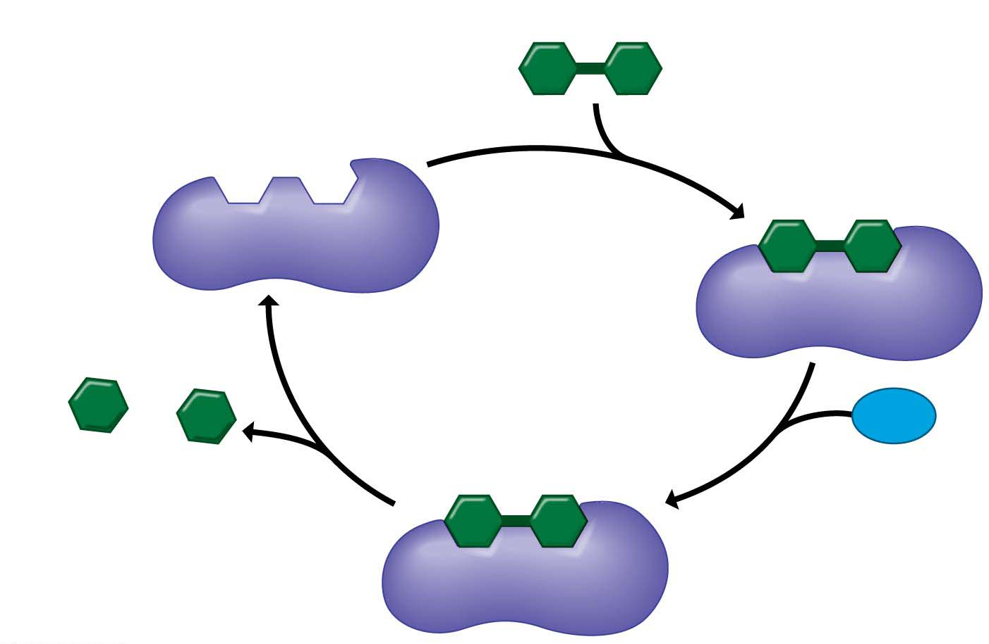
Figure 5.9-s4
Lactose Digestion Regulation
1
Ready for
substrate
Substrate (lactose)
Active site
2
Substrate
binding
Enzyme
(lactase)
Galactose
H₂O
Glucose
4
Product
release
3
Catalysis
Notes:
Figure 5.9-s4 How an enzyme works (step 4)

Slide 13
Gene Regulation in Bacteria
When lactose is present the genes that code for the enzymes that break up lactose turn on.
The key is the way the three lactose-digesting genes are organized:
They are adjacent in the DNA and turned on and off as a single unit.
This regulation is achieved through short stretches of DNA that help turn all three genes on and off at once
Notes:
13

Slide 14
How Lactose Digestion is Regulated
What is Lactose?
  a disaccharide of glucose and galactose found in milk products that must be broken into monosaccharides during digestion
What enzyme breaks the bond between glucose and galactose?
  Lactase
Do all cells produce lactase all of the time?
  No! it would be a waste of energy

Slide 15
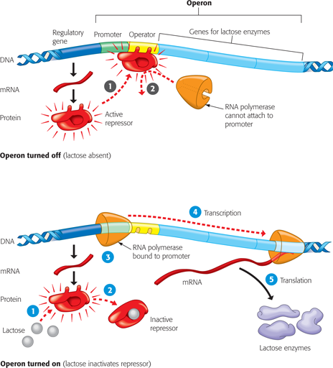
Gene Regulation in Bacteria
  Such a cluster of related genes and sequences that control them is called an operon.
  The operon considered here is the lac (short for lactose) operon.
Notes:
15

Slide 17
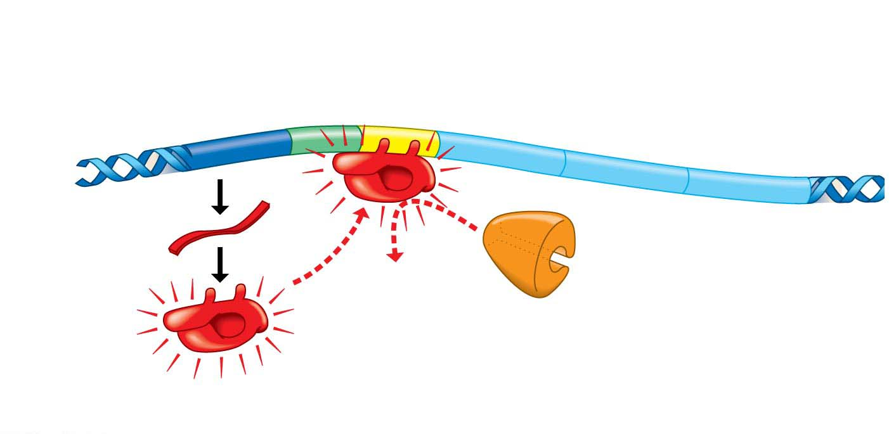
Figure 11.2-1
Operon
Operator
Genes for
lactose enzymes
Regulatory
gene
Promoter
DNA
1
mRNA
1
2
Active
repressor
RNA polymerase
cannot attach to
promoter
Protein
Operon turned off (lactose absent)
Notes:
Figure 11.2-1 The lac operon of E. coli (part 1: operon off)

Slide 18
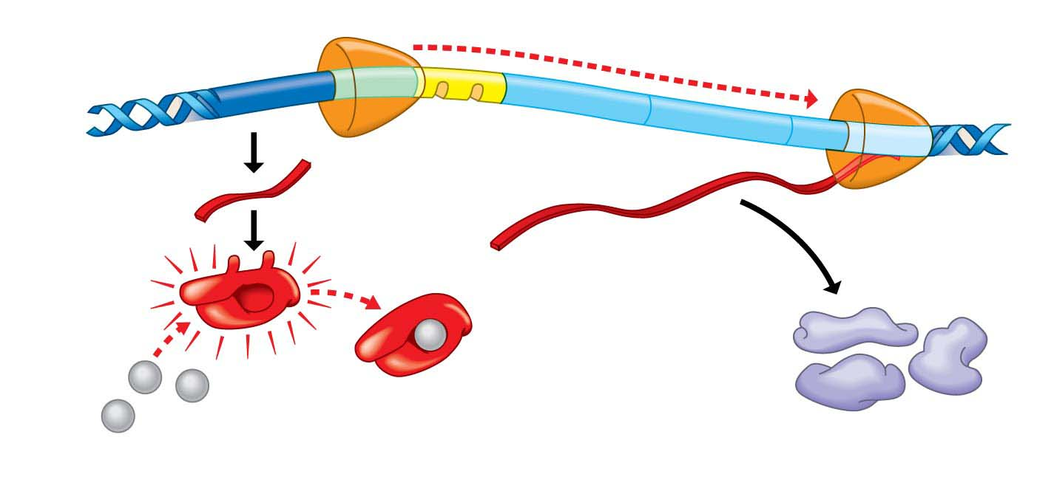
Figure 11.2-2
4
Transcription
DNA
RNA polymerase
bound to promoter
3
3
mRNA
mRNA
5
Translation
2
2
Protein
1
1
Inactive
repressor
Lactose
Lactose enzymes
Operon turned on (lactose inactivates repressor)
Notes:
Figure 11.2-2 The lac operon of E. coli (part 2: operon on)

Slide 19
start here on 10/25

Slide 20
Gene Regulation in Bacteria
How do DNA control sequences turn genes on or off?
  One control sequence, called a promoter, is the site where the enzyme RNA polymerase attaches and initiates transcription.
  Between the promoter and the enzyme genes, a DNA segment called an operator acts as a switch that is turned on or off, depending on whether a specific protein is bound there.
Notes:
20
Student Misconceptions and Concerns
1. The broad concept of selective “reading” of the genetic code associated with differentiation and types of cellular activity can be missed when concentrating on the extensive details of regulation. Analogies, noted in the text and below in the teaching tips, can help students relate this overall selective process to their own experiences. Students already understand the selective reading of relevant chapters in textbooks and the selective referencing of product manuals to get answers to different questions. These experiences are similar in many ways to the broad processes of gene regulation.
2. The many levels of gene regulation in eukaryotic cells can be confusing and frustrating. The water pipe analogy depicted in Figure 11.3 can be a helpful reference to organize the potential sites of regulation.
Teaching Tips
1. Cellular differentiation is analogous to buying a book about how to build birdhouses and reading only the plans needed to build one particular model. Although the book contains directions to build many different birdhouses, you read and follow only the directions for the particular birdhouse you choose to build. The pages and directions for the other birdhouses remain intact. When cells differentiate, they read, or express, only the genes that are needed in that particular cell type.
2. A key advantage of an operon system is the ability to turn off or on a set of genes with a single “switch.” You can demonstrate this relationship in your classroom by turning off or on a set of lights with a single switch.
3. The authors develop an analogy between the regulation of transcription and the series of water pipes that carry water from your local water supply, perhaps a reservoir, to a faucet in your home. At various points, valves control the flow of water. Similarly, the expression of genes is controlled at many points along the process. Figure 11.3 illustrates the “flow” of genetic information from a chromosome—a reservoir of genetic information—to an active protein that has been made in the cell’s cytoplasm. The multiple mechanisms that control gene expression are analogous to the control valves in water pipes. In the figure, a possible control knob indicates each gene expression “valve.” In the figure, the large size of the transcription control knob highlights its crucial role.
4. Just as a folded map is difficult to read, DNA packaging tends to prevent gene “reading” or expression.
5. Just as boxes of your things that will be little used are packed deeper into a closet, attic, or basement, chromatin that is not expressed is highly compacted and is stored away.
6. Alternative RNA splicing is like remixing music to produce a new song or re-editing a movie for a different ending. You could have a little fun by challenging students to identify which category of the Academy Awards is most like alternative RNA splicing. (Answer: the award for best editing.)
7. The action of an extracellular signal reaching a cell’s surface is like pushing the doorbell at a home. The signal is converted to another form (pushing a button rings a bell) and activities change within the house as someone comes to answer the door.
8. Students might wonder why a patch of fur on the cat’s skin is all the same color in Figure 11.4, if every cell has an equal chance of being one of the two color forms. The answer is that X chromosome inactivation occurs early in development. Thus, the patch of one color represents the progeny of one embryonic cell after X chromosome inactivation.
9. Homeotic genes are often called “master control genes.” The relationship between homeotic genes and structural genes is like the relationship between a construction supervisor and the workers. Major rearrangements can result from a few simple changes in the directions for construction.
10. There is much hope for the use of DNA microarrays to refine cancer therapies. In the past, a diagnosis of cancer was too often met with general treatments that benefited only a fraction of the patients. Physicians were left to wonder why some people with breast cancer or lung cancer responded to therapy while others did not. DNA microarrays enable us to identify differences between patients with the same apparent type of cancer (breast, lung, prostate, and so on). Consider sharing this important avenue of hope. It is likely that some of your students will soon have a family member facing these battles.
Active Lecture Tips
1. The lactose operon is turned on by removing the repressor—a sort of double negative. Students might enjoy various analogies to other situations. Ask students in lecture to work in small groups to develop their own examples from life in which something occurs by a double negative. Share with them the common example “When the cat's away, the mice will play.” Then challenge them to each create a couple more. (Another example to consider: “Like a cat watching mice, if a mom keeps her kids away from cookies, but somebody occupies her attention, kids can sneak by and snatch some cookies. Thus, the person occupying Mom’s attention functions most like lactose binding to the repressor.”)

Slide 21
Gene Regulation in Bacteria
  The operator and protein together determine whether RNA polymerase can attach to the promoter and start transcribing the genes.
  In the lac operon, when the operator switch is turned on, all the enzymes needed to metabolize lactose are made at once.
Notes:
21
Student Misconceptions and Concerns
1. The broad concept of selective “reading” of the genetic code associated with differentiation and types of cellular activity can be missed when concentrating on the extensive details of regulation. Analogies, noted in the text and below in the teaching tips, can help students relate this overall selective process to their own experiences. Students already understand the selective reading of relevant chapters in textbooks and the selective referencing of product manuals to get answers to different questions. These experiences are similar in many ways to the broad processes of gene regulation.
2. The many levels of gene regulation in eukaryotic cells can be confusing and frustrating. The water pipe analogy depicted in Figure 11.3 can be a helpful reference to organize the potential sites of regulation.
Teaching Tips
1. Cellular differentiation is analogous to buying a book about how to build birdhouses and reading only the plans needed to build one particular model. Although the book contains directions to build many different birdhouses, you read and follow only the directions for the particular birdhouse you choose to build. The pages and directions for the other birdhouses remain intact. When cells differentiate, they read, or express, only the genes that are needed in that particular cell type.
2. A key advantage of an operon system is the ability to turn off or on a set of genes with a single “switch.” You can demonstrate this relationship in your classroom by turning off or on a set of lights with a single switch.
3. The authors develop an analogy between the regulation of transcription and the series of water pipes that carry water from your local water supply, perhaps a reservoir, to a faucet in your home. At various points, valves control the flow of water. Similarly, the expression of genes is controlled at many points along the process. Figure 11.3 illustrates the “flow” of genetic information from a chromosome—a reservoir of genetic information—to an active protein that has been made in the cell’s cytoplasm. The multiple mechanisms that control gene expression are analogous to the control valves in water pipes. In the figure, a possible control knob indicates each gene expression “valve.” In the figure, the large size of the transcription control knob highlights its crucial role.
4. Just as a folded map is difficult to read, DNA packaging tends to prevent gene “reading” or expression.
5. Just as boxes of your things that will be little used are packed deeper into a closet, attic, or basement, chromatin that is not expressed is highly compacted and is stored away.
6. Alternative RNA splicing is like remixing music to produce a new song or re-editing a movie for a different ending. You could have a little fun by challenging students to identify which category of the Academy Awards is most like alternative RNA splicing. (Answer: the award for best editing.)
7. The action of an extracellular signal reaching a cell’s surface is like pushing the doorbell at a home. The signal is converted to another form (pushing a button rings a bell) and activities change within the house as someone comes to answer the door.
8. Students might wonder why a patch of fur on the cat’s skin is all the same color in Figure 11.4, if every cell has an equal chance of being one of the two color forms. The answer is that X chromosome inactivation occurs early in development. Thus, the patch of one color represents the progeny of one embryonic cell after X chromosome inactivation.
9. Homeotic genes are often called “master control genes.” The relationship between homeotic genes and structural genes is like the relationship between a construction supervisor and the workers. Major rearrangements can result from a few simple changes in the directions for construction.
10. There is much hope for the use of DNA microarrays to refine cancer therapies. In the past, a diagnosis of cancer was too often met with general treatments that benefited only a fraction of the patients. Physicians were left to wonder why some people with breast cancer or lung cancer responded to therapy while others did not. DNA microarrays enable us to identify differences between patients with the same apparent type of cancer (breast, lung, prostate, and so on). Consider sharing this important avenue of hope. It is likely that some of your students will soon have a family member facing these battles.
Active Lecture Tips
1. The lactose operon is turned on by removing the repressor—a sort of double negative. Students might enjoy various analogies to other situations. Ask students in lecture to work in small groups to develop their own examples from life in which something occurs by a double negative. Share with them the common example “When the cat's away, the mice will play.” Then challenge them to each create a couple more. (Another example to consider: “Like a cat watching mice, if a mom keeps her kids away from cookies, but somebody occupies her attention, kids can sneak by and snatch some cookies. Thus, the person occupying Mom’s attention functions most like lactose binding to the repressor.”)

Slide 22
Gene Regulation in Bacteria
The top half of Figure 11.2 shows the lac operon in “off” mode, its status when there is no lactose available.
Transcription is turned off because a protein called a repressor
  binds to the operator and
  physically blocks the attachment of RNA polymerase to the promoter.
Notes:
22
Student Misconceptions and Concerns
1. The broad concept of selective “reading” of the genetic code associated with differentiation and types of cellular activity can be missed when concentrating on the extensive details of regulation. Analogies, noted in the text and below in the teaching tips, can help students relate this overall selective process to their own experiences. Students already understand the selective reading of relevant chapters in textbooks and the selective referencing of product manuals to get answers to different questions. These experiences are similar in many ways to the broad processes of gene regulation.
2. The many levels of gene regulation in eukaryotic cells can be confusing and frustrating. The water pipe analogy depicted in Figure 11.3 can be a helpful reference to organize the potential sites of regulation.
Teaching Tips
1. Cellular differentiation is analogous to buying a book about how to build birdhouses and reading only the plans needed to build one particular model. Although the book contains directions to build many different birdhouses, you read and follow only the directions for the particular birdhouse you choose to build. The pages and directions for the other birdhouses remain intact. When cells differentiate, they read, or express, only the genes that are needed in that particular cell type.
2. A key advantage of an operon system is the ability to turn off or on a set of genes with a single “switch.” You can demonstrate this relationship in your classroom by turning off or on a set of lights with a single switch.
3. The authors develop an analogy between the regulation of transcription and the series of water pipes that carry water from your local water supply, perhaps a reservoir, to a faucet in your home. At various points, valves control the flow of water. Similarly, the expression of genes is controlled at many points along the process. Figure 11.3 illustrates the “flow” of genetic information from a chromosome—a reservoir of genetic information—to an active protein that has been made in the cell’s cytoplasm. The multiple mechanisms that control gene expression are analogous to the control valves in water pipes. In the figure, a possible control knob indicates each gene expression “valve.” In the figure, the large size of the transcription control knob highlights its crucial role.
4. Just as a folded map is difficult to read, DNA packaging tends to prevent gene “reading” or expression.
5. Just as boxes of your things that will be little used are packed deeper into a closet, attic, or basement, chromatin that is not expressed is highly compacted and is stored away.
6. Alternative RNA splicing is like remixing music to produce a new song or re-editing a movie for a different ending. You could have a little fun by challenging students to identify which category of the Academy Awards is most like alternative RNA splicing. (Answer: the award for best editing.)
7. The action of an extracellular signal reaching a cell’s surface is like pushing the doorbell at a home. The signal is converted to another form (pushing a button rings a bell) and activities change within the house as someone comes to answer the door.
8. Students might wonder why a patch of fur on the cat’s skin is all the same color in Figure 11.4, if every cell has an equal chance of being one of the two color forms. The answer is that X chromosome inactivation occurs early in development. Thus, the patch of one color represents the progeny of one embryonic cell after X chromosome inactivation.
9. Homeotic genes are often called “master control genes.” The relationship between homeotic genes and structural genes is like the relationship between a construction supervisor and the workers. Major rearrangements can result from a few simple changes in the directions for construction.
10. There is much hope for the use of DNA microarrays to refine cancer therapies. In the past, a diagnosis of cancer was too often met with general treatments that benefited only a fraction of the patients. Physicians were left to wonder why some people with breast cancer or lung cancer responded to therapy while others did not. DNA microarrays enable us to identify differences between patients with the same apparent type of cancer (breast, lung, prostate, and so on). Consider sharing this important avenue of hope. It is likely that some of your students will soon have a family member facing these battles.
Active Lecture Tips
1. The lactose operon is turned on by removing the repressor—a sort of double negative. Students might enjoy various analogies to other situations. Ask students in lecture to work in small groups to develop their own examples from life in which something occurs by a double negative. Share with them the common example “When the cat's away, the mice will play.” Then challenge them to each create a couple more. (Another example to consider: “Like a cat watching mice, if a mom keeps her kids away from cookies, but somebody occupies her attention, kids can sneak by and snatch some cookies. Thus, the person occupying Mom’s attention functions most like lactose binding to the repressor.”)

Slide 23
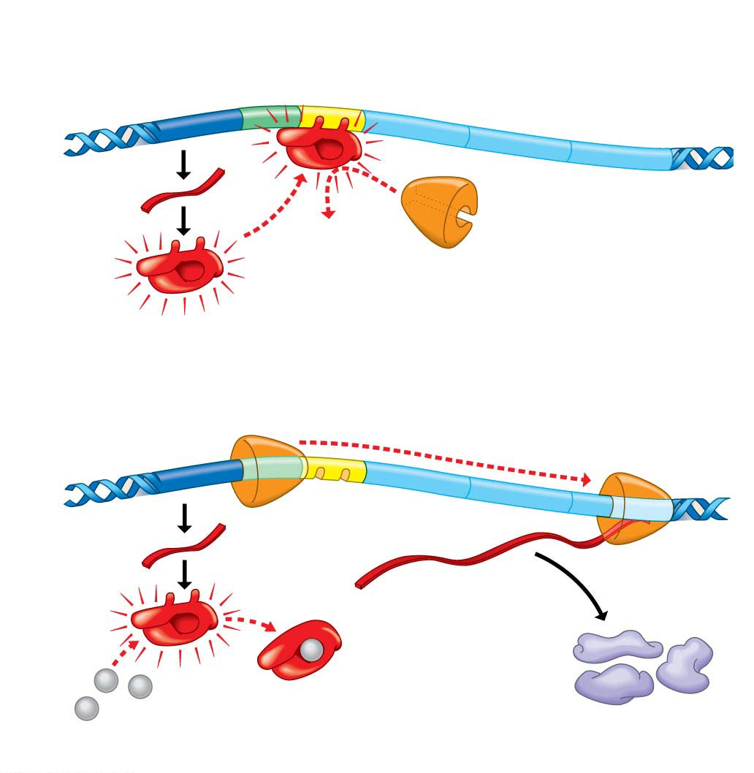
Figure 11.2
Operon
Operator
Genes for
lactose enzymes
Regulatory
gene
Promoter
DNA
mRNA
1
2
Protein
Active
repressor
RNA polymerase
cannot attach to
promoter
Operon turned off (lactose absent)
4
Transcription
DNA
RNA polymerase
bound to promoter
3
3
mRNA
mRNA
5
Translation
2
2
Protein
1
1
Inactive
repressor
Lactose
Lactose enzymes
Operon turned on (lactose inactivates repressor)
Notes:
Figure 11.2 The lac operon of E. coli

Slide 24
Figure 11.2-1
Operon
Operator
Genes for
lactose enzymes
Regulatory
gene
Promoter
DNA
1
mRNA
1
2
Active
repressor
RNA polymerase
cannot attach to
promoter
Protein
Operon turned off (lactose absent)
Notes:
Figure 11.2-1 The lac operon of E. coli (part 1: operon off)

Slide 25
Figure 11.2-2
4
Transcription
DNA
RNA polymerase
bound to promoter
3
3
mRNA
mRNA
5
Translation
2
2
Protein
1
1
Inactive
repressor
Lactose
Lactose enzymes
Operon turned on (lactose inactivates repressor)
Notes:
Figure 11.2-2 The lac operon of E. coli (part 2: operon on)

Slide 26
Gene Regulation in Bacteria
The bottom half of Figure 11.2 shows the operon in “on” mode, when lactose is present. The lactose interferes with attachment of the lac repressor to the operator by
  binding to the repressor and
  changing the repressor’s shape. In its new shape, the repressor cannot bind to the operator, and the operator switch remains on.
Notes:
26
Student Misconceptions and Concerns
1. The broad concept of selective “reading” of the genetic code associated with differentiation and types of cellular activity can be missed when concentrating on the extensive details of regulation. Analogies, noted in the text and below in the teaching tips, can help students relate this overall selective process to their own experiences. Students already understand the selective reading of relevant chapters in textbooks and the selective referencing of product manuals to get answers to different questions. These experiences are similar in many ways to the broad processes of gene regulation.
2. The many levels of gene regulation in eukaryotic cells can be confusing and frustrating. The water pipe analogy depicted in Figure 11.3 can be a helpful reference to organize the potential sites of regulation.
Teaching Tips
1. Cellular differentiation is analogous to buying a book about how to build birdhouses and reading only the plans needed to build one particular model. Although the book contains directions to build many different birdhouses, you read and follow only the directions for the particular birdhouse you choose to build. The pages and directions for the other birdhouses remain intact. When cells differentiate, they read, or express, only the genes that are needed in that particular cell type.
2. A key advantage of an operon system is the ability to turn off or on a set of genes with a single “switch.” You can demonstrate this relationship in your classroom by turning off or on a set of lights with a single switch.
3. The authors develop an analogy between the regulation of transcription and the series of water pipes that carry water from your local water supply, perhaps a reservoir, to a faucet in your home. At various points, valves control the flow of water. Similarly, the expression of genes is controlled at many points along the process. Figure 11.3 illustrates the “flow” of genetic information from a chromosome—a reservoir of genetic information—to an active protein that has been made in the cell’s cytoplasm. The multiple mechanisms that control gene expression are analogous to the control valves in water pipes. In the figure, a possible control knob indicates each gene expression “valve.” In the figure, the large size of the transcription control knob highlights its crucial role.
4. Just as a folded map is difficult to read, DNA packaging tends to prevent gene “reading” or expression.
5. Just as boxes of your things that will be little used are packed deeper into a closet, attic, or basement, chromatin that is not expressed is highly compacted and is stored away.
6. Alternative RNA splicing is like remixing music to produce a new song or re-editing a movie for a different ending. You could have a little fun by challenging students to identify which category of the Academy Awards is most like alternative RNA splicing. (Answer: the award for best editing.)
7. The action of an extracellular signal reaching a cell’s surface is like pushing the doorbell at a home. The signal is converted to another form (pushing a button rings a bell) and activities change within the house as someone comes to answer the door.
8. Students might wonder why a patch of fur on the cat’s skin is all the same color in Figure 11.4, if every cell has an equal chance of being one of the two color forms. The answer is that X chromosome inactivation occurs early in development. Thus, the patch of one color represents the progeny of one embryonic cell after X chromosome inactivation.
9. Homeotic genes are often called “master control genes.” The relationship between homeotic genes and structural genes is like the relationship between a construction supervisor and the workers. Major rearrangements can result from a few simple changes in the directions for construction.
10. There is much hope for the use of DNA microarrays to refine cancer therapies. In the past, a diagnosis of cancer was too often met with general treatments that benefited only a fraction of the patients. Physicians were left to wonder why some people with breast cancer or lung cancer responded to therapy while others did not. DNA microarrays enable us to identify differences between patients with the same apparent type of cancer (breast, lung, prostate, and so on). Consider sharing this important avenue of hope. It is likely that some of your students will soon have a family member facing these battles.
Active Lecture Tips
1. The lactose operon is turned on by removing the repressor—a sort of double negative. Students might enjoy various analogies to other situations. Ask students in lecture to work in small groups to develop their own examples from life in which something occurs by a double negative. Share with them the common example “When the cat's away, the mice will play.” Then challenge them to each create a couple more. (Another example to consider: “Like a cat watching mice, if a mom keeps her kids away from cookies, but somebody occupies her attention, kids can sneak by and snatch some cookies. Thus, the person occupying Mom’s attention functions most like lactose binding to the repressor.”)

Slide 27
Gene Regulation in Bacteria
  RNA polymerase is no longer blocked, so it can now bind to the promoter and from there
  it can transcribe the genes for the lactose enzymes into mRNA.
  Translation produces all three lactose enzymes.
Notes:
27
Student Misconceptions and Concerns
1. The broad concept of selective “reading” of the genetic code associated with differentiation and types of cellular activity can be missed when concentrating on the extensive details of regulation. Analogies, noted in the text and below in the teaching tips, can help students relate this overall selective process to their own experiences. Students already understand the selective reading of relevant chapters in textbooks and the selective referencing of product manuals to get answers to different questions. These experiences are similar in many ways to the broad processes of gene regulation.
2. The many levels of gene regulation in eukaryotic cells can be confusing and frustrating. The water pipe analogy depicted in Figure 11.3 can be a helpful reference to organize the potential sites of regulation.
Teaching Tips
1. Cellular differentiation is analogous to buying a book about how to build birdhouses and reading only the plans needed to build one particular model. Although the book contains directions to build many different birdhouses, you read and follow only the directions for the particular birdhouse you choose to build. The pages and directions for the other birdhouses remain intact. When cells differentiate, they read, or express, only the genes that are needed in that particular cell type.
2. A key advantage of an operon system is the ability to turn off or on a set of genes with a single “switch.” You can demonstrate this relationship in your classroom by turning off or on a set of lights with a single switch.
3. The authors develop an analogy between the regulation of transcription and the series of water pipes that carry water from your local water supply, perhaps a reservoir, to a faucet in your home. At various points, valves control the flow of water. Similarly, the expression of genes is controlled at many points along the process. Figure 11.3 illustrates the “flow” of genetic information from a chromosome—a reservoir of genetic information—to an active protein that has been made in the cell’s cytoplasm. The multiple mechanisms that control gene expression are analogous to the control valves in water pipes. In the figure, a possible control knob indicates each gene expression “valve.” In the figure, the large size of the transcription control knob highlights its crucial role.
4. Just as a folded map is difficult to read, DNA packaging tends to prevent gene “reading” or expression.
5. Just as boxes of your things that will be little used are packed deeper into a closet, attic, or basement, chromatin that is not expressed is highly compacted and is stored away.
6. Alternative RNA splicing is like remixing music to produce a new song or re-editing a movie for a different ending. You could have a little fun by challenging students to identify which category of the Academy Awards is most like alternative RNA splicing. (Answer: the award for best editing.)
7. The action of an extracellular signal reaching a cell’s surface is like pushing the doorbell at a home. The signal is converted to another form (pushing a button rings a bell) and activities change within the house as someone comes to answer the door.
8. Students might wonder why a patch of fur on the cat’s skin is all the same color in Figure 11.4, if every cell has an equal chance of being one of the two color forms. The answer is that X chromosome inactivation occurs early in development. Thus, the patch of one color represents the progeny of one embryonic cell after X chromosome inactivation.
9. Homeotic genes are often called “master control genes.” The relationship between homeotic genes and structural genes is like the relationship between a construction supervisor and the workers. Major rearrangements can result from a few simple changes in the directions for construction.
10. There is much hope for the use of DNA microarrays to refine cancer therapies. In the past, a diagnosis of cancer was too often met with general treatments that benefited only a fraction of the patients. Physicians were left to wonder why some people with breast cancer or lung cancer responded to therapy while others did not. DNA microarrays enable us to identify differences between patients with the same apparent type of cancer (breast, lung, prostate, and so on). Consider sharing this important avenue of hope. It is likely that some of your students will soon have a family member facing these battles.
Active Lecture Tips
1. The lactose operon is turned on by removing the repressor—a sort of double negative. Students might enjoy various analogies to other situations. Ask students in lecture to work in small groups to develop their own examples from life in which something occurs by a double negative. Share with them the common example “When the cat's away, the mice will play.” Then challenge them to each create a couple more. (Another example to consider: “Like a cat watching mice, if a mom keeps her kids away from cookies, but somebody occupies her attention, kids can sneak by and snatch some cookies. Thus, the person occupying Mom’s attention functions most like lactose binding to the repressor.”)

Slide 28
Gene Regulation in Bacteria
Many operons have been identified in bacteria.
Some are quite similar to the lac operon, whereas others have somewhat different mechanisms of control.
For example, operons that control amino acid synthesis cause bacteria to stop making these molecules when they are already present in the environment, saving materials and energy for the cells.
  In these cases, the amino acid activates the repressor.
Notes:
28
Student Misconceptions and Concerns
1. The broad concept of selective “reading” of the genetic code associated with differentiation and types of cellular activity can be missed when concentrating on the extensive details of regulation. Analogies, noted in the text and below in the teaching tips, can help students relate this overall selective process to their own experiences. Students already understand the selective reading of relevant chapters in textbooks and the selective referencing of product manuals to get answers to different questions. These experiences are similar in many ways to the broad processes of gene regulation.
2. The many levels of gene regulation in eukaryotic cells can be confusing and frustrating. The water pipe analogy depicted in Figure 11.3 can be a helpful reference to organize the potential sites of regulation.
Teaching Tips
1. Cellular differentiation is analogous to buying a book about how to build birdhouses and reading only the plans needed to build one particular model. Although the book contains directions to build many different birdhouses, you read and follow only the directions for the particular birdhouse you choose to build. The pages and directions for the other birdhouses remain intact. When cells differentiate, they read, or express, only the genes that are needed in that particular cell type.
2. A key advantage of an operon system is the ability to turn off or on a set of genes with a single “switch.” You can demonstrate this relationship in your classroom by turning off or on a set of lights with a single switch.
3. The authors develop an analogy between the regulation of transcription and the series of water pipes that carry water from your local water supply, perhaps a reservoir, to a faucet in your home. At various points, valves control the flow of water. Similarly, the expression of genes is controlled at many points along the process. Figure 11.3 illustrates the “flow” of genetic information from a chromosome—a reservoir of genetic information—to an active protein that has been made in the cell’s cytoplasm. The multiple mechanisms that control gene expression are analogous to the control valves in water pipes. In the figure, a possible control knob indicates each gene expression “valve.” In the figure, the large size of the transcription control knob highlights its crucial role.
4. Just as a folded map is difficult to read, DNA packaging tends to prevent gene “reading” or expression.
5. Just as boxes of your things that will be little used are packed deeper into a closet, attic, or basement, chromatin that is not expressed is highly compacted and is stored away.
6. Alternative RNA splicing is like remixing music to produce a new song or re-editing a movie for a different ending. You could have a little fun by challenging students to identify which category of the Academy Awards is most like alternative RNA splicing. (Answer: the award for best editing.)
7. The action of an extracellular signal reaching a cell’s surface is like pushing the doorbell at a home. The signal is converted to another form (pushing a button rings a bell) and activities change within the house as someone comes to answer the door.
8. Students might wonder why a patch of fur on the cat’s skin is all the same color in Figure 11.4, if every cell has an equal chance of being one of the two color forms. The answer is that X chromosome inactivation occurs early in development. Thus, the patch of one color represents the progeny of one embryonic cell after X chromosome inactivation.
9. Homeotic genes are often called “master control genes.” The relationship between homeotic genes and structural genes is like the relationship between a construction supervisor and the workers. Major rearrangements can result from a few simple changes in the directions for construction.
10. There is much hope for the use of DNA microarrays to refine cancer therapies. In the past, a diagnosis of cancer was too often met with general treatments that benefited only a fraction of the patients. Physicians were left to wonder why some people with breast cancer or lung cancer responded to therapy while others did not. DNA microarrays enable us to identify differences between patients with the same apparent type of cancer (breast, lung, prostate, and so on). Consider sharing this important avenue of hope. It is likely that some of your students will soon have a family member facing these battles.
Active Lecture Tips
1. The lactose operon is turned on by removing the repressor—a sort of double negative. Students might enjoy various analogies to other situations. Ask students in lecture to work in small groups to develop their own examples from life in which something occurs by a double negative. Share with them the common example “When the cat's away, the mice will play.” Then challenge them to each create a couple more. (Another example to consider: “Like a cat watching mice, if a mom keeps her kids away from cookies, but somebody occupies her attention, kids can sneak by and snatch some cookies. Thus, the person occupying Mom’s attention functions most like lactose binding to the repressor.”)

Slide 29
Gene Regulation in Eukaryotic Cells
Eukaryotes, especially multicellular ones, have more sophisticated mechanisms than bacteria for regulating the expression of their genes.
The pathway from gene to protein in eukaryotic cells is a long one, providing a number of points where the process can be turned on or off, speeded up or slowed down.
Notes:
29
Student Misconceptions and Concerns
1. The broad concept of selective “reading” of the genetic code associated with differentiation and types of cellular activity can be missed when concentrating on the extensive details of regulation. Analogies, noted in the text and below in the teaching tips, can help students relate this overall selective process to their own experiences. Students already understand the selective reading of relevant chapters in textbooks and the selective referencing of product manuals to get answers to different questions. These experiences are similar in many ways to the broad processes of gene regulation.
2. The many levels of gene regulation in eukaryotic cells can be confusing and frustrating. The water pipe analogy depicted in Figure 11.3 can be a helpful reference to organize the potential sites of regulation.
Teaching Tips
1. Cellular differentiation is analogous to buying a book about how to build birdhouses and reading only the plans needed to build one particular model. Although the book contains directions to build many different birdhouses, you read and follow only the directions for the particular birdhouse you choose to build. The pages and directions for the other birdhouses remain intact. When cells differentiate, they read, or express, only the genes that are needed in that particular cell type.
2. A key advantage of an operon system is the ability to turn off or on a set of genes with a single “switch.” You can demonstrate this relationship in your classroom by turning off or on a set of lights with a single switch.
3. The authors develop an analogy between the regulation of transcription and the series of water pipes that carry water from your local water supply, perhaps a reservoir, to a faucet in your home. At various points, valves control the flow of water. Similarly, the expression of genes is controlled at many points along the process. Figure 11.3 illustrates the “flow” of genetic information from a chromosome—a reservoir of genetic information—to an active protein that has been made in the cell’s cytoplasm. The multiple mechanisms that control gene expression are analogous to the control valves in water pipes. In the figure, a possible control knob indicates each gene expression “valve.” In the figure, the large size of the transcription control knob highlights its crucial role.
4. Just as a folded map is difficult to read, DNA packaging tends to prevent gene “reading” or expression.
5. Just as boxes of your things that will be little used are packed deeper into a closet, attic, or basement, chromatin that is not expressed is highly compacted and is stored away.
6. Alternative RNA splicing is like remixing music to produce a new song or re-editing a movie for a different ending. You could have a little fun by challenging students to identify which category of the Academy Awards is most like alternative RNA splicing. (Answer: the award for best editing.)
7. The action of an extracellular signal reaching a cell’s surface is like pushing the doorbell at a home. The signal is converted to another form (pushing a button rings a bell) and activities change within the house as someone comes to answer the door.
8. Students might wonder why a patch of fur on the cat’s skin is all the same color in Figure 11.4, if every cell has an equal chance of being one of the two color forms. The answer is that X chromosome inactivation occurs early in development. Thus, the patch of one color represents the progeny of one embryonic cell after X chromosome inactivation.
9. Homeotic genes are often called “master control genes.” The relationship between homeotic genes and structural genes is like the relationship between a construction supervisor and the workers. Major rearrangements can result from a few simple changes in the directions for construction.
10. There is much hope for the use of DNA microarrays to refine cancer therapies. In the past, a diagnosis of cancer was too often met with general treatments that benefited only a fraction of the patients. Physicians were left to wonder why some people with breast cancer or lung cancer responded to therapy while others did not. DNA microarrays enable us to identify differences between patients with the same apparent type of cancer (breast, lung, prostate, and so on). Consider sharing this important avenue of hope. It is likely that some of your students will soon have a family member facing these battles.
Active Lecture Tips
1. The lactose operon is turned on by removing the repressor—a sort of double negative. Students might enjoy various analogies to other situations. Ask students in lecture to work in small groups to develop their own examples from life in which something occurs by a double negative. Share with them the common example “When the cat's away, the mice will play.” Then challenge them to each create a couple more. (Another example to consider: “Like a cat watching mice, if a mom keeps her kids away from cookies, but somebody occupies her attention, kids can sneak by and snatch some cookies. Thus, the person occupying Mom’s attention functions most like lactose binding to the repressor.”)

Slide 30
Gene Regulation in Eukaryotic Cells
Picture the series of pipes that carry water from your local reservoir to a faucet in your home.
  At various points, valves control the flow of water.
  We use this analogy in Figure 11.3 to illustrate the flow of genetic information from a eukaryotic chromosome—a reservoir of genetic information—
  to an active protein that has been made in the
  cell’s cytoplasm.
    The multiple mechanisms that control gene expression are analogous to the control valves in your water pipes.
Notes:
30
Student Misconceptions and Concerns
1. The broad concept of selective “reading” of the genetic code associated with differentiation and types of cellular activity can be missed when concentrating on the extensive details of regulation. Analogies, noted in the text and below in the teaching tips, can help students relate this overall selective process to their own experiences. Students already understand the selective reading of relevant chapters in textbooks and the selective referencing of product manuals to get answers to different questions. These experiences are similar in many ways to the broad processes of gene regulation.
2. The many levels of gene regulation in eukaryotic cells can be confusing and frustrating. The water pipe analogy depicted in Figure 11.3 can be a helpful reference to organize the potential sites of regulation.
Teaching Tips
1. Cellular differentiation is analogous to buying a book about how to build birdhouses and reading only the plans needed to build one particular model. Although the book contains directions to build many different birdhouses, you read and follow only the directions for the particular birdhouse you choose to build. The pages and directions for the other birdhouses remain intact. When cells differentiate, they read, or express, only the genes that are needed in that particular cell type.
2. A key advantage of an operon system is the ability to turn off or on a set of genes with a single “switch.” You can demonstrate this relationship in your classroom by turning off or on a set of lights with a single switch.
3. The authors develop an analogy between the regulation of transcription and the series of water pipes that carry water from your local water supply, perhaps a reservoir, to a faucet in your home. At various points, valves control the flow of water. Similarly, the expression of genes is controlled at many points along the process. Figure 11.3 illustrates the “flow” of genetic information from a chromosome—a reservoir of genetic information—to an active protein that has been made in the cell’s cytoplasm. The multiple mechanisms that control gene expression are analogous to the control valves in water pipes. In the figure, a possible control knob indicates each gene expression “valve.” In the figure, the large size of the transcription control knob highlights its crucial role.
4. Just as a folded map is difficult to read, DNA packaging tends to prevent gene “reading” or expression.
5. Just as boxes of your things that will be little used are packed deeper into a closet, attic, or basement, chromatin that is not expressed is highly compacted and is stored away.
6. Alternative RNA splicing is like remixing music to produce a new song or re-editing a movie for a different ending. You could have a little fun by challenging students to identify which category of the Academy Awards is most like alternative RNA splicing. (Answer: the award for best editing.)
7. The action of an extracellular signal reaching a cell’s surface is like pushing the doorbell at a home. The signal is converted to another form (pushing a button rings a bell) and activities change within the house as someone comes to answer the door.
8. Students might wonder why a patch of fur on the cat’s skin is all the same color in Figure 11.4, if every cell has an equal chance of being one of the two color forms. The answer is that X chromosome inactivation occurs early in development. Thus, the patch of one color represents the progeny of one embryonic cell after X chromosome inactivation.
9. Homeotic genes are often called “master control genes.” The relationship between homeotic genes and structural genes is like the relationship between a construction supervisor and the workers. Major rearrangements can result from a few simple changes in the directions for construction.
10. There is much hope for the use of DNA microarrays to refine cancer therapies. In the past, a diagnosis of cancer was too often met with general treatments that benefited only a fraction of the patients. Physicians were left to wonder why some people with breast cancer or lung cancer responded to therapy while others did not. DNA microarrays enable us to identify differences between patients with the same apparent type of cancer (breast, lung, prostate, and so on). Consider sharing this important avenue of hope. It is likely that some of your students will soon have a family member facing these battles.
Active Lecture Tips
1. The lactose operon is turned on by removing the repressor—a sort of double negative. Students might enjoy various analogies to other situations. Ask students in lecture to work in small groups to develop their own examples from life in which something occurs by a double negative. Share with them the common example “When the cat's away, the mice will play.” Then challenge them to each create a couple more. (Another example to consider: “Like a cat watching mice, if a mom keeps her kids away from cookies, but somebody occupies her attention, kids can sneak by and snatch some cookies. Thus, the person occupying Mom’s attention functions most like lactose binding to the repressor.”)

Slide 31
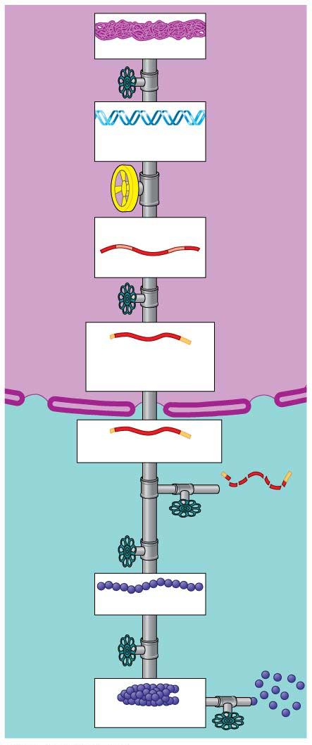
Figure 11.3
Chromosome
Unpacking
of DNA
DNA
Gene
Transcription
of gene
Intron
Exon
RNA transcript
Processing
of RNA
Flow of
mRNA
through
nuclear
envelope
Cap
Tail
Nucleus
mRNA in nucleus
Cytoplasm
mRNA in cytoplasm
Breakdown
of mRNA
Translation
of mRNA
Polypeptide
Various
changes to
polypeptide
Breakdown
of protein
Active protein
Notes:
Figure 11.3 The gene expression “pipeline” in a eukaryotic cell

Slide 32
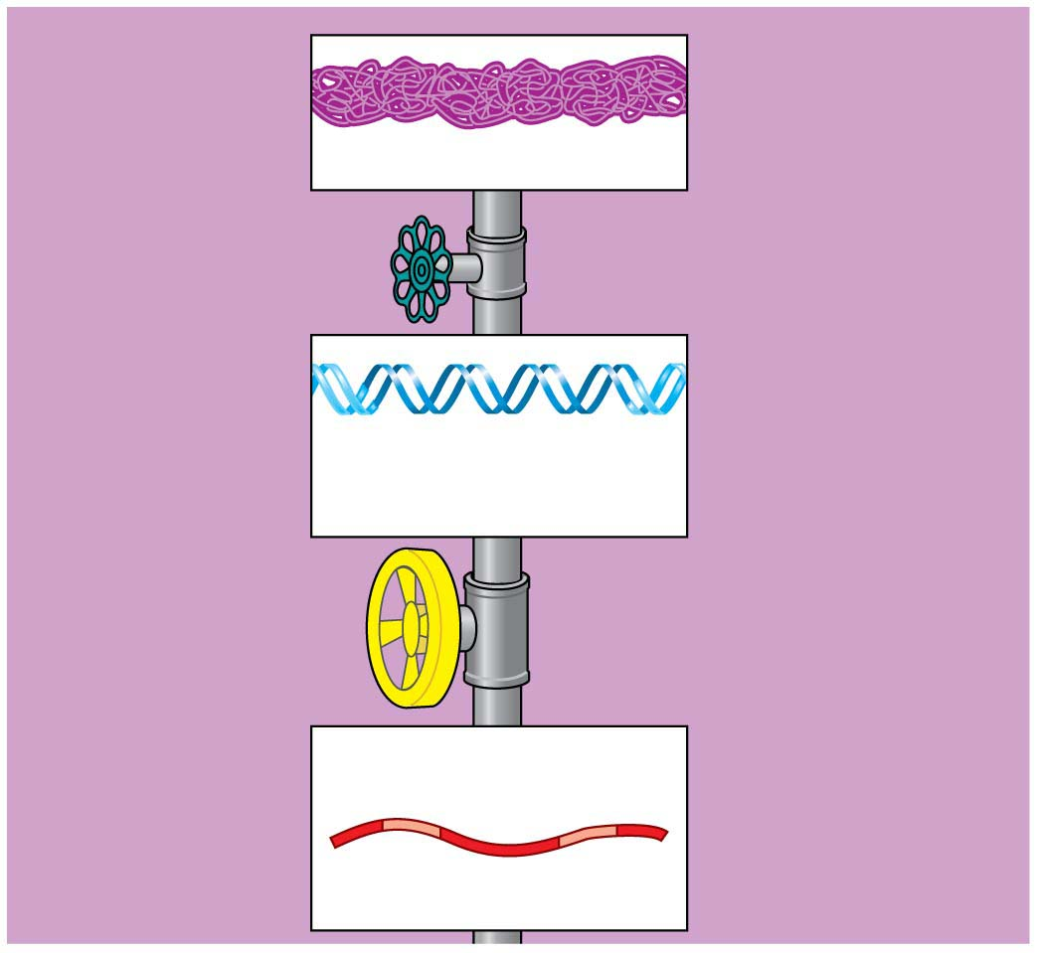
Figure 11.3-1
Chromosome
Unpacking
of DNA
DNA
Gene
Transcription
of gene
Intron
Exon
RNA transcript
Notes:
Figure 11.3-1 The gene expression “pipeline” in a eukaryotic cell (part 1: chromosome to RNA transcript)

Slide 33
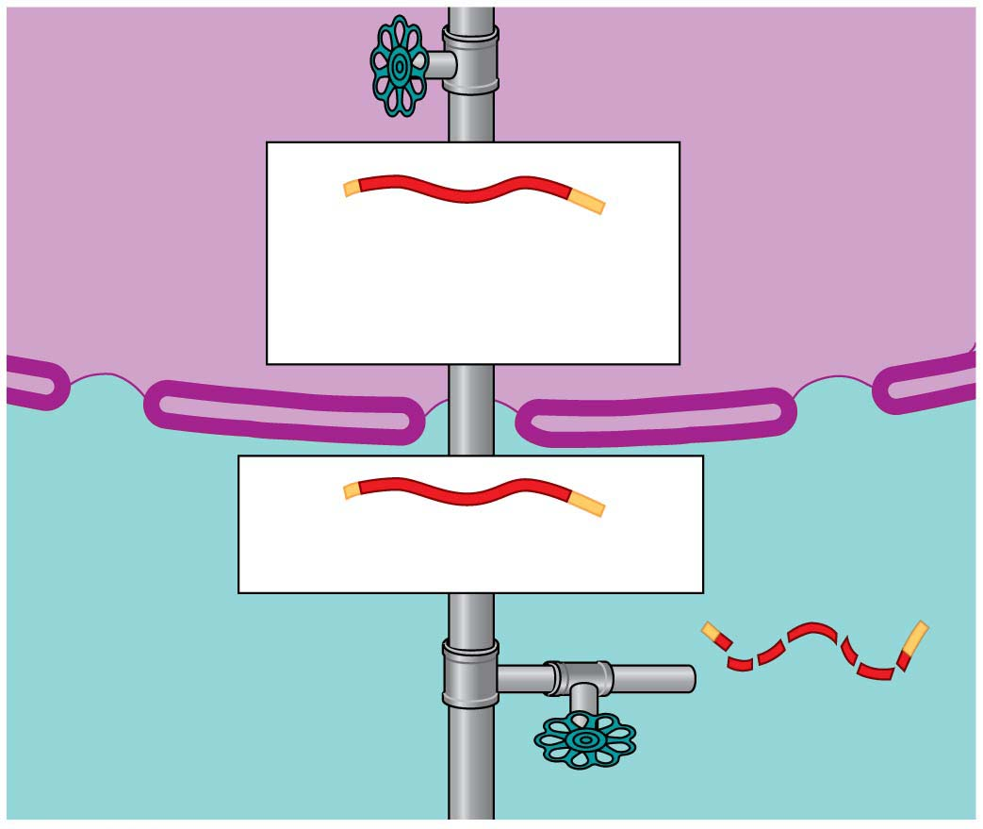
Figure 11.3-2
Processing
of RNA
Flow of
mRNA
through
nuclear
envelope
Nucleus
Cap
Tail
mRNA in nucleus
Cytoplasm
mRNA in cytoplasm
Breakdown
of mRNA
Notes:
Figure 11.3-2 The gene expression “pipeline” in a eukaryotic cell (part 2: processing of RNA to breakdown of mRNA)

Slide 34
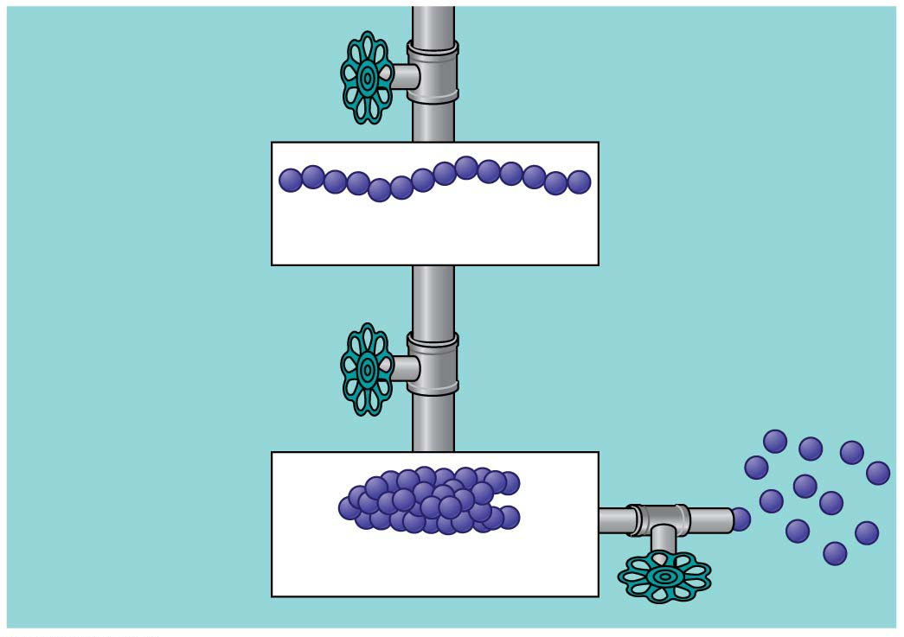
Figure 11.3-3
Translation
of mRNA
Polypeptide
Various
changes to
polypeptide
Breakdown
of protein
Active protein
Notes:
Figure 11.3-3 The gene expression “pipeline” in a eukaryotic cell (part 3: translation of mRNA to breakdown of protein)

Slide 35
The Regulation of DNA Packing
Cells may use DNA packing for long-term inactivation of genes.
X chromosome inactivation
  occurs in female mammals,
  takes place early in embryonic development, and
  is when one of the two X chromosomes in each cell is inactivated at random.
Notes:
35
Student Misconceptions and Concerns
1. The broad concept of selective “reading” of the genetic code associated with differentiation and types of cellular activity can be missed when concentrating on the extensive details of regulation. Analogies, noted in the text and below in the teaching tips, can help students relate this overall selective process to their own experiences. Students already understand the selective reading of relevant chapters in textbooks and the selective referencing of product manuals to get answers to different questions. These experiences are similar in many ways to the broad processes of gene regulation.
2. The many levels of gene regulation in eukaryotic cells can be confusing and frustrating. The water pipe analogy depicted in Figure 11.3 can be a helpful reference to organize the potential sites of regulation.
Teaching Tips
1. Cellular differentiation is analogous to buying a book about how to build birdhouses and reading only the plans needed to build one particular model. Although the book contains directions to build many different birdhouses, you read and follow only the directions for the particular birdhouse you choose to build. The pages and directions for the other birdhouses remain intact. When cells differentiate, they read, or express, only the genes that are needed in that particular cell type.
2. A key advantage of an operon system is the ability to turn off or on a set of genes with a single “switch.” You can demonstrate this relationship in your classroom by turning off or on a set of lights with a single switch.
3. The authors develop an analogy between the regulation of transcription and the series of water pipes that carry water from your local water supply, perhaps a reservoir, to a faucet in your home. At various points, valves control the flow of water. Similarly, the expression of genes is controlled at many points along the process. Figure 11.3 illustrates the “flow” of genetic information from a chromosome—a reservoir of genetic information—to an active protein that has been made in the cell’s cytoplasm. The multiple mechanisms that control gene expression are analogous to the control valves in water pipes. In the figure, a possible control knob indicates each gene expression “valve.” In the figure, the large size of the transcription control knob highlights its crucial role.
4. Just as a folded map is difficult to read, DNA packaging tends to prevent gene “reading” or expression.
5. Just as boxes of your things that will be little used are packed deeper into a closet, attic, or basement, chromatin that is not expressed is highly compacted and is stored away.
6. Alternative RNA splicing is like remixing music to produce a new song or re-editing a movie for a different ending. You could have a little fun by challenging students to identify which category of the Academy Awards is most like alternative RNA splicing. (Answer: the award for best editing.)
7. The action of an extracellular signal reaching a cell’s surface is like pushing the doorbell at a home. The signal is converted to another form (pushing a button rings a bell) and activities change within the house as someone comes to answer the door.
8. Students might wonder why a patch of fur on the cat’s skin is all the same color in Figure 11.4, if every cell has an equal chance of being one of the two color forms. The answer is that X chromosome inactivation occurs early in development. Thus, the patch of one color represents the progeny of one embryonic cell after X chromosome inactivation.
9. Homeotic genes are often called “master control genes.” The relationship between homeotic genes and structural genes is like the relationship between a construction supervisor and the workers. Major rearrangements can result from a few simple changes in the directions for construction.
10. There is much hope for the use of DNA microarrays to refine cancer therapies. In the past, a diagnosis of cancer was too often met with general treatments that benefited only a fraction of the patients. Physicians were left to wonder why some people with breast cancer or lung cancer responded to therapy while others did not. DNA microarrays enable us to identify differences between patients with the same apparent type of cancer (breast, lung, prostate, and so on). Consider sharing this important avenue of hope. It is likely that some of your students will soon have a family member facing these battles.
Active Lecture Tips
1. The lactose operon is turned on by removing the repressor—a sort of double negative. Students might enjoy various analogies to other situations. Ask students in lecture to work in small groups to develop their own examples from life in which something occurs by a double negative. Share with them the common example “When the cat's away, the mice will play.” Then challenge them to each create a couple more. (Another example to consider: “Like a cat watching mice, if a mom keeps her kids away from cookies, but somebody occupies her attention, kids can sneak by and snatch some cookies. Thus, the person occupying Mom’s attention functions most like lactose binding to the repressor.”)

Slide 36
The Regulation of DNA Packing
  After one X chromosome is inactivated in each embryonic cell, all of that cell’s descendants will have the same X chromosome turned off.
  If a female has different versions of a gene on each of her X chromosomes,
    about half of her cells will express one version,
    while the other half will express the alternate version.
Notes:
36
Student Misconceptions and Concerns
1. The broad concept of selective “reading” of the genetic code associated with differentiation and types of cellular activity can be missed when concentrating on the extensive details of regulation. Analogies, noted in the text and below in the teaching tips, can help students relate this overall selective process to their own experiences. Students already understand the selective reading of relevant chapters in textbooks and the selective referencing of product manuals to get answers to different questions. These experiences are similar in many ways to the broad processes of gene regulation.
2. The many levels of gene regulation in eukaryotic cells can be confusing and frustrating. The water pipe analogy depicted in Figure 11.3 can be a helpful reference to organize the potential sites of regulation.
Teaching Tips
1. Cellular differentiation is analogous to buying a book about how to build birdhouses and reading only the plans needed to build one particular model. Although the book contains directions to build many different birdhouses, you read and follow only the directions for the particular birdhouse you choose to build. The pages and directions for the other birdhouses remain intact. When cells differentiate, they read, or express, only the genes that are needed in that particular cell type.
2. A key advantage of an operon system is the ability to turn off or on a set of genes with a single “switch.” You can demonstrate this relationship in your classroom by turning off or on a set of lights with a single switch.
3. The authors develop an analogy between the regulation of transcription and the series of water pipes that carry water from your local water supply, perhaps a reservoir, to a faucet in your home. At various points, valves control the flow of water. Similarly, the expression of genes is controlled at many points along the process. Figure 11.3 illustrates the “flow” of genetic information from a chromosome—a reservoir of genetic information—to an active protein that has been made in the cell’s cytoplasm. The multiple mechanisms that control gene expression are analogous to the control valves in water pipes. In the figure, a possible control knob indicates each gene expression “valve.” In the figure, the large size of the transcription control knob highlights its crucial role.
4. Just as a folded map is difficult to read, DNA packaging tends to prevent gene “reading” or expression.
5. Just as boxes of your things that will be little used are packed deeper into a closet, attic, or basement, chromatin that is not expressed is highly compacted and is stored away.
6. Alternative RNA splicing is like remixing music to produce a new song or re-editing a movie for a different ending. You could have a little fun by challenging students to identify which category of the Academy Awards is most like alternative RNA splicing. (Answer: the award for best editing.)
7. The action of an extracellular signal reaching a cell’s surface is like pushing the doorbell at a home. The signal is converted to another form (pushing a button rings a bell) and activities change within the house as someone comes to answer the door.
8. Students might wonder why a patch of fur on the cat’s skin is all the same color in Figure 11.4, if every cell has an equal chance of being one of the two color forms. The answer is that X chromosome inactivation occurs early in development. Thus, the patch of one color represents the progeny of one embryonic cell after X chromosome inactivation.
9. Homeotic genes are often called “master control genes.” The relationship between homeotic genes and structural genes is like the relationship between a construction supervisor and the workers. Major rearrangements can result from a few simple changes in the directions for construction.
10. There is much hope for the use of DNA microarrays to refine cancer therapies. In the past, a diagnosis of cancer was too often met with general treatments that benefited only a fraction of the patients. Physicians were left to wonder why some people with breast cancer or lung cancer responded to therapy while others did not. DNA microarrays enable us to identify differences between patients with the same apparent type of cancer (breast, lung, prostate, and so on). Consider sharing this important avenue of hope. It is likely that some of your students will soon have a family member facing these battles.
Active Lecture Tips
1. The lactose operon is turned on by removing the repressor—a sort of double negative. Students might enjoy various analogies to other situations. Ask students in lecture to work in small groups to develop their own examples from life in which something occurs by a double negative. Share with them the common example “When the cat's away, the mice will play.” Then challenge them to each create a couple more. (Another example to consider: “Like a cat watching mice, if a mom keeps her kids away from cookies, but somebody occupies her attention, kids can sneak by and snatch some cookies. Thus, the person occupying Mom’s attention functions most like lactose binding to the repressor.”)

Slide 37
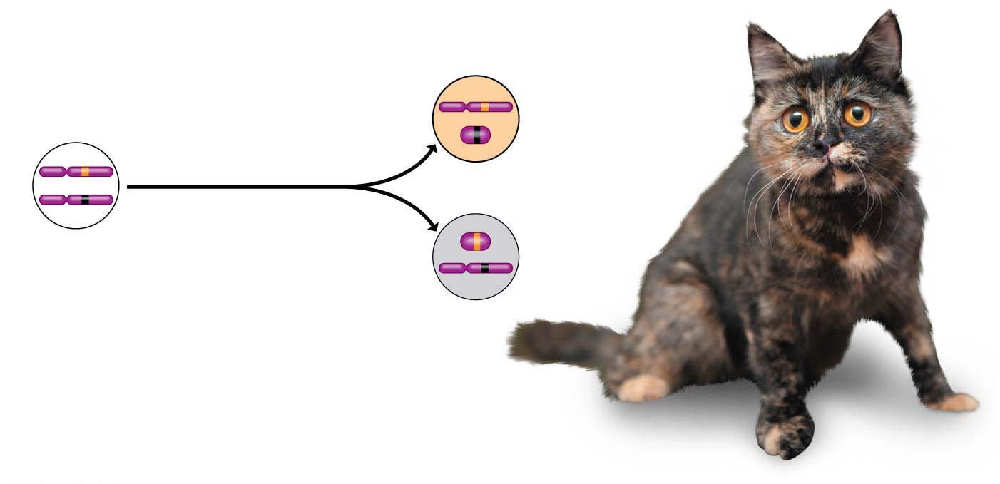
Figure 11.4
Two cell
populations
in adult cat:
Early embryo:
X
Cell division
and X
chromosome
inactivation
Active X
chromosomes
Orange fur
Inactive X
Allele for
orange fur
Allele for
black fur
Inactive X
Active X
Black fur
Notes:
Figure 11.4 X chromosome inactivation: the tortoiseshell pattern on a cat

Slide 38
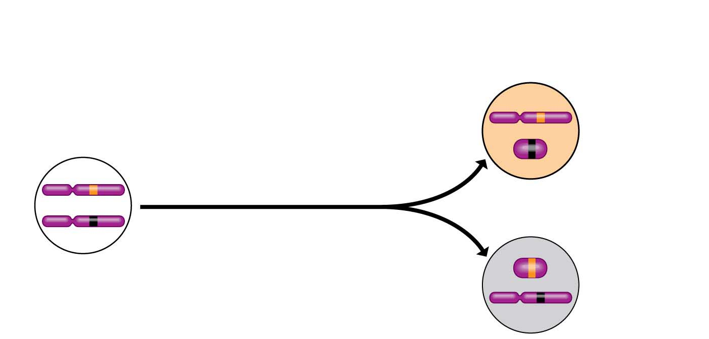
Figure 11.4-1
Two cell
populations
in adult cat:
Early embryo:
X
Cell division
and X
chromosome
inactivation
Active X
chromosomes
Orange fur
Inactive X
Allele for
black fur
Inactive X
Allele for
orange fur
Black fur
Active X
Notes:
Figure 11.4-1 X chromosome inactivation: the tortoiseshell pattern on a cat (part 1: detail)

Slide 39
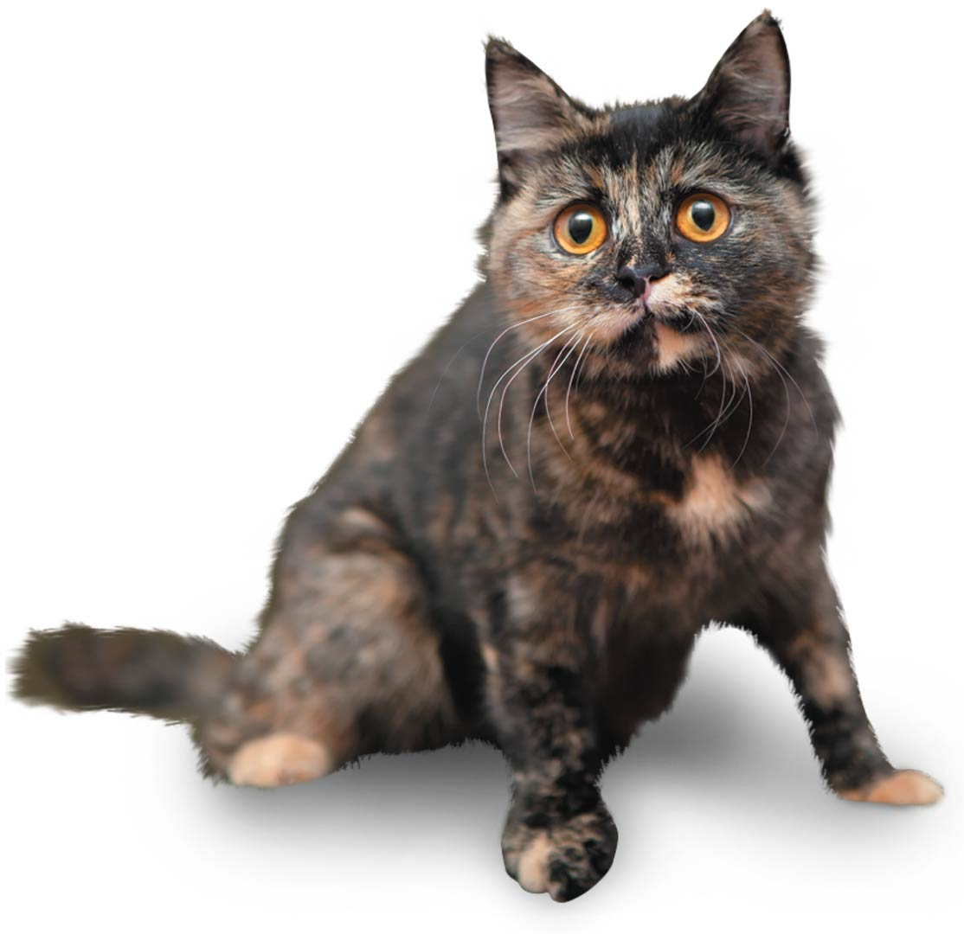
Figure 11.4-2
Notes:
Figure 11.4-2 X chromosome inactivation: the tortoiseshell pattern on a cat (part 2: photo)

Slide 40
The Initiation of Transcription
The initiation of transcription is the most important stage for regulating gene expression.
In prokaryotes and eukaryotes, regulatory proteins
  bind to DNA and
  turn the transcription of genes on and off.
Notes:
40
Student Misconceptions and Concerns
1. The broad concept of selective “reading” of the genetic code associated with differentiation and types of cellular activity can be missed when concentrating on the extensive details of regulation. Analogies, noted in the text and below in the teaching tips, can help students relate this overall selective process to their own experiences. Students already understand the selective reading of relevant chapters in textbooks and the selective referencing of product manuals to get answers to different questions. These experiences are similar in many ways to the broad processes of gene regulation.
2. The many levels of gene regulation in eukaryotic cells can be confusing and frustrating. The water pipe analogy depicted in Figure 11.3 can be a helpful reference to organize the potential sites of regulation.
Teaching Tips
1. Cellular differentiation is analogous to buying a book about how to build birdhouses and reading only the plans needed to build one particular model. Although the book contains directions to build many different birdhouses, you read and follow only the directions for the particular birdhouse you choose to build. The pages and directions for the other birdhouses remain intact. When cells differentiate, they read, or express, only the genes that are needed in that particular cell type.
2. A key advantage of an operon system is the ability to turn off or on a set of genes with a single “switch.” You can demonstrate this relationship in your classroom by turning off or on a set of lights with a single switch.
3. The authors develop an analogy between the regulation of transcription and the series of water pipes that carry water from your local water supply, perhaps a reservoir, to a faucet in your home. At various points, valves control the flow of water. Similarly, the expression of genes is controlled at many points along the process. Figure 11.3 illustrates the “flow” of genetic information from a chromosome—a reservoir of genetic information—to an active protein that has been made in the cell’s cytoplasm. The multiple mechanisms that control gene expression are analogous to the control valves in water pipes. In the figure, a possible control knob indicates each gene expression “valve.” In the figure, the large size of the transcription control knob highlights its crucial role.
4. Just as a folded map is difficult to read, DNA packaging tends to prevent gene “reading” or expression.
5. Just as boxes of your things that will be little used are packed deeper into a closet, attic, or basement, chromatin that is not expressed is highly compacted and is stored away.
6. Alternative RNA splicing is like remixing music to produce a new song or re-editing a movie for a different ending. You could have a little fun by challenging students to identify which category of the Academy Awards is most like alternative RNA splicing. (Answer: the award for best editing.)
7. The action of an extracellular signal reaching a cell’s surface is like pushing the doorbell at a home. The signal is converted to another form (pushing a button rings a bell) and activities change within the house as someone comes to answer the door.
8. Students might wonder why a patch of fur on the cat’s skin is all the same color in Figure 11.4, if every cell has an equal chance of being one of the two color forms. The answer is that X chromosome inactivation occurs early in development. Thus, the patch of one color represents the progeny of one embryonic cell after X chromosome inactivation.
9. Homeotic genes are often called “master control genes.” The relationship between homeotic genes and structural genes is like the relationship between a construction supervisor and the workers. Major rearrangements can result from a few simple changes in the directions for construction.
10. There is much hope for the use of DNA microarrays to refine cancer therapies. In the past, a diagnosis of cancer was too often met with general treatments that benefited only a fraction of the patients. Physicians were left to wonder why some people with breast cancer or lung cancer responded to therapy while others did not. DNA microarrays enable us to identify differences between patients with the same apparent type of cancer (breast, lung, prostate, and so on). Consider sharing this important avenue of hope. It is likely that some of your students will soon have a family member facing these battles.
Active Lecture Tips
1. The lactose operon is turned on by removing the repressor—a sort of double negative. Students might enjoy various analogies to other situations. Ask students in lecture to work in small groups to develop their own examples from life in which something occurs by a double negative. Share with them the common example “When the cat's away, the mice will play.” Then challenge them to each create a couple more. (Another example to consider: “Like a cat watching mice, if a mom keeps her kids away from cookies, but somebody occupies her attention, kids can sneak by and snatch some cookies. Thus, the person occupying Mom’s attention functions most like lactose binding to the repressor.”)

Slide 41
The Initiation of Transcription
As illustrated in Figure 11.5, transcriptional regulation in eukaryotes is complex, typically involving many proteins, collectively called transcription factors, acting in concert to bind
to DNA sequences called enhancers and to the promoter.
The DNA-protein assembly promotes the binding
of RNA polymerase to the promoter.
Notes:
41
Student Misconceptions and Concerns
1. The broad concept of selective “reading” of the genetic code associated with differentiation and types of cellular activity can be missed when concentrating on the extensive details of regulation. Analogies, noted in the text and below in the teaching tips, can help students relate this overall selective process to their own experiences. Students already understand the selective reading of relevant chapters in textbooks and the selective referencing of product manuals to get answers to different questions. These experiences are similar in many ways to the broad processes of gene regulation.
2. The many levels of gene regulation in eukaryotic cells can be confusing and frustrating. The water pipe analogy depicted in Figure 11.3 can be a helpful reference to organize the potential sites of regulation.
Teaching Tips
1. Cellular differentiation is analogous to buying a book about how to build birdhouses and reading only the plans needed to build one particular model. Although the book contains directions to build many different birdhouses, you read and follow only the directions for the particular birdhouse you choose to build. The pages and directions for the other birdhouses remain intact. When cells differentiate, they read, or express, only the genes that are needed in that particular cell type.
2. A key advantage of an operon system is the ability to turn off or on a set of genes with a single “switch.” You can demonstrate this relationship in your classroom by turning off or on a set of lights with a single switch.
3. The authors develop an analogy between the regulation of transcription and the series of water pipes that carry water from your local water supply, perhaps a reservoir, to a faucet in your home. At various points, valves control the flow of water. Similarly, the expression of genes is controlled at many points along the process. Figure 11.3 illustrates the “flow” of genetic information from a chromosome—a reservoir of genetic information—to an active protein that has been made in the cell’s cytoplasm. The multiple mechanisms that control gene expression are analogous to the control valves in water pipes. In the figure, a possible control knob indicates each gene expression “valve.” In the figure, the large size of the transcription control knob highlights its crucial role.
4. Just as a folded map is difficult to read, DNA packaging tends to prevent gene “reading” or expression.
5. Just as boxes of your things that will be little used are packed deeper into a closet, attic, or basement, chromatin that is not expressed is highly compacted and is stored away.
6. Alternative RNA splicing is like remixing music to produce a new song or re-editing a movie for a different ending. You could have a little fun by challenging students to identify which category of the Academy Awards is most like alternative RNA splicing. (Answer: the award for best editing.)
7. The action of an extracellular signal reaching a cell’s surface is like pushing the doorbell at a home. The signal is converted to another form (pushing a button rings a bell) and activities change within the house as someone comes to answer the door.
8. Students might wonder why a patch of fur on the cat’s skin is all the same color in Figure 11.4, if every cell has an equal chance of being one of the two color forms. The answer is that X chromosome inactivation occurs early in development. Thus, the patch of one color represents the progeny of one embryonic cell after X chromosome inactivation.
9. Homeotic genes are often called “master control genes.” The relationship between homeotic genes and structural genes is like the relationship between a construction supervisor and the workers. Major rearrangements can result from a few simple changes in the directions for construction.
10. There is much hope for the use of DNA microarrays to refine cancer therapies. In the past, a diagnosis of cancer was too often met with general treatments that benefited only a fraction of the patients. Physicians were left to wonder why some people with breast cancer or lung cancer responded to therapy while others did not. DNA microarrays enable us to identify differences between patients with the same apparent type of cancer (breast, lung, prostate, and so on). Consider sharing this important avenue of hope. It is likely that some of your students will soon have a family member facing these battles.
Active Lecture Tips
1. The lactose operon is turned on by removing the repressor—a sort of double negative. Students might enjoy various analogies to other situations. Ask students in lecture to work in small groups to develop their own examples from life in which something occurs by a double negative. Share with them the common example “When the cat's away, the mice will play.” Then challenge them to each create a couple more. (Another example to consider: “Like a cat watching mice, if a mom keeps her kids away from cookies, but somebody occupies her attention, kids can sneak by and snatch some cookies. Thus, the person occupying Mom’s attention functions most like lactose binding to the repressor.”)

Slide 42
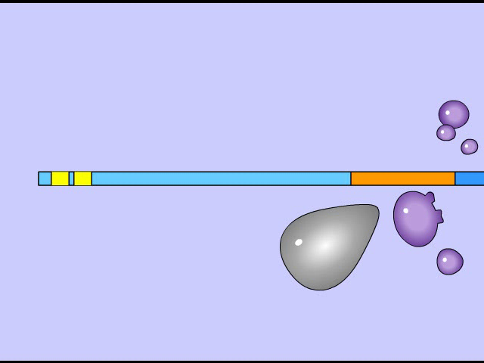
Animation: Initiation of Transcription

Slide 43
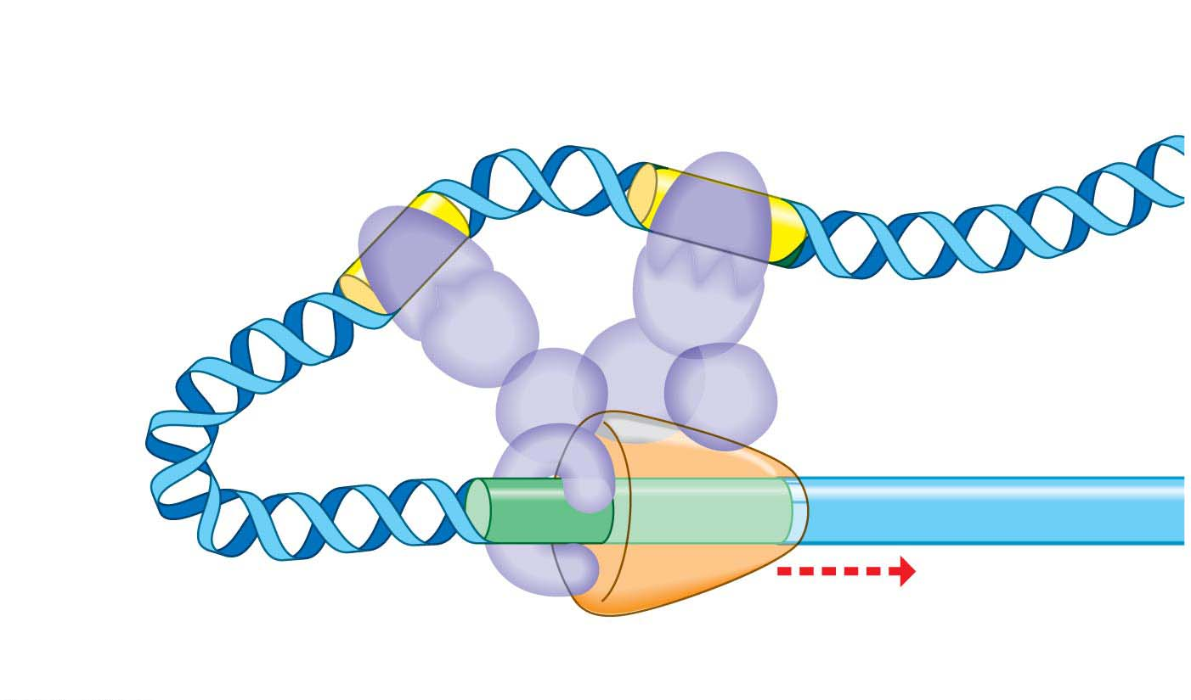
Figure 11.5
Enhancers (DNA control sequences)
RNA polymerase
Gene
Bend in
the DNA
Transcription
Transcription
factors
Promoter
Notes:
Figure 11.5 A model for turning on a eukaryotic gene

Slide 44
The Initiation of Transcription
Repressor proteins, which may bind to DNA sequences called silencers, inhibit the start of transcription.
Repressor proteins that turn genes off are less common in eukaryotes than activators, proteins that turn genes on by binding to DNA. Activators act by making it easier for RNA polymerase to bind to the promoter.
The “default” state for most genes in multicellular eukaryotes seems to be off, with the exception of “housekeeping” genes for routine activities such as the digestion of glucose.
Notes:
44
Student Misconceptions and Concerns
1. The broad concept of selective “reading” of the genetic code associated with differentiation and types of cellular activity can be missed when concentrating on the extensive details of regulation. Analogies, noted in the text and below in the teaching tips, can help students relate this overall selective process to their own experiences. Students already understand the selective reading of relevant chapters in textbooks and the selective referencing of product manuals to get answers to different questions. These experiences are similar in many ways to the broad processes of gene regulation.
2. The many levels of gene regulation in eukaryotic cells can be confusing and frustrating. The water pipe analogy depicted in Figure 11.3 can be a helpful reference to organize the potential sites of regulation.
Teaching Tips
1. Cellular differentiation is analogous to buying a book about how to build birdhouses and reading only the plans needed to build one particular model. Although the book contains directions to build many different birdhouses, you read and follow only the directions for the particular birdhouse you choose to build. The pages and directions for the other birdhouses remain intact. When cells differentiate, they read, or express, only the genes that are needed in that particular cell type.
2. A key advantage of an operon system is the ability to turn off or on a set of genes with a single “switch.” You can demonstrate this relationship in your classroom by turning off or on a set of lights with a single switch.
3. The authors develop an analogy between the regulation of transcription and the series of water pipes that carry water from your local water supply, perhaps a reservoir, to a faucet in your home. At various points, valves control the flow of water. Similarly, the expression of genes is controlled at many points along the process. Figure 11.3 illustrates the “flow” of genetic information from a chromosome—a reservoir of genetic information—to an active protein that has been made in the cell’s cytoplasm. The multiple mechanisms that control gene expression are analogous to the control valves in water pipes. In the figure, a possible control knob indicates each gene expression “valve.” In the figure, the large size of the transcription control knob highlights its crucial role.
4. Just as a folded map is difficult to read, DNA packaging tends to prevent gene “reading” or expression.
5. Just as boxes of your things that will be little used are packed deeper into a closet, attic, or basement, chromatin that is not expressed is highly compacted and is stored away.
6. Alternative RNA splicing is like remixing music to produce a new song or re-editing a movie for a different ending. You could have a little fun by challenging students to identify which category of the Academy Awards is most like alternative RNA splicing. (Answer: the award for best editing.)
7. The action of an extracellular signal reaching a cell’s surface is like pushing the doorbell at a home. The signal is converted to another form (pushing a button rings a bell) and activities change within the house as someone comes to answer the door.
8. Students might wonder why a patch of fur on the cat’s skin is all the same color in Figure 11.4, if every cell has an equal chance of being one of the two color forms. The answer is that X chromosome inactivation occurs early in development. Thus, the patch of one color represents the progeny of one embryonic cell after X chromosome inactivation.
9. Homeotic genes are often called “master control genes.” The relationship between homeotic genes and structural genes is like the relationship between a construction supervisor and the workers. Major rearrangements can result from a few simple changes in the directions for construction.
10. There is much hope for the use of DNA microarrays to refine cancer therapies. In the past, a diagnosis of cancer was too often met with general treatments that benefited only a fraction of the patients. Physicians were left to wonder why some people with breast cancer or lung cancer responded to therapy while others did not. DNA microarrays enable us to identify differences between patients with the same apparent type of cancer (breast, lung, prostate, and so on). Consider sharing this important avenue of hope. It is likely that some of your students will soon have a family member facing these battles.
Active Lecture Tips
1. The lactose operon is turned on by removing the repressor—a sort of double negative. Students might enjoy various analogies to other situations. Ask students in lecture to work in small groups to develop their own examples from life in which something occurs by a double negative. Share with them the common example “When the cat's away, the mice will play.” Then challenge them to each create a couple more. (Another example to consider: “Like a cat watching mice, if a mom keeps her kids away from cookies, but somebody occupies her attention, kids can sneak by and snatch some cookies. Thus, the person occupying Mom’s attention functions most like lactose binding to the repressor.”)

Slide 45
RNA Processing and Breakdown
Within a eukaryotic cell, transcription occurs in the nucleus, where RNA transcripts are processed into mRNA before moving to the cytoplasm for translation by the ribosomes.
RNA processing includes the
  addition of a cap and tail,
  removal of any introns, and
  splicing together of the remaining exons.
Notes:
45
Student Misconceptions and Concerns
1. The broad concept of selective “reading” of the genetic code associated with differentiation and types of cellular activity can be missed when concentrating on the extensive details of regulation. Analogies, noted in the text and below in the teaching tips, can help students relate this overall selective process to their own experiences. Students already understand the selective reading of relevant chapters in textbooks and the selective referencing of product manuals to get answers to different questions. These experiences are similar in many ways to the broad processes of gene regulation.
2. The many levels of gene regulation in eukaryotic cells can be confusing and frustrating. The water pipe analogy depicted in Figure 11.3 can be a helpful reference to organize the potential sites of regulation.
Teaching Tips
1. Cellular differentiation is analogous to buying a book about how to build birdhouses and reading only the plans needed to build one particular model. Although the book contains directions to build many different birdhouses, you read and follow only the directions for the particular birdhouse you choose to build. The pages and directions for the other birdhouses remain intact. When cells differentiate, they read, or express, only the genes that are needed in that particular cell type.
2. A key advantage of an operon system is the ability to turn off or on a set of genes with a single “switch.” You can demonstrate this relationship in your classroom by turning off or on a set of lights with a single switch.
3. The authors develop an analogy between the regulation of transcription and the series of water pipes that carry water from your local water supply, perhaps a reservoir, to a faucet in your home. At various points, valves control the flow of water. Similarly, the expression of genes is controlled at many points along the process. Figure 11.3 illustrates the “flow” of genetic information from a chromosome—a reservoir of genetic information—to an active protein that has been made in the cell’s cytoplasm. The multiple mechanisms that control gene expression are analogous to the control valves in water pipes. In the figure, a possible control knob indicates each gene expression “valve.” In the figure, the large size of the transcription control knob highlights its crucial role.
4. Just as a folded map is difficult to read, DNA packaging tends to prevent gene “reading” or expression.
5. Just as boxes of your things that will be little used are packed deeper into a closet, attic, or basement, chromatin that is not expressed is highly compacted and is stored away.
6. Alternative RNA splicing is like remixing music to produce a new song or re-editing a movie for a different ending. You could have a little fun by challenging students to identify which category of the Academy Awards is most like alternative RNA splicing. (Answer: the award for best editing.)
7. The action of an extracellular signal reaching a cell’s surface is like pushing the doorbell at a home. The signal is converted to another form (pushing a button rings a bell) and activities change within the house as someone comes to answer the door.
8. Students might wonder why a patch of fur on the cat’s skin is all the same color in Figure 11.4, if every cell has an equal chance of being one of the two color forms. The answer is that X chromosome inactivation occurs early in development. Thus, the patch of one color represents the progeny of one embryonic cell after X chromosome inactivation.
9. Homeotic genes are often called “master control genes.” The relationship between homeotic genes and structural genes is like the relationship between a construction supervisor and the workers. Major rearrangements can result from a few simple changes in the directions for construction.
10. There is much hope for the use of DNA microarrays to refine cancer therapies. In the past, a diagnosis of cancer was too often met with general treatments that benefited only a fraction of the patients. Physicians were left to wonder why some people with breast cancer or lung cancer responded to therapy while others did not. DNA microarrays enable us to identify differences between patients with the same apparent type of cancer (breast, lung, prostate, and so on). Consider sharing this important avenue of hope. It is likely that some of your students will soon have a family member facing these battles.
Active Lecture Tips
1. The lactose operon is turned on by removing the repressor—a sort of double negative. Students might enjoy various analogies to other situations. Ask students in lecture to work in small groups to develop their own examples from life in which something occurs by a double negative. Share with them the common example “When the cat's away, the mice will play.” Then challenge them to each create a couple more. (Another example to consider: “Like a cat watching mice, if a mom keeps her kids away from cookies, but somebody occupies her attention, kids can sneak by and snatch some cookies. Thus, the person occupying Mom’s attention functions most like lactose binding to the repressor.”)

Slide 46
RNA Processing and Breakdown
Within a cell, exon splicing can occur in more than one way, generating different mRNA molecules from the same starting RNA molecule.
With this sort of alternative RNA splicing, an organism can produce more than one type of polypeptide from a single gene.
Notes:
46
Student Misconceptions and Concerns
1. The broad concept of selective “reading” of the genetic code associated with differentiation and types of cellular activity can be missed when concentrating on the extensive details of regulation. Analogies, noted in the text and below in the teaching tips, can help students relate this overall selective process to their own experiences. Students already understand the selective reading of relevant chapters in textbooks and the selective referencing of product manuals to get answers to different questions. These experiences are similar in many ways to the broad processes of gene regulation.
2. The many levels of gene regulation in eukaryotic cells can be confusing and frustrating. The water pipe analogy depicted in Figure 11.3 can be a helpful reference to organize the potential sites of regulation.
Teaching Tips
1. Cellular differentiation is analogous to buying a book about how to build birdhouses and reading only the plans needed to build one particular model. Although the book contains directions to build many different birdhouses, you read and follow only the directions for the particular birdhouse you choose to build. The pages and directions for the other birdhouses remain intact. When cells differentiate, they read, or express, only the genes that are needed in that particular cell type.
2. A key advantage of an operon system is the ability to turn off or on a set of genes with a single “switch.” You can demonstrate this relationship in your classroom by turning off or on a set of lights with a single switch.
3. The authors develop an analogy between the regulation of transcription and the series of water pipes that carry water from your local water supply, perhaps a reservoir, to a faucet in your home. At various points, valves control the flow of water. Similarly, the expression of genes is controlled at many points along the process. Figure 11.3 illustrates the “flow” of genetic information from a chromosome—a reservoir of genetic information—to an active protein that has been made in the cell’s cytoplasm. The multiple mechanisms that control gene expression are analogous to the control valves in water pipes. In the figure, a possible control knob indicates each gene expression “valve.” In the figure, the large size of the transcription control knob highlights its crucial role.
4. Just as a folded map is difficult to read, DNA packaging tends to prevent gene “reading” or expression.
5. Just as boxes of your things that will be little used are packed deeper into a closet, attic, or basement, chromatin that is not expressed is highly compacted and is stored away.
6. Alternative RNA splicing is like remixing music to produce a new song or re-editing a movie for a different ending. You could have a little fun by challenging students to identify which category of the Academy Awards is most like alternative RNA splicing. (Answer: the award for best editing.)
7. The action of an extracellular signal reaching a cell’s surface is like pushing the doorbell at a home. The signal is converted to another form (pushing a button rings a bell) and activities change within the house as someone comes to answer the door.
8. Students might wonder why a patch of fur on the cat’s skin is all the same color in Figure 11.4, if every cell has an equal chance of being one of the two color forms. The answer is that X chromosome inactivation occurs early in development. Thus, the patch of one color represents the progeny of one embryonic cell after X chromosome inactivation.
9. Homeotic genes are often called “master control genes.” The relationship between homeotic genes and structural genes is like the relationship between a construction supervisor and the workers. Major rearrangements can result from a few simple changes in the directions for construction.
10. There is much hope for the use of DNA microarrays to refine cancer therapies. In the past, a diagnosis of cancer was too often met with general treatments that benefited only a fraction of the patients. Physicians were left to wonder why some people with breast cancer or lung cancer responded to therapy while others did not. DNA microarrays enable us to identify differences between patients with the same apparent type of cancer (breast, lung, prostate, and so on). Consider sharing this important avenue of hope. It is likely that some of your students will soon have a family member facing these battles.
Active Lecture Tips
1. The lactose operon is turned on by removing the repressor—a sort of double negative. Students might enjoy various analogies to other situations. Ask students in lecture to work in small groups to develop their own examples from life in which something occurs by a double negative. Share with them the common example “When the cat's away, the mice will play.” Then challenge them to each create a couple more. (Another example to consider: “Like a cat watching mice, if a mom keeps her kids away from cookies, but somebody occupies her attention, kids can sneak by and snatch some cookies. Thus, the person occupying Mom’s attention functions most like lactose binding to the repressor.”)

Slide 47
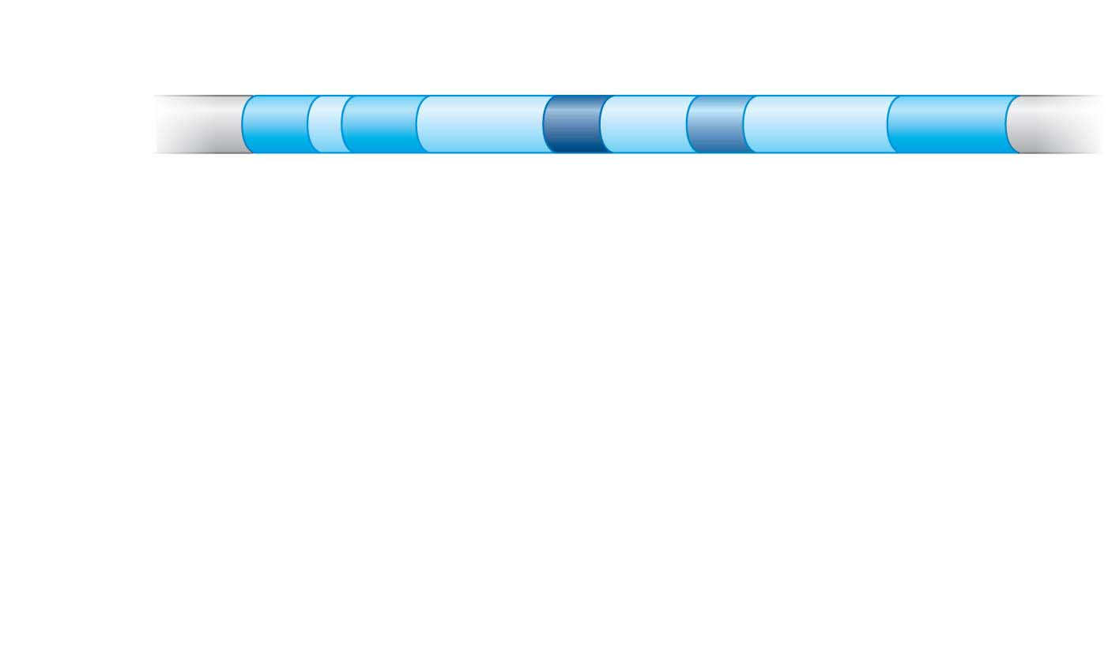
Figure 11.6-s1
Exons
DNA
1
2
3
4
5
Introns
Notes:
Figure 11.6-s1 Alternative RNA splicing: producing multiple mRNAs from the same gene (step 1)

Slide 48
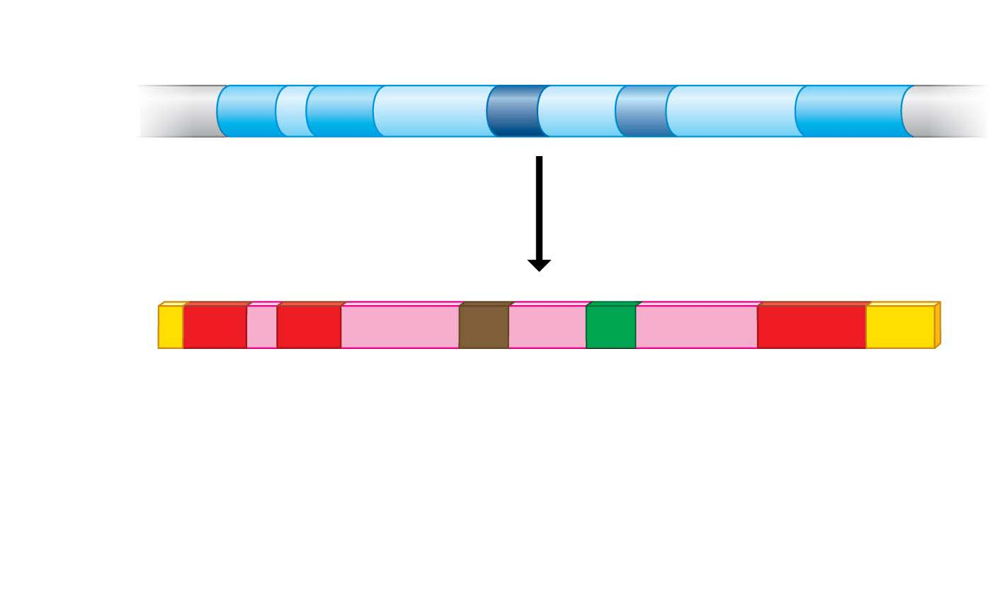
Figure 11.6-s2
Exons
DNA
1
2
3
4
5
Introns
RNA
transcript
1
2
3
4
5
Notes:
Figure 11.6-s2 Alternative RNA splicing: producing multiple mRNAs from the same gene (step 2)

Slide 49
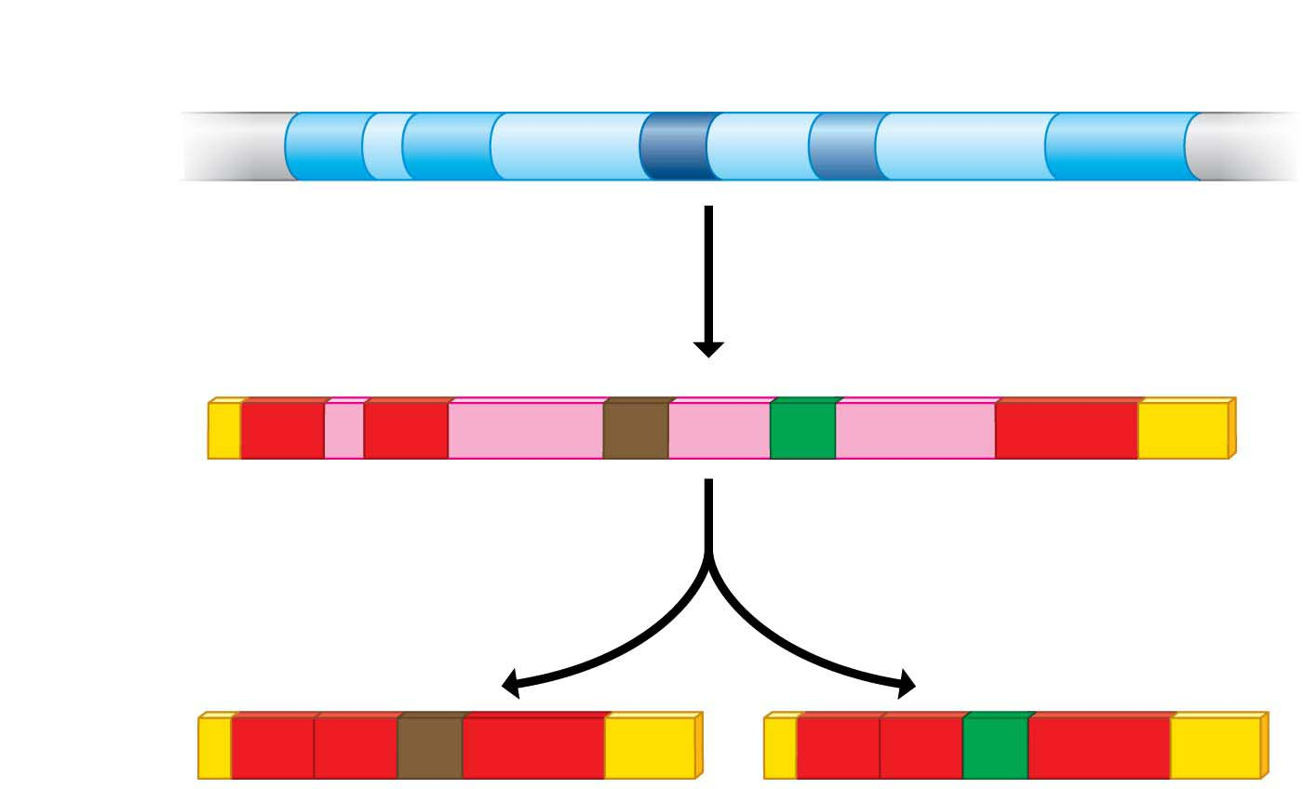
Figure 11.6-s3
Exons
DNA
1
2
3
4
5
Introns
RNA
transcript
1
2
3
4
5
RNA splicing
or
mRNA
1
2
3
5
1
2
4
5
Notes:
Figure 11.6-s3 Alternative RNA splicing: producing multiple mRNAs from the same gene (step 3)

Slide 50
RNA Processing and Breakdown
After an mRNA is produced in its final form, its “lifetime” can be highly variable, from hours to weeks to months.
  Controlling the timing of mRNA breakdown provides another opportunity for regulation.
  But all mRNAs are eventually broken down and their parts recycled.
Notes:
50
Student Misconceptions and Concerns
1. The broad concept of selective “reading” of the genetic code associated with differentiation and types of cellular activity can be missed when concentrating on the extensive details of regulation. Analogies, noted in the text and below in the teaching tips, can help students relate this overall selective process to their own experiences. Students already understand the selective reading of relevant chapters in textbooks and the selective referencing of product manuals to get answers to different questions. These experiences are similar in many ways to the broad processes of gene regulation.
2. The many levels of gene regulation in eukaryotic cells can be confusing and frustrating. The water pipe analogy depicted in Figure 11.3 can be a helpful reference to organize the potential sites of regulation.
Teaching Tips
1. Cellular differentiation is analogous to buying a book about how to build birdhouses and reading only the plans needed to build one particular model. Although the book contains directions to build many different birdhouses, you read and follow only the directions for the particular birdhouse you choose to build. The pages and directions for the other birdhouses remain intact. When cells differentiate, they read, or express, only the genes that are needed in that particular cell type.
2. A key advantage of an operon system is the ability to turn off or on a set of genes with a single “switch.” You can demonstrate this relationship in your classroom by turning off or on a set of lights with a single switch.
3. The authors develop an analogy between the regulation of transcription and the series of water pipes that carry water from your local water supply, perhaps a reservoir, to a faucet in your home. At various points, valves control the flow of water. Similarly, the expression of genes is controlled at many points along the process. Figure 11.3 illustrates the “flow” of genetic information from a chromosome—a reservoir of genetic information—to an active protein that has been made in the cell’s cytoplasm. The multiple mechanisms that control gene expression are analogous to the control valves in water pipes. In the figure, a possible control knob indicates each gene expression “valve.” In the figure, the large size of the transcription control knob highlights its crucial role.
4. Just as a folded map is difficult to read, DNA packaging tends to prevent gene “reading” or expression.
5. Just as boxes of your things that will be little used are packed deeper into a closet, attic, or basement, chromatin that is not expressed is highly compacted and is stored away.
6. Alternative RNA splicing is like remixing music to produce a new song or re-editing a movie for a different ending. You could have a little fun by challenging students to identify which category of the Academy Awards is most like alternative RNA splicing. (Answer: the award for best editing.)
7. The action of an extracellular signal reaching a cell’s surface is like pushing the doorbell at a home. The signal is converted to another form (pushing a button rings a bell) and activities change within the house as someone comes to answer the door.
8. Students might wonder why a patch of fur on the cat’s skin is all the same color in Figure 11.4, if every cell has an equal chance of being one of the two color forms. The answer is that X chromosome inactivation occurs early in development. Thus, the patch of one color represents the progeny of one embryonic cell after X chromosome inactivation.
9. Homeotic genes are often called “master control genes.” The relationship between homeotic genes and structural genes is like the relationship between a construction supervisor and the workers. Major rearrangements can result from a few simple changes in the directions for construction.
10. There is much hope for the use of DNA microarrays to refine cancer therapies. In the past, a diagnosis of cancer was too often met with general treatments that benefited only a fraction of the patients. Physicians were left to wonder why some people with breast cancer or lung cancer responded to therapy while others did not. DNA microarrays enable us to identify differences between patients with the same apparent type of cancer (breast, lung, prostate, and so on). Consider sharing this important avenue of hope. It is likely that some of your students will soon have a family member facing these battles.
Active Lecture Tips
1. The lactose operon is turned on by removing the repressor—a sort of double negative. Students might enjoy various analogies to other situations. Ask students in lecture to work in small groups to develop their own examples from life in which something occurs by a double negative. Share with them the common example “When the cat's away, the mice will play.” Then challenge them to each create a couple more. (Another example to consider: “Like a cat watching mice, if a mom keeps her kids away from cookies, but somebody occupies her attention, kids can sneak by and snatch some cookies. Thus, the person occupying Mom’s attention functions most like lactose binding to the repressor.”)

Slide 51
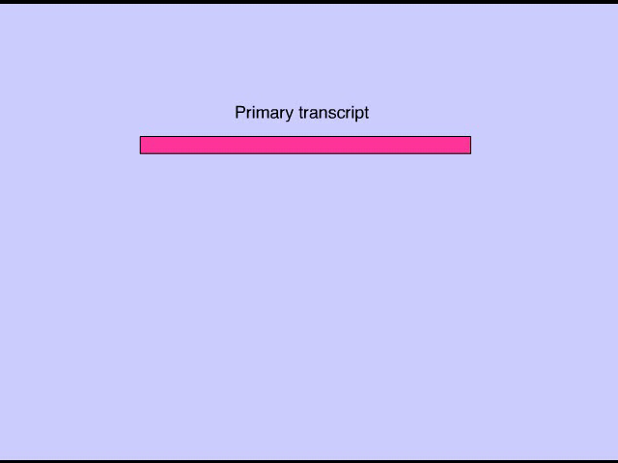
Animation: RNA Processing

Slide 52
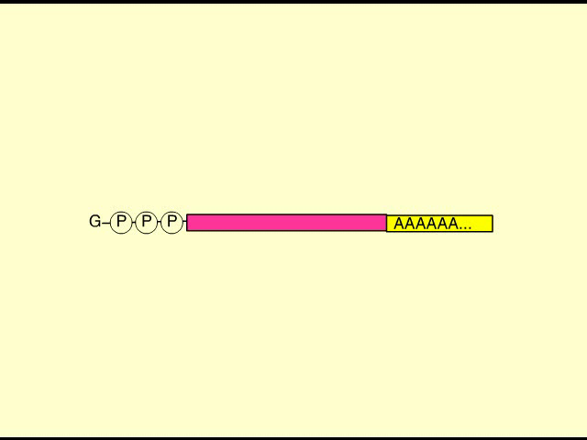
Animation: Blocking Translation

Slide 53
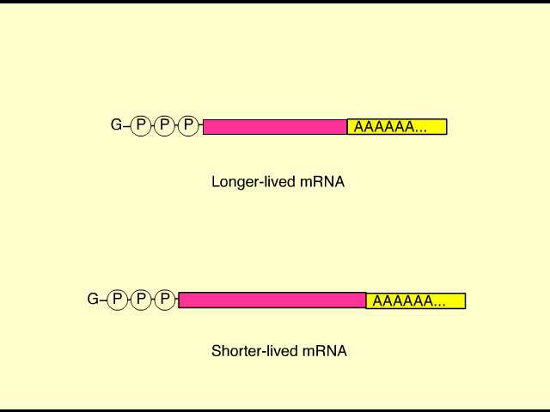
Animation: mRNA Degradation

Slide 54
microRNAs
Small single-stranded RNA molecules, called microRNAs (miRNAs), can bind to complementary sequences on mRNA molecules in the cytoplasm.
Some trigger breakdown of their target mRNA, whereas others block translation.
It has been estimated that miRNAs may regulate the expression of one-half of all human genes, a striking figure given that miRNAs were unknown 20 years ago.
Notes:
54
Student Misconceptions and Concerns
1. The broad concept of selective “reading” of the genetic code associated with differentiation and types of cellular activity can be missed when concentrating on the extensive details of regulation. Analogies, noted in the text and below in the teaching tips, can help students relate this overall selective process to their own experiences. Students already understand the selective reading of relevant chapters in textbooks and the selective referencing of product manuals to get answers to different questions. These experiences are similar in many ways to the broad processes of gene regulation.
2. The many levels of gene regulation in eukaryotic cells can be confusing and frustrating. The water pipe analogy depicted in Figure 11.3 can be a helpful reference to organize the potential sites of regulation.
Teaching Tips
1. Cellular differentiation is analogous to buying a book about how to build birdhouses and reading only the plans needed to build one particular model. Although the book contains directions to build many different birdhouses, you read and follow only the directions for the particular birdhouse you choose to build. The pages and directions for the other birdhouses remain intact. When cells differentiate, they read, or express, only the genes that are needed in that particular cell type.
2. A key advantage of an operon system is the ability to turn off or on a set of genes with a single “switch.” You can demonstrate this relationship in your classroom by turning off or on a set of lights with a single switch.
3. The authors develop an analogy between the regulation of transcription and the series of water pipes that carry water from your local water supply, perhaps a reservoir, to a faucet in your home. At various points, valves control the flow of water. Similarly, the expression of genes is controlled at many points along the process. Figure 11.3 illustrates the “flow” of genetic information from a chromosome—a reservoir of genetic information—to an active protein that has been made in the cell’s cytoplasm. The multiple mechanisms that control gene expression are analogous to the control valves in water pipes. In the figure, a possible control knob indicates each gene expression “valve.” In the figure, the large size of the transcription control knob highlights its crucial role.
4. Just as a folded map is difficult to read, DNA packaging tends to prevent gene “reading” or expression.
5. Just as boxes of your things that will be little used are packed deeper into a closet, attic, or basement, chromatin that is not expressed is highly compacted and is stored away.
6. Alternative RNA splicing is like remixing music to produce a new song or re-editing a movie for a different ending. You could have a little fun by challenging students to identify which category of the Academy Awards is most like alternative RNA splicing. (Answer: the award for best editing.)
7. The action of an extracellular signal reaching a cell’s surface is like pushing the doorbell at a home. The signal is converted to another form (pushing a button rings a bell) and activities change within the house as someone comes to answer the door.
8. Students might wonder why a patch of fur on the cat’s skin is all the same color in Figure 11.4, if every cell has an equal chance of being one of the two color forms. The answer is that X chromosome inactivation occurs early in development. Thus, the patch of one color represents the progeny of one embryonic cell after X chromosome inactivation.
9. Homeotic genes are often called “master control genes.” The relationship between homeotic genes and structural genes is like the relationship between a construction supervisor and the workers. Major rearrangements can result from a few simple changes in the directions for construction.
10. There is much hope for the use of DNA microarrays to refine cancer therapies. In the past, a diagnosis of cancer was too often met with general treatments that benefited only a fraction of the patients. Physicians were left to wonder why some people with breast cancer or lung cancer responded to therapy while others did not. DNA microarrays enable us to identify differences between patients with the same apparent type of cancer (breast, lung, prostate, and so on). Consider sharing this important avenue of hope. It is likely that some of your students will soon have a family member facing these battles.
Active Lecture Tips
1. The lactose operon is turned on by removing the repressor—a sort of double negative. Students might enjoy various analogies to other situations. Ask students in lecture to work in small groups to develop their own examples from life in which something occurs by a double negative. Share with them the common example “When the cat's away, the mice will play.” Then challenge them to each create a couple more. (Another example to consider: “Like a cat watching mice, if a mom keeps her kids away from cookies, but somebody occupies her attention, kids can sneak by and snatch some cookies. Thus, the person occupying Mom’s attention functions most like lactose binding to the repressor.”)

Slide 55
The Initiation of Translation
The process of translation offers additional opportunities for control by regulatory molecules.
Notes:
55
Student Misconceptions and Concerns
1. The broad concept of selective “reading” of the genetic code associated with differentiation and types of cellular activity can be missed when concentrating on the extensive details of regulation. Analogies, noted in the text and below in the teaching tips, can help students relate this overall selective process to their own experiences. Students already understand the selective reading of relevant chapters in textbooks and the selective referencing of product manuals to get answers to different questions. These experiences are similar in many ways to the broad processes of gene regulation.
2. The many levels of gene regulation in eukaryotic cells can be confusing and frustrating. The water pipe analogy depicted in Figure 11.3 can be a helpful reference to organize the potential sites of regulation.
Teaching Tips
1. Cellular differentiation is analogous to buying a book about how to build birdhouses and reading only the plans needed to build one particular model. Although the book contains directions to build many different birdhouses, you read and follow only the directions for the particular birdhouse you choose to build. The pages and directions for the other birdhouses remain intact. When cells differentiate, they read, or express, only the genes that are needed in that particular cell type.
2. A key advantage of an operon system is the ability to turn off or on a set of genes with a single “switch.” You can demonstrate this relationship in your classroom by turning off or on a set of lights with a single switch.
3. The authors develop an analogy between the regulation of transcription and the series of water pipes that carry water from your local water supply, perhaps a reservoir, to a faucet in your home. At various points, valves control the flow of water. Similarly, the expression of genes is controlled at many points along the process. Figure 11.3 illustrates the “flow” of genetic information from a chromosome—a reservoir of genetic information—to an active protein that has been made in the cell’s cytoplasm. The multiple mechanisms that control gene expression are analogous to the control valves in water pipes. In the figure, a possible control knob indicates each gene expression “valve.” In the figure, the large size of the transcription control knob highlights its crucial role.
4. Just as a folded map is difficult to read, DNA packaging tends to prevent gene “reading” or expression.
5. Just as boxes of your things that will be little used are packed deeper into a closet, attic, or basement, chromatin that is not expressed is highly compacted and is stored away.
6. Alternative RNA splicing is like remixing music to produce a new song or re-editing a movie for a different ending. You could have a little fun by challenging students to identify which category of the Academy Awards is most like alternative RNA splicing. (Answer: the award for best editing.)
7. The action of an extracellular signal reaching a cell’s surface is like pushing the doorbell at a home. The signal is converted to another form (pushing a button rings a bell) and activities change within the house as someone comes to answer the door.
8. Students might wonder why a patch of fur on the cat’s skin is all the same color in Figure 11.4, if every cell has an equal chance of being one of the two color forms. The answer is that X chromosome inactivation occurs early in development. Thus, the patch of one color represents the progeny of one embryonic cell after X chromosome inactivation.
9. Homeotic genes are often called “master control genes.” The relationship between homeotic genes and structural genes is like the relationship between a construction supervisor and the workers. Major rearrangements can result from a few simple changes in the directions for construction.
10. There is much hope for the use of DNA microarrays to refine cancer therapies. In the past, a diagnosis of cancer was too often met with general treatments that benefited only a fraction of the patients. Physicians were left to wonder why some people with breast cancer or lung cancer responded to therapy while others did not. DNA microarrays enable us to identify differences between patients with the same apparent type of cancer (breast, lung, prostate, and so on). Consider sharing this important avenue of hope. It is likely that some of your students will soon have a family member facing these battles.
Active Lecture Tips
1. The lactose operon is turned on by removing the repressor—a sort of double negative. Students might enjoy various analogies to other situations. Ask students in lecture to work in small groups to develop their own examples from life in which something occurs by a double negative. Share with them the common example “When the cat's away, the mice will play.” Then challenge them to each create a couple more. (Another example to consider: “Like a cat watching mice, if a mom keeps her kids away from cookies, but somebody occupies her attention, kids can sneak by and snatch some cookies. Thus, the person occupying Mom’s attention functions most like lactose binding to the repressor.”)

Slide 56
Protein Activation and Breakdown
The final opportunities for regulating gene expression occur after translation.
  For example, the hormone insulin is synthesized as one long, inactive polypeptide that must be chopped into pieces before it comes active.
  Other proteins require chemical modification before they become active.
Notes:
56
Student Misconceptions and Concerns
1. The broad concept of selective “reading” of the genetic code associated with differentiation and types of cellular activity can be missed when concentrating on the extensive details of regulation. Analogies, noted in the text and below in the teaching tips, can help students relate this overall selective process to their own experiences. Students already understand the selective reading of relevant chapters in textbooks and the selective referencing of product manuals to get answers to different questions. These experiences are similar in many ways to the broad processes of gene regulation.
2. The many levels of gene regulation in eukaryotic cells can be confusing and frustrating. The water pipe analogy depicted in Figure 11.3 can be a helpful reference to organize the potential sites of regulation.
Teaching Tips
1. Cellular differentiation is analogous to buying a book about how to build birdhouses and reading only the plans needed to build one particular model. Although the book contains directions to build many different birdhouses, you read and follow only the directions for the particular birdhouse you choose to build. The pages and directions for the other birdhouses remain intact. When cells differentiate, they read, or express, only the genes that are needed in that particular cell type.
2. A key advantage of an operon system is the ability to turn off or on a set of genes with a single “switch.” You can demonstrate this relationship in your classroom by turning off or on a set of lights with a single switch.
3. The authors develop an analogy between the regulation of transcription and the series of water pipes that carry water from your local water supply, perhaps a reservoir, to a faucet in your home. At various points, valves control the flow of water. Similarly, the expression of genes is controlled at many points along the process. Figure 11.3 illustrates the “flow” of genetic information from a chromosome—a reservoir of genetic information—to an active protein that has been made in the cell’s cytoplasm. The multiple mechanisms that control gene expression are analogous to the control valves in water pipes. In the figure, a possible control knob indicates each gene expression “valve.” In the figure, the large size of the transcription control knob highlights its crucial role.
4. Just as a folded map is difficult to read, DNA packaging tends to prevent gene “reading” or expression.
5. Just as boxes of your things that will be little used are packed deeper into a closet, attic, or basement, chromatin that is not expressed is highly compacted and is stored away.
6. Alternative RNA splicing is like remixing music to produce a new song or re-editing a movie for a different ending. You could have a little fun by challenging students to identify which category of the Academy Awards is most like alternative RNA splicing. (Answer: the award for best editing.)
7. The action of an extracellular signal reaching a cell’s surface is like pushing the doorbell at a home. The signal is converted to another form (pushing a button rings a bell) and activities change within the house as someone comes to answer the door.
8. Students might wonder why a patch of fur on the cat’s skin is all the same color in Figure 11.4, if every cell has an equal chance of being one of the two color forms. The answer is that X chromosome inactivation occurs early in development. Thus, the patch of one color represents the progeny of one embryonic cell after X chromosome inactivation.
9. Homeotic genes are often called “master control genes.” The relationship between homeotic genes and structural genes is like the relationship between a construction supervisor and the workers. Major rearrangements can result from a few simple changes in the directions for construction.
10. There is much hope for the use of DNA microarrays to refine cancer therapies. In the past, a diagnosis of cancer was too often met with general treatments that benefited only a fraction of the patients. Physicians were left to wonder why some people with breast cancer or lung cancer responded to therapy while others did not. DNA microarrays enable us to identify differences between patients with the same apparent type of cancer (breast, lung, prostate, and so on). Consider sharing this important avenue of hope. It is likely that some of your students will soon have a family member facing these battles.
Active Lecture Tips
1. The lactose operon is turned on by removing the repressor—a sort of double negative. Students might enjoy various analogies to other situations. Ask students in lecture to work in small groups to develop their own examples from life in which something occurs by a double negative. Share with them the common example “When the cat's away, the mice will play.” Then challenge them to each create a couple more. (Another example to consider: “Like a cat watching mice, if a mom keeps her kids away from cookies, but somebody occupies her attention, kids can sneak by and snatch some cookies. Thus, the person occupying Mom’s attention functions most like lactose binding to the repressor.”)

Slide 57
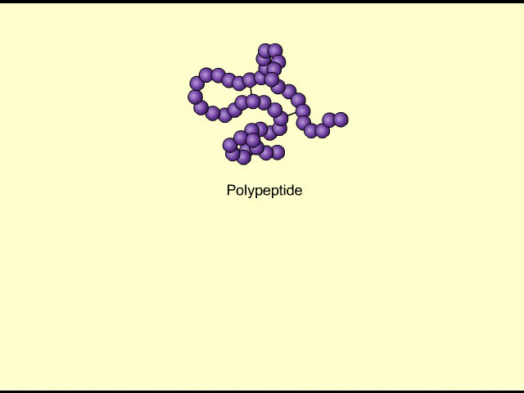
Animation: Protein Processing

Slide 58
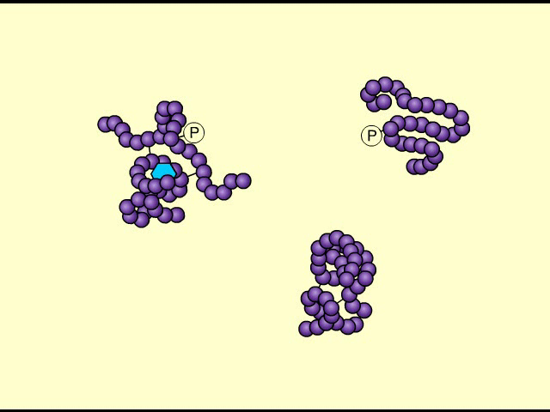
Animation: Protein Degradation

Slide 59
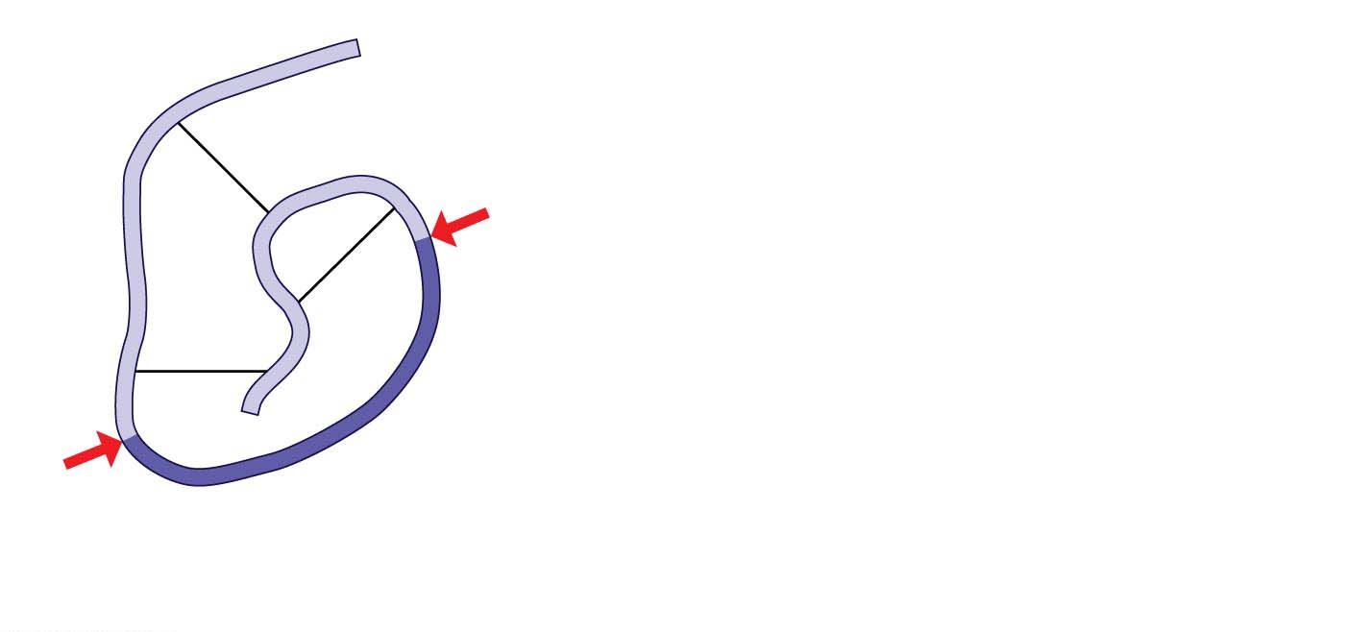
Figure 11.7-s1
Region to
be removed
Initial polypeptide (inactive)
Notes:
Figure 11.7-s1 The formation of an active insulin molecule (step 1)

Slide 60
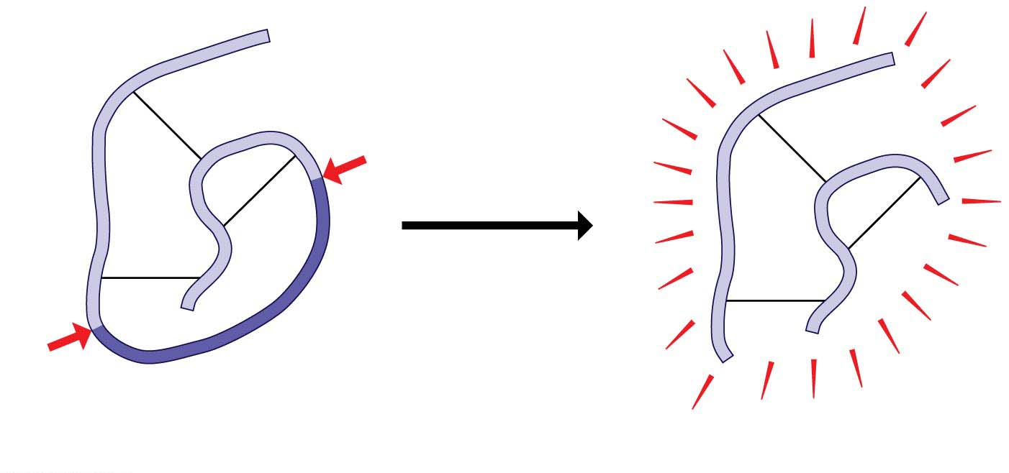
Figure 11.7-s2
Cutting
Region to
be removed
Initial polypeptide (inactive)
Insulin (active hormone)
Notes:
Figure 11.7-s2 The formation of an active insulin molecule (step 2)

Slide 61
Protein Activation and Breakdown
Another control mechanism operating after translation is the selective breakdown of proteins.
  Some proteins that trigger metabolic changes in cells are broken down within a few minutes or hours.
  This regulation allows a cell to adjust the kinds and amounts of its proteins in response to changes in its environment.
Notes:
61
Student Misconceptions and Concerns
1. The broad concept of selective “reading” of the genetic code associated with differentiation and types of cellular activity can be missed when concentrating on the extensive details of regulation. Analogies, noted in the text and below in the teaching tips, can help students relate this overall selective process to their own experiences. Students already understand the selective reading of relevant chapters in textbooks and the selective referencing of product manuals to get answers to different questions. These experiences are similar in many ways to the broad processes of gene regulation.
2. The many levels of gene regulation in eukaryotic cells can be confusing and frustrating. The water pipe analogy depicted in Figure 11.3 can be a helpful reference to organize the potential sites of regulation.
Teaching Tips
1. Cellular differentiation is analogous to buying a book about how to build birdhouses and reading only the plans needed to build one particular model. Although the book contains directions to build many different birdhouses, you read and follow only the directions for the particular birdhouse you choose to build. The pages and directions for the other birdhouses remain intact. When cells differentiate, they read, or express, only the genes that are needed in that particular cell type.
2. A key advantage of an operon system is the ability to turn off or on a set of genes with a single “switch.” You can demonstrate this relationship in your classroom by turning off or on a set of lights with a single switch.
3. The authors develop an analogy between the regulation of transcription and the series of water pipes that carry water from your local water supply, perhaps a reservoir, to a faucet in your home. At various points, valves control the flow of water. Similarly, the expression of genes is controlled at many points along the process. Figure 11.3 illustrates the “flow” of genetic information from a chromosome—a reservoir of genetic information—to an active protein that has been made in the cell’s cytoplasm. The multiple mechanisms that control gene expression are analogous to the control valves in water pipes. In the figure, a possible control knob indicates each gene expression “valve.” In the figure, the large size of the transcription control knob highlights its crucial role.
4. Just as a folded map is difficult to read, DNA packaging tends to prevent gene “reading” or expression.
5. Just as boxes of your things that will be little used are packed deeper into a closet, attic, or basement, chromatin that is not expressed is highly compacted and is stored away.
6. Alternative RNA splicing is like remixing music to produce a new song or re-editing a movie for a different ending. You could have a little fun by challenging students to identify which category of the Academy Awards is most like alternative RNA splicing. (Answer: the award for best editing.)
7. The action of an extracellular signal reaching a cell’s surface is like pushing the doorbell at a home. The signal is converted to another form (pushing a button rings a bell) and activities change within the house as someone comes to answer the door.
8. Students might wonder why a patch of fur on the cat’s skin is all the same color in Figure 11.4, if every cell has an equal chance of being one of the two color forms. The answer is that X chromosome inactivation occurs early in development. Thus, the patch of one color represents the progeny of one embryonic cell after X chromosome inactivation.
9. Homeotic genes are often called “master control genes.” The relationship between homeotic genes and structural genes is like the relationship between a construction supervisor and the workers. Major rearrangements can result from a few simple changes in the directions for construction.
10. There is much hope for the use of DNA microarrays to refine cancer therapies. In the past, a diagnosis of cancer was too often met with general treatments that benefited only a fraction of the patients. Physicians were left to wonder why some people with breast cancer or lung cancer responded to therapy while others did not. DNA microarrays enable us to identify differences between patients with the same apparent type of cancer (breast, lung, prostate, and so on). Consider sharing this important avenue of hope. It is likely that some of your students will soon have a family member facing these battles.
Active Lecture Tips
1. The lactose operon is turned on by removing the repressor—a sort of double negative. Students might enjoy various analogies to other situations. Ask students in lecture to work in small groups to develop their own examples from life in which something occurs by a double negative. Share with them the common example “When the cat's away, the mice will play.” Then challenge them to each create a couple more. (Another example to consider: “Like a cat watching mice, if a mom keeps her kids away from cookies, but somebody occupies her attention, kids can sneak by and snatch some cookies. Thus, the person occupying Mom’s attention functions most like lactose binding to the repressor.”)

Slide 62
Information Flow: Cell Signaling
In a multicellular organism, gene regulation can cross cell boundaries, allowing information to be communicated between and among cells.
A cell can produce and secrete chemicals, such as hormones, that affect gene regulation in another cell.
Notes:
62
Student Misconceptions and Concerns
1. The broad concept of selective “reading” of the genetic code associated with differentiation and types of cellular activity can be missed when concentrating on the extensive details of regulation. Analogies, noted in the text and below in the teaching tips, can help students relate this overall selective process to their own experiences. Students already understand the selective reading of relevant chapters in textbooks and the selective referencing of product manuals to get answers to different questions. These experiences are similar in many ways to the broad processes of gene regulation.
2. The many levels of gene regulation in eukaryotic cells can be confusing and frustrating. The water pipe analogy depicted in Figure 11.3 can be a helpful reference to organize the potential sites of regulation.
Teaching Tips
1. Cellular differentiation is analogous to buying a book about how to build birdhouses and reading only the plans needed to build one particular model. Although the book contains directions to build many different birdhouses, you read and follow only the directions for the particular birdhouse you choose to build. The pages and directions for the other birdhouses remain intact. When cells differentiate, they read, or express, only the genes that are needed in that particular cell type.
2. A key advantage of an operon system is the ability to turn off or on a set of genes with a single “switch.” You can demonstrate this relationship in your classroom by turning off or on a set of lights with a single switch.
3. The authors develop an analogy between the regulation of transcription and the series of water pipes that carry water from your local water supply, perhaps a reservoir, to a faucet in your home. At various points, valves control the flow of water. Similarly, the expression of genes is controlled at many points along the process. Figure 11.3 illustrates the “flow” of genetic information from a chromosome—a reservoir of genetic information—to an active protein that has been made in the cell’s cytoplasm. The multiple mechanisms that control gene expression are analogous to the control valves in water pipes. In the figure, a possible control knob indicates each gene expression “valve.” In the figure, the large size of the transcription control knob highlights its crucial role.
4. Just as a folded map is difficult to read, DNA packaging tends to prevent gene “reading” or expression.
5. Just as boxes of your things that will be little used are packed deeper into a closet, attic, or basement, chromatin that is not expressed is highly compacted and is stored away.
6. Alternative RNA splicing is like remixing music to produce a new song or re-editing a movie for a different ending. You could have a little fun by challenging students to identify which category of the Academy Awards is most like alternative RNA splicing. (Answer: the award for best editing.)
7. The action of an extracellular signal reaching a cell’s surface is like pushing the doorbell at a home. The signal is converted to another form (pushing a button rings a bell) and activities change within the house as someone comes to answer the door.
8. Students might wonder why a patch of fur on the cat’s skin is all the same color in Figure 11.4, if every cell has an equal chance of being one of the two color forms. The answer is that X chromosome inactivation occurs early in development. Thus, the patch of one color represents the progeny of one embryonic cell after X chromosome inactivation.
9. Homeotic genes are often called “master control genes.” The relationship between homeotic genes and structural genes is like the relationship between a construction supervisor and the workers. Major rearrangements can result from a few simple changes in the directions for construction.
10. There is much hope for the use of DNA microarrays to refine cancer therapies. In the past, a diagnosis of cancer was too often met with general treatments that benefited only a fraction of the patients. Physicians were left to wonder why some people with breast cancer or lung cancer responded to therapy while others did not. DNA microarrays enable us to identify differences between patients with the same apparent type of cancer (breast, lung, prostate, and so on). Consider sharing this important avenue of hope. It is likely that some of your students will soon have a family member facing these battles.
Active Lecture Tips
1. The lactose operon is turned on by removing the repressor—a sort of double negative. Students might enjoy various analogies to other situations. Ask students in lecture to work in small groups to develop their own examples from life in which something occurs by a double negative. Share with them the common example “When the cat's away, the mice will play.” Then challenge them to each create a couple more. (Another example to consider: “Like a cat watching mice, if a mom keeps her kids away from cookies, but somebody occupies her attention, kids can sneak by and snatch some cookies. Thus, the person occupying Mom’s attention functions most like lactose binding to the repressor.”)

Slide 63
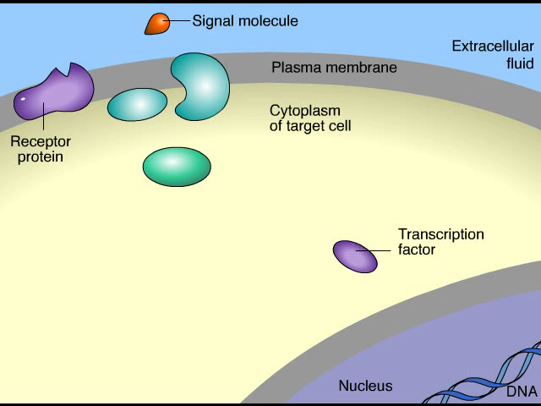
Animation: Cell Signaling

Slide 64
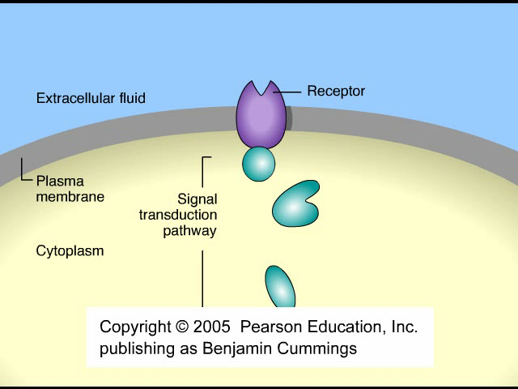
Animation: Overview of Cell Signaling

Slide 65
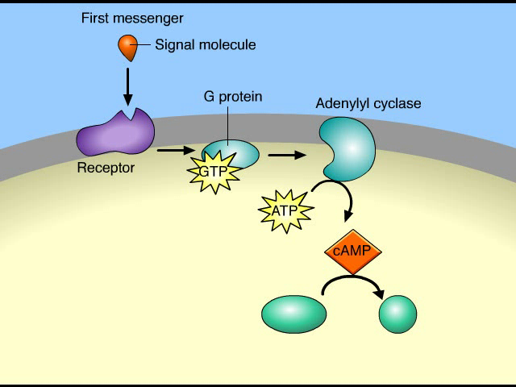
Animation: Signal Transduction Pathways

Slide 66
Information Flow: Cell Signaling
Within a cell, a signal molecule can act by binding to a receptor protein and initiating a signal transduction pathway, a series of molecular changes that converts a signal received outside a cell to a specific response inside the target cell.
Figure 11.8 shows an example of cell-to-cell signaling in which the target cell’s response is the transcription (turning on) of a gene.
Notes:
66
Student Misconceptions and Concerns
1. The broad concept of selective “reading” of the genetic code associated with differentiation and types of cellular activity can be missed when concentrating on the extensive details of regulation. Analogies, noted in the text and below in the teaching tips, can help students relate this overall selective process to their own experiences. Students already understand the selective reading of relevant chapters in textbooks and the selective referencing of product manuals to get answers to different questions. These experiences are similar in many ways to the broad processes of gene regulation.
2. The many levels of gene regulation in eukaryotic cells can be confusing and frustrating. The water pipe analogy depicted in Figure 11.3 can be a helpful reference to organize the potential sites of regulation.
Teaching Tips
1. Cellular differentiation is analogous to buying a book about how to build birdhouses and reading only the plans needed to build one particular model. Although the book contains directions to build many different birdhouses, you read and follow only the directions for the particular birdhouse you choose to build. The pages and directions for the other birdhouses remain intact. When cells differentiate, they read, or express, only the genes that are needed in that particular cell type.
2. A key advantage of an operon system is the ability to turn off or on a set of genes with a single “switch.” You can demonstrate this relationship in your classroom by turning off or on a set of lights with a single switch.
3. The authors develop an analogy between the regulation of transcription and the series of water pipes that carry water from your local water supply, perhaps a reservoir, to a faucet in your home. At various points, valves control the flow of water. Similarly, the expression of genes is controlled at many points along the process. Figure 11.3 illustrates the “flow” of genetic information from a chromosome—a reservoir of genetic information—to an active protein that has been made in the cell’s cytoplasm. The multiple mechanisms that control gene expression are analogous to the control valves in water pipes. In the figure, a possible control knob indicates each gene expression “valve.” In the figure, the large size of the transcription control knob highlights its crucial role.
4. Just as a folded map is difficult to read, DNA packaging tends to prevent gene “reading” or expression.
5. Just as boxes of your things that will be little used are packed deeper into a closet, attic, or basement, chromatin that is not expressed is highly compacted and is stored away.
6. Alternative RNA splicing is like remixing music to produce a new song or re-editing a movie for a different ending. You could have a little fun by challenging students to identify which category of the Academy Awards is most like alternative RNA splicing. (Answer: the award for best editing.)
7. The action of an extracellular signal reaching a cell’s surface is like pushing the doorbell at a home. The signal is converted to another form (pushing a button rings a bell) and activities change within the house as someone comes to answer the door.
8. Students might wonder why a patch of fur on the cat’s skin is all the same color in Figure 11.4, if every cell has an equal chance of being one of the two color forms. The answer is that X chromosome inactivation occurs early in development. Thus, the patch of one color represents the progeny of one embryonic cell after X chromosome inactivation.
9. Homeotic genes are often called “master control genes.” The relationship between homeotic genes and structural genes is like the relationship between a construction supervisor and the workers. Major rearrangements can result from a few simple changes in the directions for construction.
10. There is much hope for the use of DNA microarrays to refine cancer therapies. In the past, a diagnosis of cancer was too often met with general treatments that benefited only a fraction of the patients. Physicians were left to wonder why some people with breast cancer or lung cancer responded to therapy while others did not. DNA microarrays enable us to identify differences between patients with the same apparent type of cancer (breast, lung, prostate, and so on). Consider sharing this important avenue of hope. It is likely that some of your students will soon have a family member facing these battles.
Active Lecture Tips
1. The lactose operon is turned on by removing the repressor—a sort of double negative. Students might enjoy various analogies to other situations. Ask students in lecture to work in small groups to develop their own examples from life in which something occurs by a double negative. Share with them the common example “When the cat's away, the mice will play.” Then challenge them to each create a couple more. (Another example to consider: “Like a cat watching mice, if a mom keeps her kids away from cookies, but somebody occupies her attention, kids can sneak by and snatch some cookies. Thus, the person occupying Mom’s attention functions most like lactose binding to the repressor.”)

Slide 67
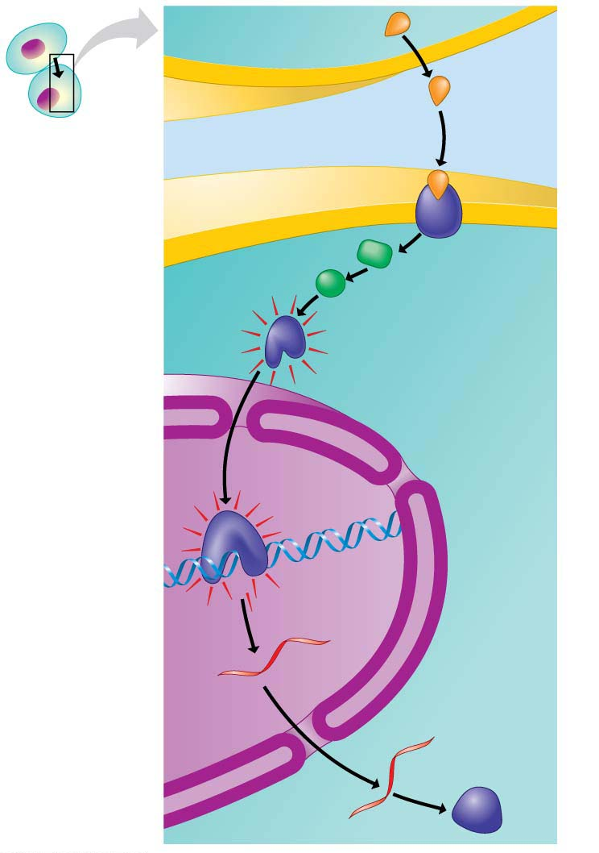
Figure 11.8
SIGNALING CELL
1
1
Signal
molecule
Plasma
membrane
2
2
3
3
4
4
Receptor
protein
TARGET
CELL
Relay
proteins
Transcription
factor
(activated)
Nucleus
5
5
Transcription
mRNA
New
protein
6
6
Translation
Notes:
Figure 11.8 A cell-signaling pathway that turns on a gene

Slide 68
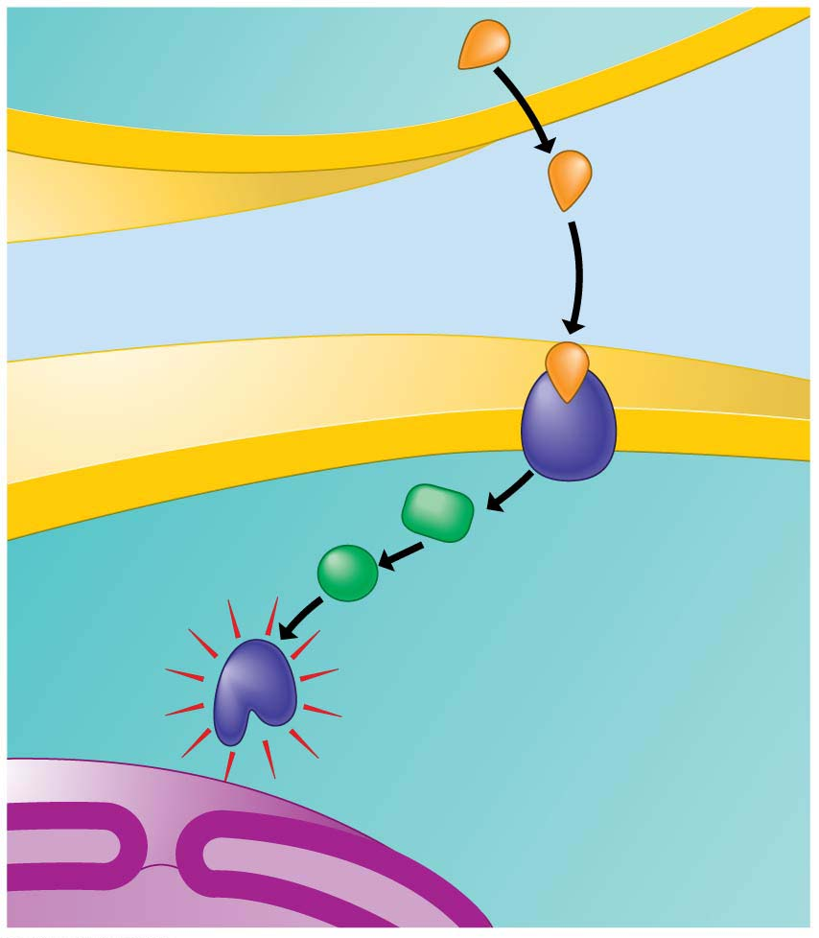
Figure 11.8-1
SIGNALING CELL
1
1
Signal
molecule
Plasma
membrane
2
3
4
Receptor
protein
TARGET
CELL
Relay
proteins
Transcription
factor
(activated)
Notes:
Figure 11.8-1 A cell-signaling pathway that turns on a gene (part 1: signal molecule to activated transcription factor)

Slide 69
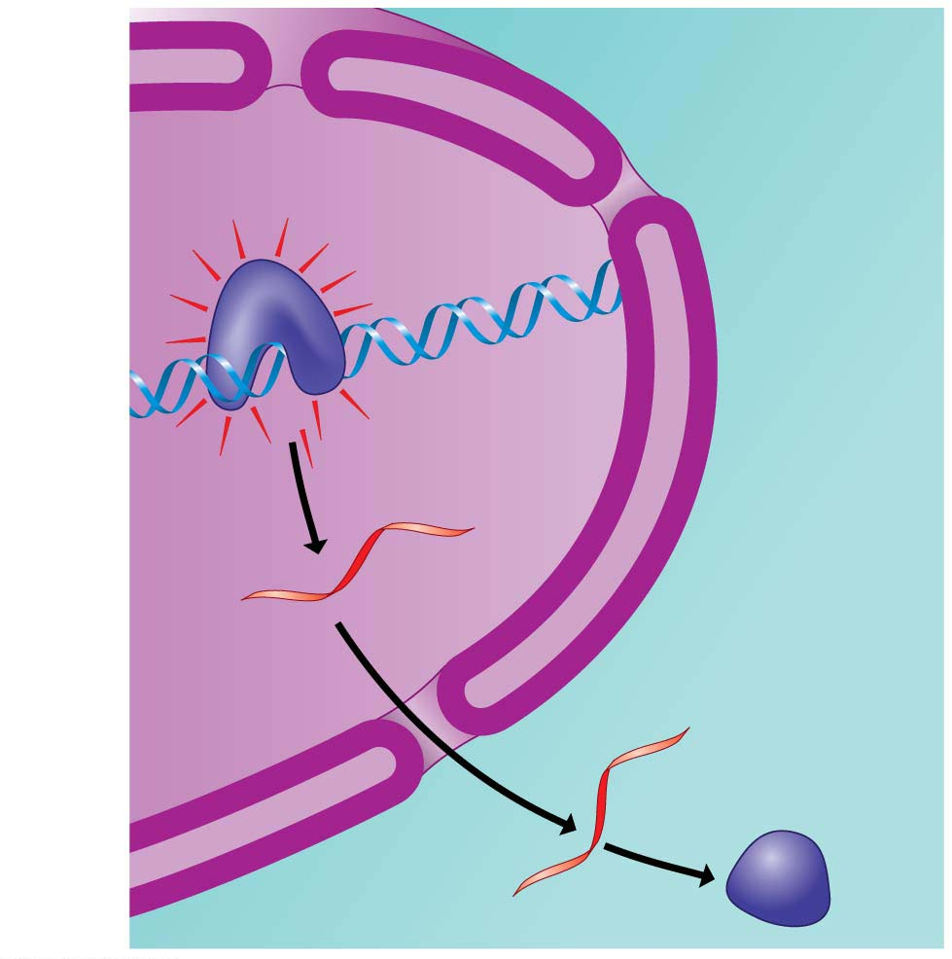
Figure 11.8-2
Nucleus
5
5
Transcription
mRNA
New
protein
6
6
Translation
Notes:
Figure 11.8-2 A cell-signaling pathway that turns on a gene (part 2: activated transcription factor to new protein)

Slide 70
Homeotic Genes
Master control genes called homeotic genes regulate groups of other genes that determine what body parts will develop in which locations.
Mutations in homeotic genes can produce bizarre effects. For example, fruit flies with mutations in homeotic genes may have extra sets of legs growing from their head (Figure 11.9).
Notes:
70
Student Misconceptions and Concerns
1. The broad concept of selective “reading” of the genetic code associated with differentiation and types of cellular activity can be missed when concentrating on the extensive details of regulation. Analogies, noted in the text and below in the teaching tips, can help students relate this overall selective process to their own experiences. Students already understand the selective reading of relevant chapters in textbooks and the selective referencing of product manuals to get answers to different questions. These experiences are similar in many ways to the broad processes of gene regulation.
2. The many levels of gene regulation in eukaryotic cells can be confusing and frustrating. The water pipe analogy depicted in Figure 11.3 can be a helpful reference to organize the potential sites of regulation.
Teaching Tips
1. Cellular differentiation is analogous to buying a book about how to build birdhouses and reading only the plans needed to build one particular model. Although the book contains directions to build many different birdhouses, you read and follow only the directions for the particular birdhouse you choose to build. The pages and directions for the other birdhouses remain intact. When cells differentiate, they read, or express, only the genes that are needed in that particular cell type.
2. A key advantage of an operon system is the ability to turn off or on a set of genes with a single “switch.” You can demonstrate this relationship in your classroom by turning off or on a set of lights with a single switch.
3. The authors develop an analogy between the regulation of transcription and the series of water pipes that carry water from your local water supply, perhaps a reservoir, to a faucet in your home. At various points, valves control the flow of water. Similarly, the expression of genes is controlled at many points along the process. Figure 11.3 illustrates the “flow” of genetic information from a chromosome—a reservoir of genetic information—to an active protein that has been made in the cell’s cytoplasm. The multiple mechanisms that control gene expression are analogous to the control valves in water pipes. In the figure, a possible control knob indicates each gene expression “valve.” In the figure, the large size of the transcription control knob highlights its crucial role.
4. Just as a folded map is difficult to read, DNA packaging tends to prevent gene “reading” or expression.
5. Just as boxes of your things that will be little used are packed deeper into a closet, attic, or basement, chromatin that is not expressed is highly compacted and is stored away.
6. Alternative RNA splicing is like remixing music to produce a new song or re-editing a movie for a different ending. You could have a little fun by challenging students to identify which category of the Academy Awards is most like alternative RNA splicing. (Answer: the award for best editing.)
7. The action of an extracellular signal reaching a cell’s surface is like pushing the doorbell at a home. The signal is converted to another form (pushing a button rings a bell) and activities change within the house as someone comes to answer the door.
8. Students might wonder why a patch of fur on the cat’s skin is all the same color in Figure 11.4, if every cell has an equal chance of being one of the two color forms. The answer is that X chromosome inactivation occurs early in development. Thus, the patch of one color represents the progeny of one embryonic cell after X chromosome inactivation.
9. Homeotic genes are often called “master control genes.” The relationship between homeotic genes and structural genes is like the relationship between a construction supervisor and the workers. Major rearrangements can result from a few simple changes in the directions for construction.
10. There is much hope for the use of DNA microarrays to refine cancer therapies. In the past, a diagnosis of cancer was too often met with general treatments that benefited only a fraction of the patients. Physicians were left to wonder why some people with breast cancer or lung cancer responded to therapy while others did not. DNA microarrays enable us to identify differences between patients with the same apparent type of cancer (breast, lung, prostate, and so on). Consider sharing this important avenue of hope. It is likely that some of your students will soon have a family member facing these battles.
Active Lecture Tips
1. The lactose operon is turned on by removing the repressor—a sort of double negative. Students might enjoy various analogies to other situations. Ask students in lecture to work in small groups to develop their own examples from life in which something occurs by a double negative. Share with them the common example “When the cat's away, the mice will play.” Then challenge them to each create a couple more. (Another example to consider: “Like a cat watching mice, if a mom keeps her kids away from cookies, but somebody occupies her attention, kids can sneak by and snatch some cookies. Thus, the person occupying Mom’s attention functions most like lactose binding to the repressor.”)

Slide 71
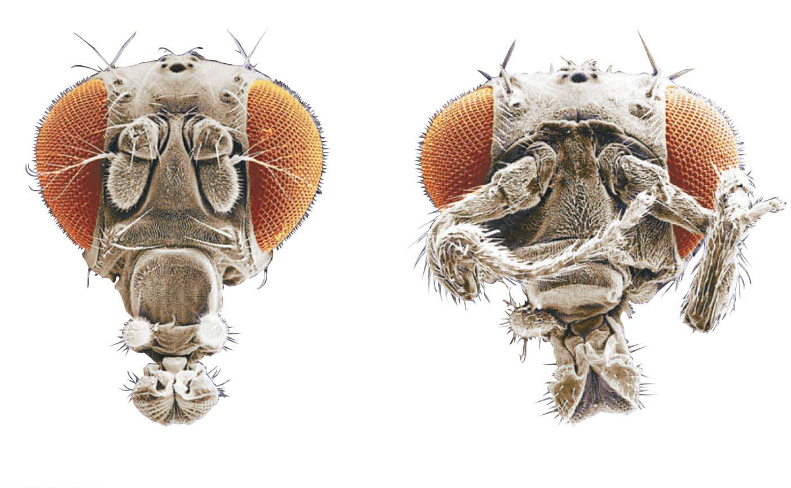
Figure 11.9
Antenna
Eye
Extra pair
of legs
Normal head due to presence
of normal homeotic gene
Head with extra legs growing due to
presence of mutant homeotic gene
Notes:
Figure 11.9 The effect of homeotic genes

Slide 72
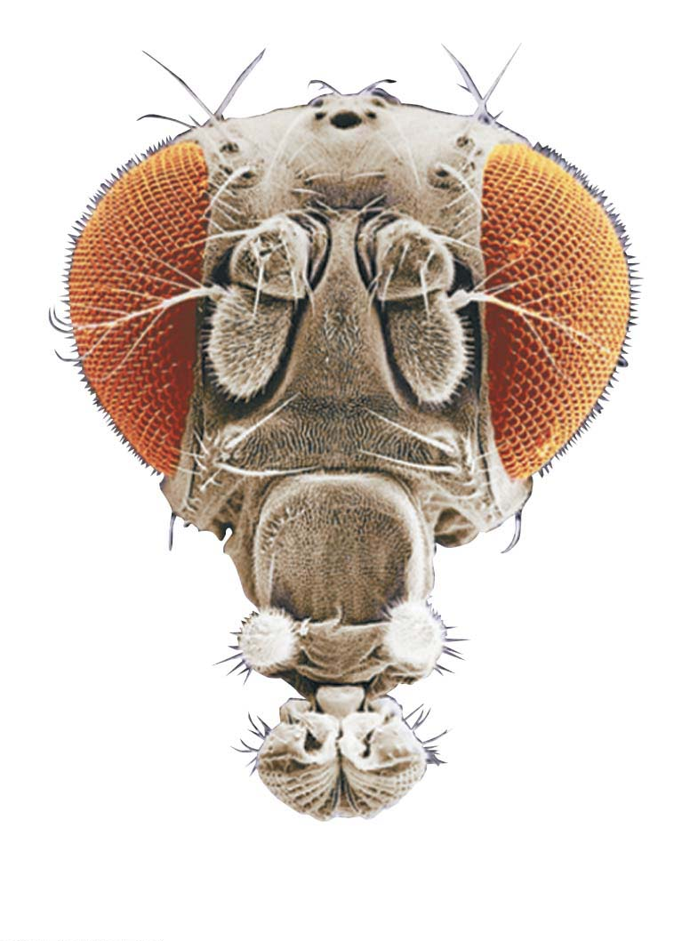
Figure 11.9-1
Antenna
Eye
Normal head due to presence
of normal homeotic gene
Notes:
Figure 11.9-1 The effect of homeotic genes (part 1: normal homeotic gene)

Slide 73
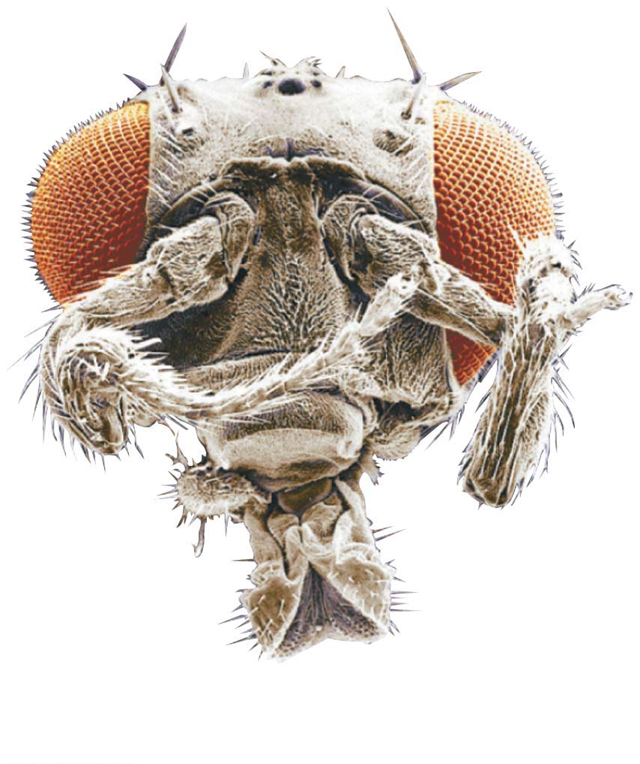
Figure 11.9-2
Extra pair
of legs
Head with extra legs growing due to
presence of mutant homeotic gene
Notes:
Figure 11.9-2 The effect of homeotic genes (part 2: mutant homeotic gene)

Slide 74
Homeotic Genes
Similar homeotic genes help direct embryonic development in nearly every eukaryotic organism examined so far, including yeasts, plants, earthworms, frogs, chickens, mice, and humans.
Notes:
74
Student Misconceptions and Concerns
1. The broad concept of selective “reading” of the genetic code associated with differentiation and types of cellular activity can be missed when concentrating on the extensive details of regulation. Analogies, noted in the text and below in the teaching tips, can help students relate this overall selective process to their own experiences. Students already understand the selective reading of relevant chapters in textbooks and the selective referencing of product manuals to get answers to different questions. These experiences are similar in many ways to the broad processes of gene regulation.
2. The many levels of gene regulation in eukaryotic cells can be confusing and frustrating. The water pipe analogy depicted in Figure 11.3 can be a helpful reference to organize the potential sites of regulation.
Teaching Tips
1. Cellular differentiation is analogous to buying a book about how to build birdhouses and reading only the plans needed to build one particular model. Although the book contains directions to build many different birdhouses, you read and follow only the directions for the particular birdhouse you choose to build. The pages and directions for the other birdhouses remain intact. When cells differentiate, they read, or express, only the genes that are needed in that particular cell type.
2. A key advantage of an operon system is the ability to turn off or on a set of genes with a single “switch.” You can demonstrate this relationship in your classroom by turning off or on a set of lights with a single switch.
3. The authors develop an analogy between the regulation of transcription and the series of water pipes that carry water from your local water supply, perhaps a reservoir, to a faucet in your home. At various points, valves control the flow of water. Similarly, the expression of genes is controlled at many points along the process. Figure 11.3 illustrates the “flow” of genetic information from a chromosome—a reservoir of genetic information—to an active protein that has been made in the cell’s cytoplasm. The multiple mechanisms that control gene expression are analogous to the control valves in water pipes. In the figure, a possible control knob indicates each gene expression “valve.” In the figure, the large size of the transcription control knob highlights its crucial role.
4. Just as a folded map is difficult to read, DNA packaging tends to prevent gene “reading” or expression.
5. Just as boxes of your things that will be little used are packed deeper into a closet, attic, or basement, chromatin that is not expressed is highly compacted and is stored away.
6. Alternative RNA splicing is like remixing music to produce a new song or re-editing a movie for a different ending. You could have a little fun by challenging students to identify which category of the Academy Awards is most like alternative RNA splicing. (Answer: the award for best editing.)
7. The action of an extracellular signal reaching a cell’s surface is like pushing the doorbell at a home. The signal is converted to another form (pushing a button rings a bell) and activities change within the house as someone comes to answer the door.
8. Students might wonder why a patch of fur on the cat’s skin is all the same color in Figure 11.4, if every cell has an equal chance of being one of the two color forms. The answer is that X chromosome inactivation occurs early in development. Thus, the patch of one color represents the progeny of one embryonic cell after X chromosome inactivation.
9. Homeotic genes are often called “master control genes.” The relationship between homeotic genes and structural genes is like the relationship between a construction supervisor and the workers. Major rearrangements can result from a few simple changes in the directions for construction.
10. There is much hope for the use of DNA microarrays to refine cancer therapies. In the past, a diagnosis of cancer was too often met with general treatments that benefited only a fraction of the patients. Physicians were left to wonder why some people with breast cancer or lung cancer responded to therapy while others did not. DNA microarrays enable us to identify differences between patients with the same apparent type of cancer (breast, lung, prostate, and so on). Consider sharing this important avenue of hope. It is likely that some of your students will soon have a family member facing these battles.
Active Lecture Tips
1. The lactose operon is turned on by removing the repressor—a sort of double negative. Students might enjoy various analogies to other situations. Ask students in lecture to work in small groups to develop their own examples from life in which something occurs by a double negative. Share with them the common example “When the cat's away, the mice will play.” Then challenge them to each create a couple more. (Another example to consider: “Like a cat watching mice, if a mom keeps her kids away from cookies, but somebody occupies her attention, kids can sneak by and snatch some cookies. Thus, the person occupying Mom’s attention functions most like lactose binding to the repressor.”)

Slide 75
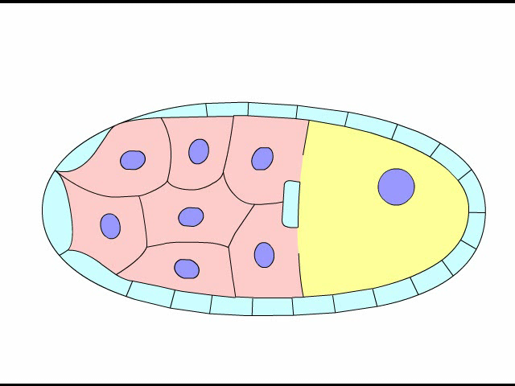
Animation: Development of Head-Tail Axis in Fruit Flies

Slide 76
DNA Microarrays: Visualizing Gene Expression
Scientists who study gene regulation often want to determine which genes are switched on or off in a particular cell.
  A DNA microarray is a glass slide with thousands
  of different kinds of single-stranded DNA fragments attached in a tightly spaced array (grid).
  Each DNA fragment is obtained from a particular gene; a single microarray thus carries DNA from thousands of genes, perhaps even all the genes of an organism.
  Figure 11.10 outlines how microarrays are used.
Notes:
76
Student Misconceptions and Concerns
1. The broad concept of selective “reading” of the genetic code associated with differentiation and types of cellular activity can be missed when concentrating on the extensive details of regulation. Analogies, noted in the text and below in the teaching tips, can help students relate this overall selective process to their own experiences. Students already understand the selective reading of relevant chapters in textbooks and the selective referencing of product manuals to get answers to different questions. These experiences are similar in many ways to the broad processes of gene regulation.
2. The many levels of gene regulation in eukaryotic cells can be confusing and frustrating. The water pipe analogy depicted in Figure 11.3 can be a helpful reference to organize the potential sites of regulation.
Teaching Tips
1. Cellular differentiation is analogous to buying a book about how to build birdhouses and reading only the plans needed to build one particular model. Although the book contains directions to build many different birdhouses, you read and follow only the directions for the particular birdhouse you choose to build. The pages and directions for the other birdhouses remain intact. When cells differentiate, they read, or express, only the genes that are needed in that particular cell type.
2. A key advantage of an operon system is the ability to turn off or on a set of genes with a single “switch.” You can demonstrate this relationship in your classroom by turning off or on a set of lights with a single switch.
3. The authors develop an analogy between the regulation of transcription and the series of water pipes that carry water from your local water supply, perhaps a reservoir, to a faucet in your home. At various points, valves control the flow of water. Similarly, the expression of genes is controlled at many points along the process. Figure 11.3 illustrates the “flow” of genetic information from a chromosome—a reservoir of genetic information—to an active protein that has been made in the cell’s cytoplasm. The multiple mechanisms that control gene expression are analogous to the control valves in water pipes. In the figure, a possible control knob indicates each gene expression “valve.” In the figure, the large size of the transcription control knob highlights its crucial role.
4. Just as a folded map is difficult to read, DNA packaging tends to prevent gene “reading” or expression.
5. Just as boxes of your things that will be little used are packed deeper into a closet, attic, or basement, chromatin that is not expressed is highly compacted and is stored away.
6. Alternative RNA splicing is like remixing music to produce a new song or re-editing a movie for a different ending. You could have a little fun by challenging students to identify which category of the Academy Awards is most like alternative RNA splicing. (Answer: the award for best editing.)
7. The action of an extracellular signal reaching a cell’s surface is like pushing the doorbell at a home. The signal is converted to another form (pushing a button rings a bell) and activities change within the house as someone comes to answer the door.
8. Students might wonder why a patch of fur on the cat’s skin is all the same color in Figure 11.4, if every cell has an equal chance of being one of the two color forms. The answer is that X chromosome inactivation occurs early in development. Thus, the patch of one color represents the progeny of one embryonic cell after X chromosome inactivation.
9. Homeotic genes are often called “master control genes.” The relationship between homeotic genes and structural genes is like the relationship between a construction supervisor and the workers. Major rearrangements can result from a few simple changes in the directions for construction.
10. There is much hope for the use of DNA microarrays to refine cancer therapies. In the past, a diagnosis of cancer was too often met with general treatments that benefited only a fraction of the patients. Physicians were left to wonder why some people with breast cancer or lung cancer responded to therapy while others did not. DNA microarrays enable us to identify differences between patients with the same apparent type of cancer (breast, lung, prostate, and so on). Consider sharing this important avenue of hope. It is likely that some of your students will soon have a family member facing these battles.
Active Lecture Tips
1. The lactose operon is turned on by removing the repressor—a sort of double negative. Students might enjoy various analogies to other situations. Ask students in lecture to work in small groups to develop their own examples from life in which something occurs by a double negative. Share with them the common example “When the cat's away, the mice will play.” Then challenge them to each create a couple more. (Another example to consider: “Like a cat watching mice, if a mom keeps her kids away from cookies, but somebody occupies her attention, kids can sneak by and snatch some cookies. Thus, the person occupying Mom’s attention functions most like lactose binding to the repressor.”)

Slide 77
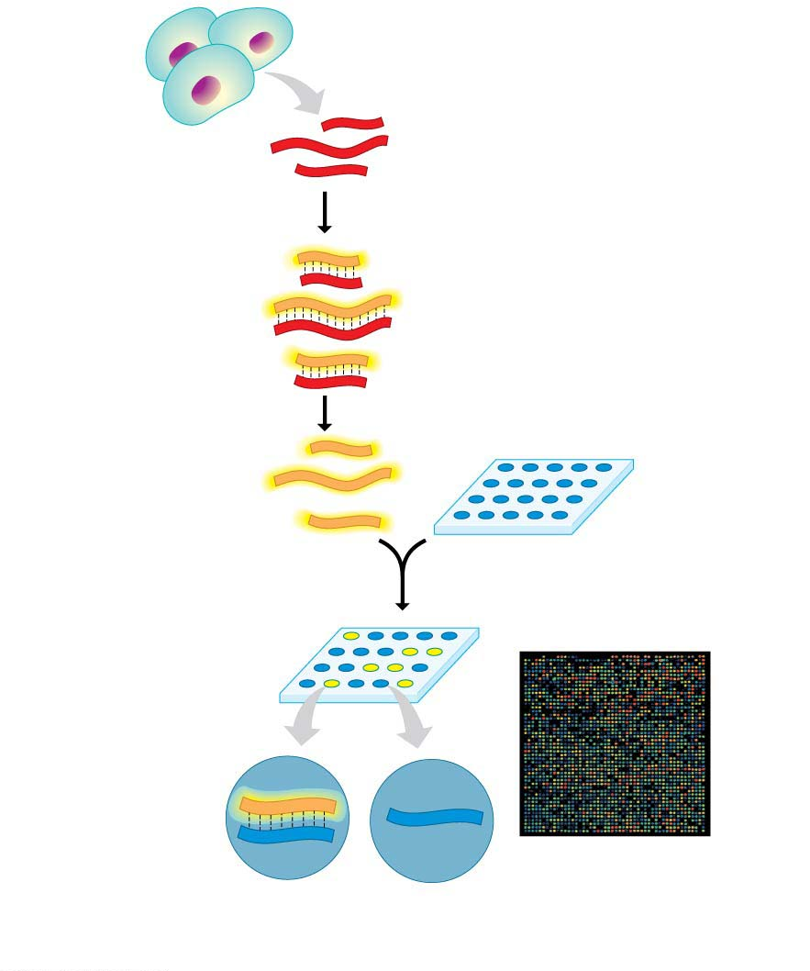
Figure 11.10
1
mRNA isolated
Reverse transcriptase combined
with fluorescent DNA nucleotides
2
cDNA made
from mRNA
Fluorescent cDNA
DNA microarray
(each spot contains
DNA from a particular gene)
3
cDNA mixture
added to spots
4
Unbound cDNA
rinsed away
Nonfluorescent spot
Fluorescent
spot
Fluorescent
cDNA
DNA microarray
(6,400 genes)
DNA of an
expressed gene
DNA of an
unexpressed gene
Notes:
Figure 11.10 Visualizing gene expression using a DNA microarray

Slide 78
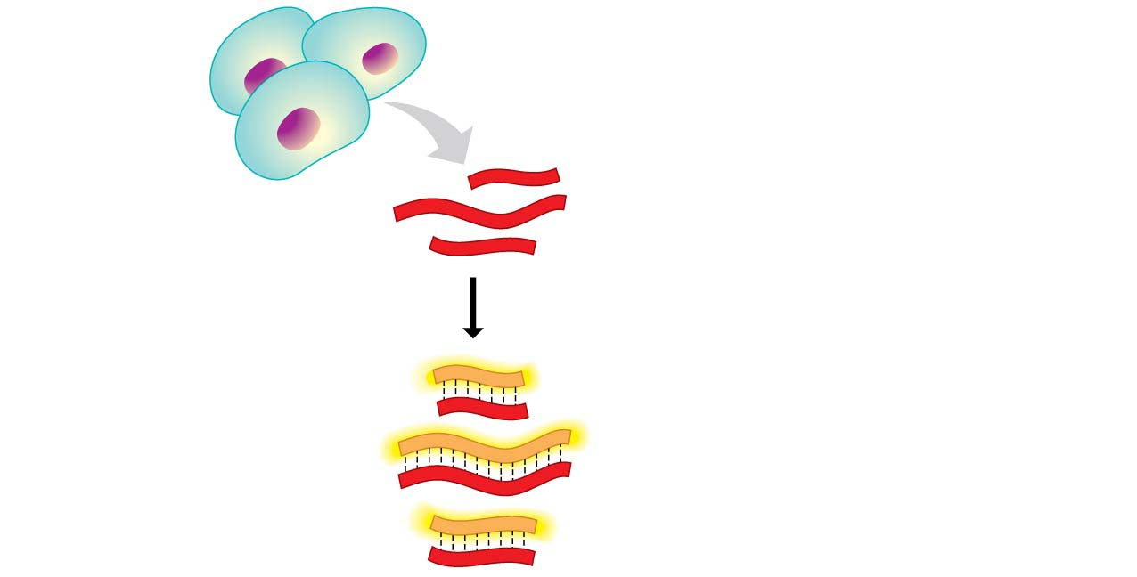
Figure 11.10-1
1
mRNA isolated
Reverse transcriptase combined
with fluorescent DNA nucleotides
2
cDNA made
from mRNA
Fluorescent cDNA
Notes:
Figure 11.10-1 Visualizing gene expression using a DNA microarray (part 1: cDNA from mRNA)

Slide 79
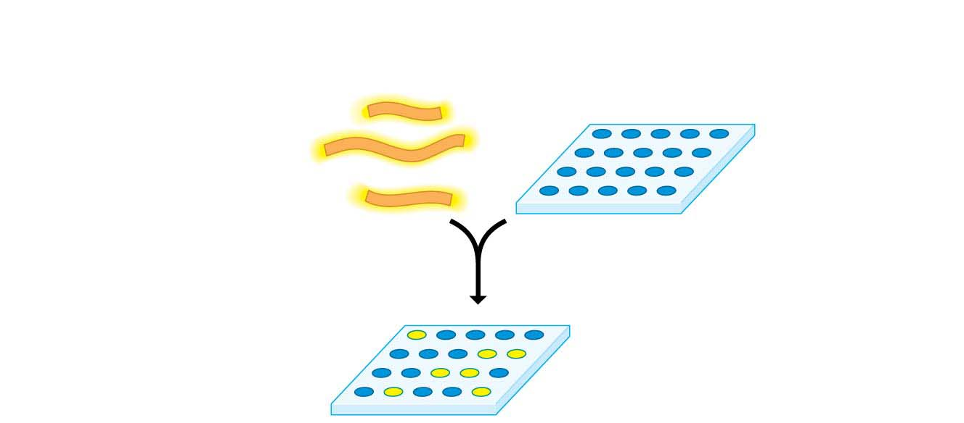
Figure 11.10-2
DNA microarray
(each spot contains
DNA from a particular gene)
3
cDNA mixture
added to spots
4
Unbound cDNA
rinsed away
Nonfluorescent spot
Fluorescent
spot
Notes:
Figure 11.10-2 Visualizing gene expression using a DNA microarray (part 2: cDNA added to microarray)

Slide 80
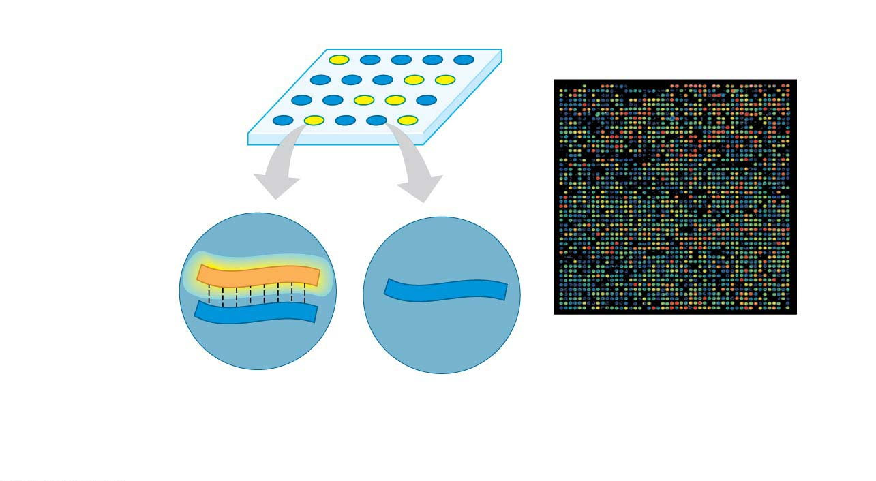
Figure 11.10-3
Nonfluorescent spot
Fluorescent
spot
Fluorescent
cDNA
DNA microarray
(6,400 genes)
DNA of an
expressed gene
DNA of an
unexpressed gene
Notes:
Figure 11.10-3 Visualizing gene expression using a DNA microarray (part 3: results)

Slide 81
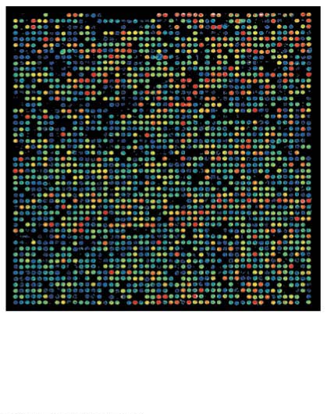
Figure 11.10-4
DNA microarray
(6,400 genes)
Notes:
Figure 11.10-4 Visualizing gene expression using a DNA microarray (part 4: microarray photo)

Slide 82
Cloning Plants and Animals
Gene regulation affects two important processes:
  cloning and
  cancer.
Notes:
82
Student Misconceptions and Concerns
1. Students often fail to see the similarities between identical twins and cloning. Each process produces multiple individuals with identical nuclear genetic material.
2. Students often assume that clones will appear and act identically. This misunderstanding provides an opportunity to discuss the important influence of the environment in shaping the final phenotype.
3. Students might not immediately understand why reproductive cloning is necessary to transmit specific traits in farm animals. They may fail to realize that unlike cloning, sexual reproduction mixes the genetic material and may not produce offspring with the desired trait(s).
Teaching Tips
1. The researchers who cloned Dolly the sheep from a mammary gland cell named Dolly after the celebrity Dolly Parton.
2. An even more remarkable aspect of salamander limb regeneration is that only the missing limb segments are regenerated. If an arm is amputated at the elbow, only the forearm, wrist, and hand are regenerated.
3. Preimplantation genetic diagnosis (PGD) is a genetic screening technique that removes one or two cells from an embryo at about the 6- to 10-cell stage. The cells that are removed are genetically analyzed, whereas the remaining embryonic cell mass retains the potential to develop into a normal individual. This technique permits embryos to be genetically screened before implanting them into a woman. However, PGD has another potential use. Researchers can use PGD to obtain embryonic stem cells without destroying a human embryo. This procedure might be more acceptable than methods that destroy the embryo to obtain embryonic stem cells.
4. The transplantation of pig or other nonhuman tissues into humans (called xenotransplantation) risks the introduction of pig (or other animal) viruses into humans. This viral DNA might not otherwise have the capacity for transmission to humans.
5. Political restrictions on the use of federal funds to study stem cells from various sources illustrate the influence of society on the directions of science. As time permits, consider opportunities to discuss or investigate this and other ways that science and society interact.
Active Lecture Tips
1. Cloning and reproductive technologies raise many ethical questions. To help students begin to consider these issues, consider asking students in class to form small groups with nearby students to consider one of these issues. For example, (1) Is it acceptable to use these technologies to determine the sex of our children, implanting only embryos of a certain sex? (2) Is it acceptable to clone ourselves to produce cultures of replacement tissues to treat damage or disease? (3) Should federal money be spent on research using human ES cells? And does it matter if the ES cells come from embryos that (a) remain viable or (b) were destroyed to produce ES cells?

Slide 83
The Genetic Potential of Cells
All body cells contain a complete complement of genes, even if they are not expressing all of them.
A single differentiated plant cell can undergo cell division and give rise to a complete adult plant.
On a larger scale, the technique described in Figure 11.11 can be used to produce hundreds or thousands of genetically identical organisms—clones—from the cells of a single plant.
Notes:
83
Student Misconceptions and Concerns
1. Students often fail to see the similarities between identical twins and cloning. Each process produces multiple individuals with identical nuclear genetic material.
2. Students often assume that clones will appear and act identically. This misunderstanding provides an opportunity to discuss the important influence of the environment in shaping the final phenotype.
3. Students might not immediately understand why reproductive cloning is necessary to transmit specific traits in farm animals. They may fail to realize that unlike cloning, sexual reproduction mixes the genetic material and may not produce offspring with the desired trait(s).
Teaching Tips
1. The researchers who cloned Dolly the sheep from a mammary gland cell named Dolly after the celebrity Dolly Parton.
2. An even more remarkable aspect of salamander limb regeneration is that only the missing limb segments are regenerated. If an arm is amputated at the elbow, only the forearm, wrist, and hand are regenerated.
3. Preimplantation genetic diagnosis (PGD) is a genetic screening technique that removes one or two cells from an embryo at about the 6- to 10-cell stage. The cells that are removed are genetically analyzed, whereas the remaining embryonic cell mass retains the potential to develop into a normal individual. This technique permits embryos to be genetically screened before implanting them into a woman. However, PGD has another potential use. Researchers can use PGD to obtain embryonic stem cells without destroying a human embryo. This procedure might be more acceptable than methods that destroy the embryo to obtain embryonic stem cells.
4. The transplantation of pig or other nonhuman tissues into humans (called xenotransplantation) risks the introduction of pig (or other animal) viruses into humans. This viral DNA might not otherwise have the capacity for transmission to humans.
5. Political restrictions on the use of federal funds to study stem cells from various sources illustrate the influence of society on the directions of science. As time permits, consider opportunities to discuss or investigate this and other ways that science and society interact.
Active Lecture Tips
1. Cloning and reproductive technologies raise many ethical questions. To help students begin to consider these issues, consider asking students in class to form small groups with nearby students to consider one of these issues. For example, (1) Is it acceptable to use these technologies to determine the sex of our children, implanting only embryos of a certain sex? (2) Is it acceptable to clone ourselves to produce cultures of replacement tissues to treat damage or disease? (3) Should federal money be spent on research using human ES cells? And does it matter if the ES cells come from embryos that (a) remain viable or (b) were destroyed to produce ES cells?

Slide 84
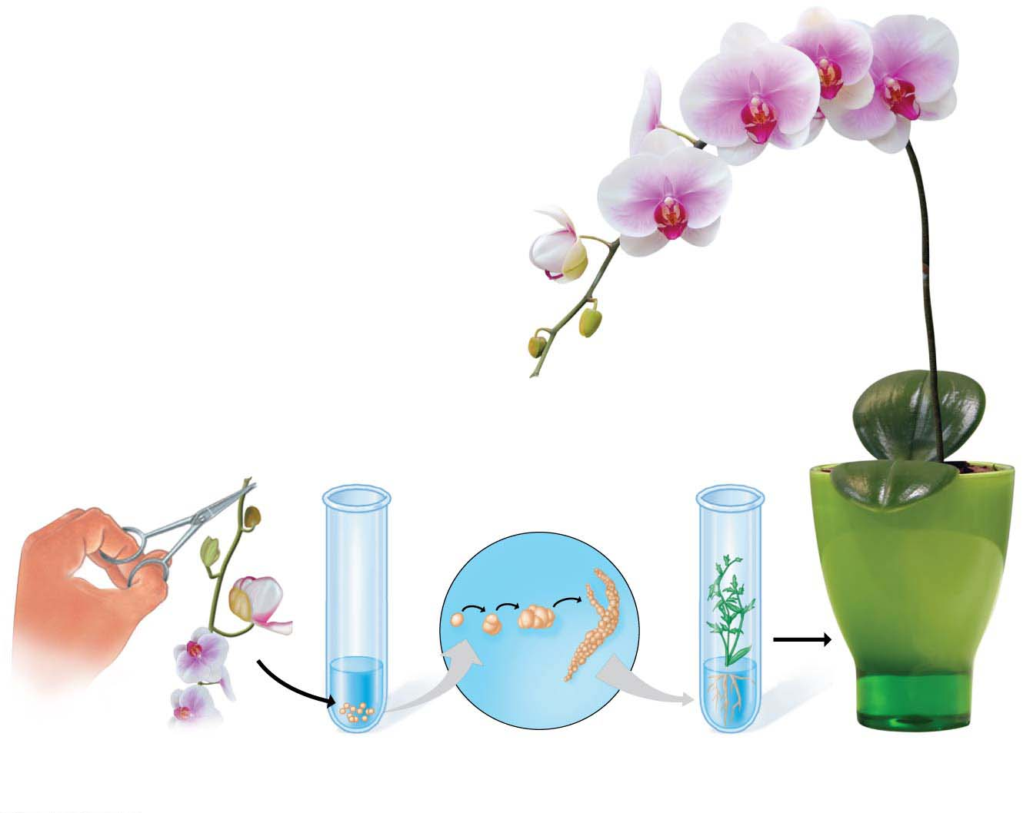
Figure 11.11
Single
cell
Cells removed
from orchid plant
Cells in growth
medium
Cell division
in culture
Young plant
Adult plant
Notes:
Figure 11.11 Test-tube cloning of an orchid

Slide 85
The Genetic Potential of Cells
Plant cloning is now used extensively in agriculture.
  For some plants, such as orchids, cloning is the only commercially practical means of reproducing plants.
  In other cases, cloning has been used to reproduce a plant with specific desirable traits, such as high fruit yield or resistance to disease.
  Seedless plants (such as seedless grapes, watermelons, and oranges) cannot reproduce sexually, leaving cloning as the sole means of mass-producing these common foods.
Notes:
85
Student Misconceptions and Concerns
1. Students often fail to see the similarities between identical twins and cloning. Each process produces multiple individuals with identical nuclear genetic material.
2. Students often assume that clones will appear and act identically. This misunderstanding provides an opportunity to discuss the important influence of the environment in shaping the final phenotype.
3. Students might not immediately understand why reproductive cloning is necessary to transmit specific traits in farm animals. They may fail to realize that unlike cloning, sexual reproduction mixes the genetic material and may not produce offspring with the desired trait(s).
Teaching Tips
1. The researchers who cloned Dolly the sheep from a mammary gland cell named Dolly after the celebrity Dolly Parton.
2. An even more remarkable aspect of salamander limb regeneration is that only the missing limb segments are regenerated. If an arm is amputated at the elbow, only the forearm, wrist, and hand are regenerated.
3. Preimplantation genetic diagnosis (PGD) is a genetic screening technique that removes one or two cells from an embryo at about the 6- to 10-cell stage. The cells that are removed are genetically analyzed, whereas the remaining embryonic cell mass retains the potential to develop into a normal individual. This technique permits embryos to be genetically screened before implanting them into a woman. However, PGD has another potential use. Researchers can use PGD to obtain embryonic stem cells without destroying a human embryo. This procedure might be more acceptable than methods that destroy the embryo to obtain embryonic stem cells.
4. The transplantation of pig or other nonhuman tissues into humans (called xenotransplantation) risks the introduction of pig (or other animal) viruses into humans. This viral DNA might not otherwise have the capacity for transmission to humans.
5. Political restrictions on the use of federal funds to study stem cells from various sources illustrate the influence of society on the directions of science. As time permits, consider opportunities to discuss or investigate this and other ways that science and society interact.
Active Lecture Tips
1. Cloning and reproductive technologies raise many ethical questions. To help students begin to consider these issues, consider asking students in class to form small groups with nearby students to consider one of these issues. For example, (1) Is it acceptable to use these technologies to determine the sex of our children, implanting only embryos of a certain sex? (2) Is it acceptable to clone ourselves to produce cultures of replacement tissues to treat damage or disease? (3) Should federal money be spent on research using human ES cells? And does it matter if the ES cells come from embryos that (a) remain viable or (b) were destroyed to produce ES cells?

Slide 86
The Genetic Potential of Cells
Regeneration is the regrowth of lost body parts.
  When a salamander loses a leg, certain cells in the leg stump reverse their differentiated state, divide, and then differentiate again to give rise to a new leg.
  Many other animals, especially among the invertebrates, can regenerate lost parts.
  Isolated pieces of a few relatively simple animals can dedifferentiate and then develop into an entirely new organism.
Notes:
86
Student Misconceptions and Concerns
1. Students often fail to see the similarities between identical twins and cloning. Each process produces multiple individuals with identical nuclear genetic material.
2. Students often assume that clones will appear and act identically. This misunderstanding provides an opportunity to discuss the important influence of the environment in shaping the final phenotype.
3. Students might not immediately understand why reproductive cloning is necessary to transmit specific traits in farm animals. They may fail to realize that unlike cloning, sexual reproduction mixes the genetic material and may not produce offspring with the desired trait(s).
Teaching Tips
1. The researchers who cloned Dolly the sheep from a mammary gland cell named Dolly after the celebrity Dolly Parton.
2. An even more remarkable aspect of salamander limb regeneration is that only the missing limb segments are regenerated. If an arm is amputated at the elbow, only the forearm, wrist, and hand are regenerated.
3. Preimplantation genetic diagnosis (PGD) is a genetic screening technique that removes one or two cells from an embryo at about the 6- to 10-cell stage. The cells that are removed are genetically analyzed, whereas the remaining embryonic cell mass retains the potential to develop into a normal individual. This technique permits embryos to be genetically screened before implanting them into a woman. However, PGD has another potential use. Researchers can use PGD to obtain embryonic stem cells without destroying a human embryo. This procedure might be more acceptable than methods that destroy the embryo to obtain embryonic stem cells.
4. The transplantation of pig or other nonhuman tissues into humans (called xenotransplantation) risks the introduction of pig (or other animal) viruses into humans. This viral DNA might not otherwise have the capacity for transmission to humans.
5. Political restrictions on the use of federal funds to study stem cells from various sources illustrate the influence of society on the directions of science. As time permits, consider opportunities to discuss or investigate this and other ways that science and society interact.
Active Lecture Tips
1. Cloning and reproductive technologies raise many ethical questions. To help students begin to consider these issues, consider asking students in class to form small groups with nearby students to consider one of these issues. For example, (1) Is it acceptable to use these technologies to determine the sex of our children, implanting only embryos of a certain sex? (2) Is it acceptable to clone ourselves to produce cultures of replacement tissues to treat damage or disease? (3) Should federal money be spent on research using human ES cells? And does it matter if the ES cells come from embryos that (a) remain viable or (b) were destroyed to produce ES cells?

Slide 87
Reproductive Cloning of Animals
Nuclear transplantation involves replacing the nucleus of an egg cell or a zygote with a nucleus removed from an adult body cell.
  If the animal to be cloned is a mammal, further development requires implanting the early embryo into the uterus of a surrogate mother.
  This type of cloning is called reproductive cloning because it results in the birth of a new animal.
Notes:
87
Student Misconceptions and Concerns
1. Students often fail to see the similarities between identical twins and cloning. Each process produces multiple individuals with identical nuclear genetic material.
2. Students often assume that clones will appear and act identically. This misunderstanding provides an opportunity to discuss the important influence of the environment in shaping the final phenotype.
3. Students might not immediately understand why reproductive cloning is necessary to transmit specific traits in farm animals. They may fail to realize that unlike cloning, sexual reproduction mixes the genetic material and may not produce offspring with the desired trait(s).
Teaching Tips
1. The researchers who cloned Dolly the sheep from a mammary gland cell named Dolly after the celebrity Dolly Parton.
2. An even more remarkable aspect of salamander limb regeneration is that only the missing limb segments are regenerated. If an arm is amputated at the elbow, only the forearm, wrist, and hand are regenerated.
3. Preimplantation genetic diagnosis (PGD) is a genetic screening technique that removes one or two cells from an embryo at about the 6- to 10-cell stage. The cells that are removed are genetically analyzed, whereas the remaining embryonic cell mass retains the potential to develop into a normal individual. This technique permits embryos to be genetically screened before implanting them into a woman. However, PGD has another potential use. Researchers can use PGD to obtain embryonic stem cells without destroying a human embryo. This procedure might be more acceptable than methods that destroy the embryo to obtain embryonic stem cells.
4. The transplantation of pig or other nonhuman tissues into humans (called xenotransplantation) risks the introduction of pig (or other animal) viruses into humans. This viral DNA might not otherwise have the capacity for transmission to humans.
5. Political restrictions on the use of federal funds to study stem cells from various sources illustrate the influence of society on the directions of science. As time permits, consider opportunities to discuss or investigate this and other ways that science and society interact.
Active Lecture Tips
1. Cloning and reproductive technologies raise many ethical questions. To help students begin to consider these issues, consider asking students in class to form small groups with nearby students to consider one of these issues. For example, (1) Is it acceptable to use these technologies to determine the sex of our children, implanting only embryos of a certain sex? (2) Is it acceptable to clone ourselves to produce cultures of replacement tissues to treat damage or disease? (3) Should federal money be spent on research using human ES cells? And does it matter if the ES cells come from embryos that (a) remain viable or (b) were destroyed to produce ES cells?

Slide 88
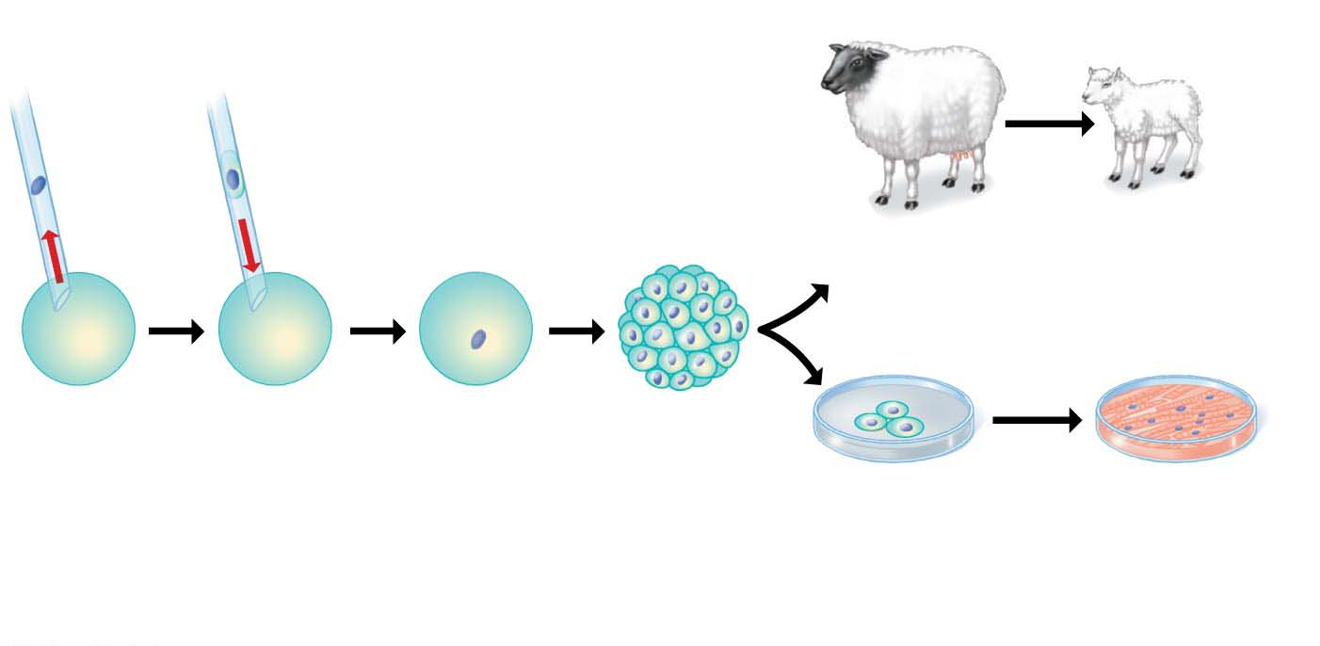
Figure 11.12
Reproductive cloning
Donor
cell
Nucleus from
donor cell
Implant embryo in
surrogate mother
Clone of
donor is born
Therapeutic cloning
Remove
nucleus
from
egg cell
Add somatic
cell from
adult donor
Grow in culture
to produce a
ball of cells
Remove embryonic
stem cells from
embryo and
grow in culture
Induce stem
cells to form
specialized cells
for therapeutic
use
Notes:
Figure 11.12 Cloning by nuclear transplantation

Slide 89
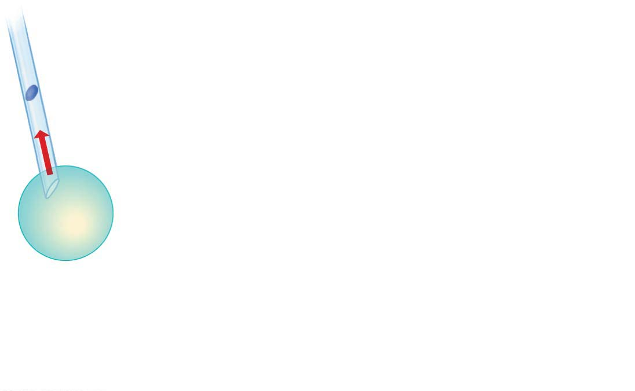
Figure 11.12-1-s1
Remove
nucleus
from
egg cell
Notes:
Figure 11.12-1-s1 Cloning by nuclear transplantation (part 1, step 1)

Slide 90
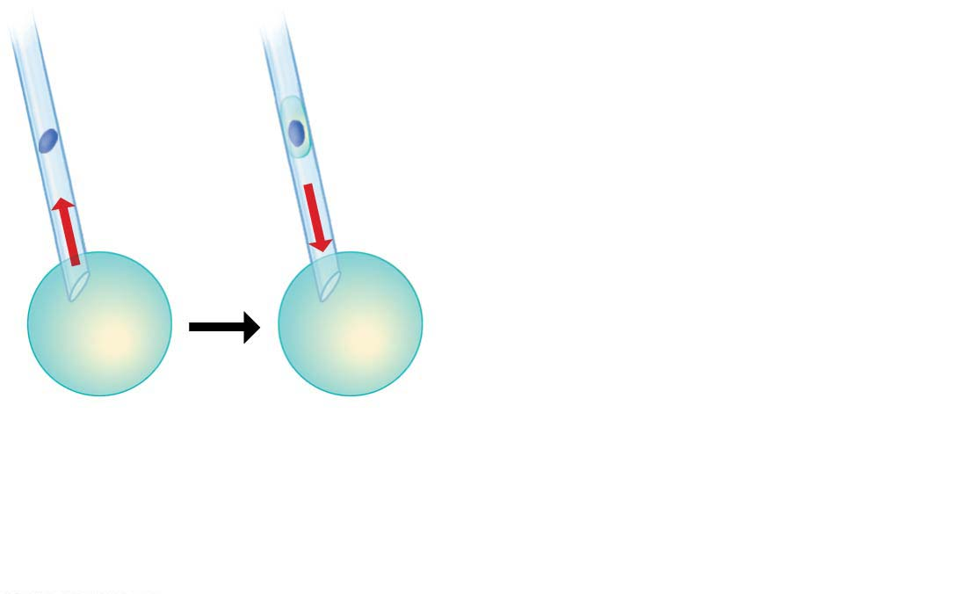
Figure 11.12-1-s2
Donor
cell
Remove
nucleus
from
egg cell
Add somatic
cell from
adult donor
Notes:
Figure 11.12-1-s2 Cloning by nuclear transplantation (part 1, step 2)

Slide 91
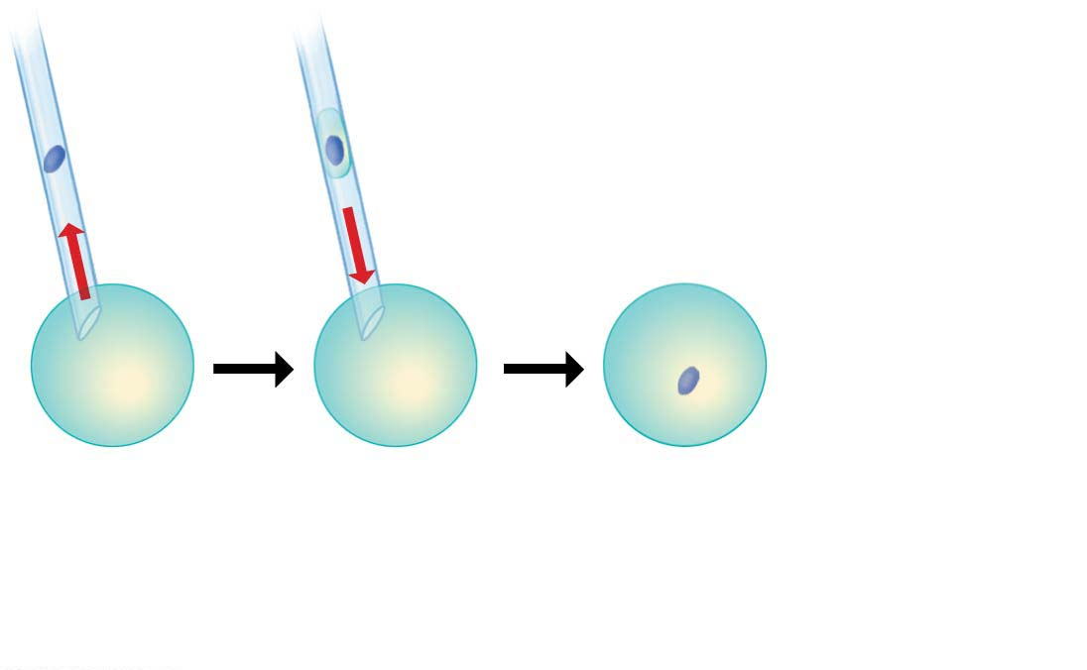
Figure 11.12-1-s3
Donor
cell
Nucleus from
donor cell
Remove
nucleus
from
egg cell
Add somatic
cell from
adult donor
Notes:
Figure 11.12-1-s3 Cloning by nuclear transplantation (part 1, step 3)

Slide 92
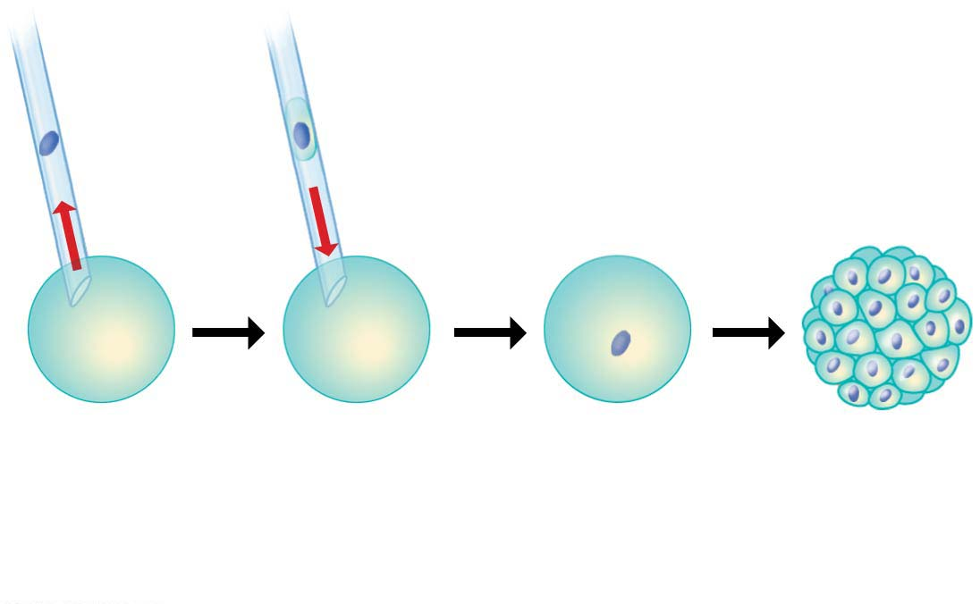
Figure 11.12-1-s4
Donor
cell
Nucleus from
donor cell
Remove
nucleus
from
egg cell
Add somatic
cell from
adult donor
Grow in culture
to produce a
ball of cells
Notes:
Figure 11.12-1-s4 Cloning by nuclear transplantation (part 1, step 4)

Slide 93
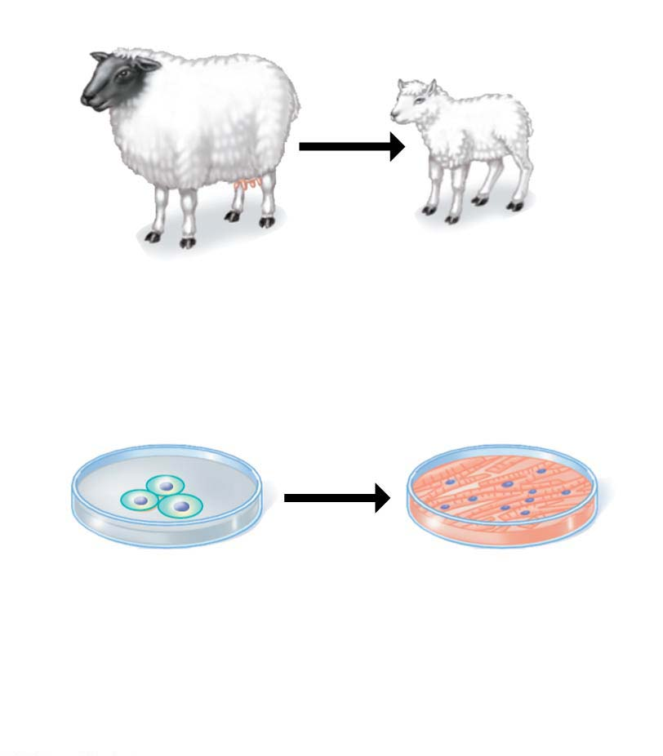
Figure 11.12-2
Reproductive cloning
Implant embryo in
surrogate mother
Clone of
donor is born
Therapeutic cloning
Remove embryonic
stem cells from
embryo and
grow in culture
Induce stem
cells to form
specialized cells
for therapeutic
use
Notes:
Figure 11.12-2 Cloning by nuclear transplantation (part 2)

Slide 94
Reproductive Cloning of Animals
In 1996, researchers used reproductive cloning to produce the first mammal cloned from an adult cell, a sheep named Dolly.
  The researchers fused specially treated sheep cells with eggs from which they had removed the nuclei.
  After several days of growth, the resulting embryos were implanted in the uteruses of surrogate mothers.
  One of the embryos developed into Dolly—and as expected, Dolly resembled the nucleus donor, not the egg donor or the surrogate mother.
Notes:
94
Student Misconceptions and Concerns
1. Students often fail to see the similarities between identical twins and cloning. Each process produces multiple individuals with identical nuclear genetic material.
2. Students often assume that clones will appear and act identically. This misunderstanding provides an opportunity to discuss the important influence of the environment in shaping the final phenotype.
3. Students might not immediately understand why reproductive cloning is necessary to transmit specific traits in farm animals. They may fail to realize that unlike cloning, sexual reproduction mixes the genetic material and may not produce offspring with the desired trait(s).
Teaching Tips
1. The researchers who cloned Dolly the sheep from a mammary gland cell named Dolly after the celebrity Dolly Parton.
2. An even more remarkable aspect of salamander limb regeneration is that only the missing limb segments are regenerated. If an arm is amputated at the elbow, only the forearm, wrist, and hand are regenerated.
3. Preimplantation genetic diagnosis (PGD) is a genetic screening technique that removes one or two cells from an embryo at about the 6- to 10-cell stage. The cells that are removed are genetically analyzed, whereas the remaining embryonic cell mass retains the potential to develop into a normal individual. This technique permits embryos to be genetically screened before implanting them into a woman. However, PGD has another potential use. Researchers can use PGD to obtain embryonic stem cells without destroying a human embryo. This procedure might be more acceptable than methods that destroy the embryo to obtain embryonic stem cells.
4. The transplantation of pig or other nonhuman tissues into humans (called xenotransplantation) risks the introduction of pig (or other animal) viruses into humans. This viral DNA might not otherwise have the capacity for transmission to humans.
5. Political restrictions on the use of federal funds to study stem cells from various sources illustrate the influence of society on the directions of science. As time permits, consider opportunities to discuss or investigate this and other ways that science and society interact.
Active Lecture Tips
1. Cloning and reproductive technologies raise many ethical questions. To help students begin to consider these issues, consider asking students in class to form small groups with nearby students to consider one of these issues. For example, (1) Is it acceptable to use these technologies to determine the sex of our children, implanting only embryos of a certain sex? (2) Is it acceptable to clone ourselves to produce cultures of replacement tissues to treat damage or disease? (3) Should federal money be spent on research using human ES cells? And does it matter if the ES cells come from embryos that (a) remain viable or (b) were destroyed to produce ES cells?

Slide 95
Practical Applications of Reproductive Cloning
Since the first success in 1996, researchers have cloned many species of mammals, including mice, horses, dogs, mules, cows, pigs, rabbits, ferrets, camels, goats, and cats.
Notes:
95
Student Misconceptions and Concerns
1. Students often fail to see the similarities between identical twins and cloning. Each process produces multiple individuals with identical nuclear genetic material.
2. Students often assume that clones will appear and act identically. This misunderstanding provides an opportunity to discuss the important influence of the environment in shaping the final phenotype.
3. Students might not immediately understand why reproductive cloning is necessary to transmit specific traits in farm animals. They may fail to realize that unlike cloning, sexual reproduction mixes the genetic material and may not produce offspring with the desired trait(s).
Teaching Tips
1. The researchers who cloned Dolly the sheep from a mammary gland cell named Dolly after the celebrity Dolly Parton.
2. An even more remarkable aspect of salamander limb regeneration is that only the missing limb segments are regenerated. If an arm is amputated at the elbow, only the forearm, wrist, and hand are regenerated.
3. Preimplantation genetic diagnosis (PGD) is a genetic screening technique that removes one or two cells from an embryo at about the 6- to 10-cell stage. The cells that are removed are genetically analyzed, whereas the remaining embryonic cell mass retains the potential to develop into a normal individual. This technique permits embryos to be genetically screened before implanting them into a woman. However, PGD has another potential use. Researchers can use PGD to obtain embryonic stem cells without destroying a human embryo. This procedure might be more acceptable than methods that destroy the embryo to obtain embryonic stem cells.
4. The transplantation of pig or other nonhuman tissues into humans (called xenotransplantation) risks the introduction of pig (or other animal) viruses into humans. This viral DNA might not otherwise have the capacity for transmission to humans.
5. Political restrictions on the use of federal funds to study stem cells from various sources illustrate the influence of society on the directions of science. As time permits, consider opportunities to discuss or investigate this and other ways that science and society interact.
Active Lecture Tips
1. Cloning and reproductive technologies raise many ethical questions. To help students begin to consider these issues, consider asking students in class to form small groups with nearby students to consider one of these issues. For example, (1) Is it acceptable to use these technologies to determine the sex of our children, implanting only embryos of a certain sex? (2) Is it acceptable to clone ourselves to produce cultures of replacement tissues to treat damage or disease? (3) Should federal money be spent on research using human ES cells? And does it matter if the ES cells come from embryos that (a) remain viable or (b) were destroyed to produce ES cells?

Slide 96
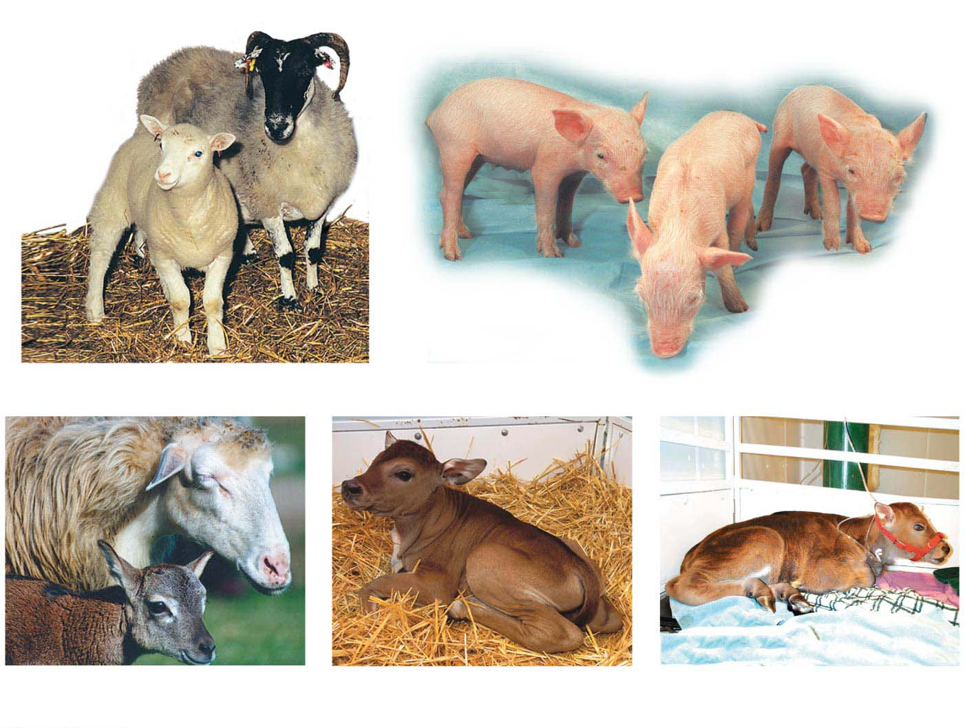
Figure 11.13
(a) The first clone
(b) Cloning for medical use
(c) Clones of endangered animals
Mouflon lamb with
mother
Banteng
Gaur
Notes:
Figure 11.13 Reproductive cloning of mammals

Slide 97

Figure 11.13-1
(a) The first clone
Notes:
Figure 11.13-1 Reproductive cloning of mammals (part 1: the first clone, Dolly)

Slide 98

Figure 11.13-2
(b) Cloning for medical use
Notes:
Figure 11.13-2 Reproductive cloning of mammals (part 2: cloning for medical use, piglets)

Slide 99

Figure 11.13-3
(c) Clones of endangered animals
Mouflon lamb with mother
Notes:
Figure 11.13-3 Reproductive cloning of mammals (part 3: clones of endangered animals, mouflon lamb)

Slide 100

Figure 11.13-4
(c) Clones of endangered animals
Banteng
Notes:
Figure 11.13-4 Reproductive cloning of mammals (part 4: clones of endangered animals, banteng)

Slide 101

Figure 11.13-5
(c) Clones of endangered animals
Gaur
Notes:
Figure 11.13-5 Reproductive cloning of mammals (part 5: clones of endangered animals, gaur)

Slide 102
Practical Applications of Reproductive Cloning
Why is reproductive cloning used?
  In agriculture, farm animals with specific sets of desirable traits might be cloned to produce identical herds.
  In research, genetically identical animals can provide perfect “control animals” for experiments.
  Reproductive cloning is used to restock populations of endangered animals.
Notes:
102
Student Misconceptions and Concerns
1. Students often fail to see the similarities between identical twins and cloning. Each process produces multiple individuals with identical nuclear genetic material.
2. Students often assume that clones will appear and act identically. This misunderstanding provides an opportunity to discuss the important influence of the environment in shaping the final phenotype.
3. Students might not immediately understand why reproductive cloning is necessary to transmit specific traits in farm animals. They may fail to realize that unlike cloning, sexual reproduction mixes the genetic material and may not produce offspring with the desired trait(s).
Teaching Tips
1. The researchers who cloned Dolly the sheep from a mammary gland cell named Dolly after the celebrity Dolly Parton.
2. An even more remarkable aspect of salamander limb regeneration is that only the missing limb segments are regenerated. If an arm is amputated at the elbow, only the forearm, wrist, and hand are regenerated.
3. Preimplantation genetic diagnosis (PGD) is a genetic screening technique that removes one or two cells from an embryo at about the 6- to 10-cell stage. The cells that are removed are genetically analyzed, whereas the remaining embryonic cell mass retains the potential to develop into a normal individual. This technique permits embryos to be genetically screened before implanting them into a woman. However, PGD has another potential use. Researchers can use PGD to obtain embryonic stem cells without destroying a human embryo. This procedure might be more acceptable than methods that destroy the embryo to obtain embryonic stem cells.
4. The transplantation of pig or other nonhuman tissues into humans (called xenotransplantation) risks the introduction of pig (or other animal) viruses into humans. This viral DNA might not otherwise have the capacity for transmission to humans.
5. Political restrictions on the use of federal funds to study stem cells from various sources illustrate the influence of society on the directions of science. As time permits, consider opportunities to discuss or investigate this and other ways that science and society interact.
Active Lecture Tips
1. Cloning and reproductive technologies raise many ethical questions. To help students begin to consider these issues, consider asking students in class to form small groups with nearby students to consider one of these issues. For example, (1) Is it acceptable to use these technologies to determine the sex of our children, implanting only embryos of a certain sex? (2) Is it acceptable to clone ourselves to produce cultures of replacement tissues to treat damage or disease? (3) Should federal money be spent on research using human ES cells? And does it matter if the ES cells come from embryos that (a) remain viable or (b) were destroyed to produce ES cells?

Slide 103
Practical Applications of Reproductive Cloning
Cloning may also create new problems.
  Conservationists argue that cloning
    may detract from efforts to preserve natural habitats.
    does not increase genetic diversity, and
    is therefore not as beneficial to endangered species as natural reproduction.
  An increasing body of evidence suggests that cloned animals are less healthy than animals produced via fertilization.
Notes:
103
Student Misconceptions and Concerns
1. Students often fail to see the similarities between identical twins and cloning. Each process produces multiple individuals with identical nuclear genetic material.
2. Students often assume that clones will appear and act identically. This misunderstanding provides an opportunity to discuss the important influence of the environment in shaping the final phenotype.
3. Students might not immediately understand why reproductive cloning is necessary to transmit specific traits in farm animals. They may fail to realize that unlike cloning, sexual reproduction mixes the genetic material and may not produce offspring with the desired trait(s).
Teaching Tips
1. The researchers who cloned Dolly the sheep from a mammary gland cell named Dolly after the celebrity Dolly Parton.
2. An even more remarkable aspect of salamander limb regeneration is that only the missing limb segments are regenerated. If an arm is amputated at the elbow, only the forearm, wrist, and hand are regenerated.
3. Preimplantation genetic diagnosis (PGD) is a genetic screening technique that removes one or two cells from an embryo at about the 6- to 10-cell stage. The cells that are removed are genetically analyzed, whereas the remaining embryonic cell mass retains the potential to develop into a normal individual. This technique permits embryos to be genetically screened before implanting them into a woman. However, PGD has another potential use. Researchers can use PGD to obtain embryonic stem cells without destroying a human embryo. This procedure might be more acceptable than methods that destroy the embryo to obtain embryonic stem cells.
4. The transplantation of pig or other nonhuman tissues into humans (called xenotransplantation) risks the introduction of pig (or other animal) viruses into humans. This viral DNA might not otherwise have the capacity for transmission to humans.
5. Political restrictions on the use of federal funds to study stem cells from various sources illustrate the influence of society on the directions of science. As time permits, consider opportunities to discuss or investigate this and other ways that science and society interact.
Active Lecture Tips
1. Cloning and reproductive technologies raise many ethical questions. To help students begin to consider these issues, consider asking students in class to form small groups with nearby students to consider one of these issues. For example, (1) Is it acceptable to use these technologies to determine the sex of our children, implanting only embryos of a certain sex? (2) Is it acceptable to clone ourselves to produce cultures of replacement tissues to treat damage or disease? (3) Should federal money be spent on research using human ES cells? And does it matter if the ES cells come from embryos that (a) remain viable or (b) were destroyed to produce ES cells?

Slide 104
Human Cloning
The cloning of various mammals has heightened speculation that humans could be cloned.
Critics point out the many practical and ethical objections to human cloning.
Practically, cloning of mammals is extremely difficult and inefficient.
  Only a small percentage of cloned embryos develop normally and
  they appear less healthy than naturally born kin.
Notes:
104
Student Misconceptions and Concerns
1. Students often fail to see the similarities between identical twins and cloning. Each process produces multiple individuals with identical nuclear genetic material.
2. Students often assume that clones will appear and act identically. This misunderstanding provides an opportunity to discuss the important influence of the environment in shaping the final phenotype.
3. Students might not immediately understand why reproductive cloning is necessary to transmit specific traits in farm animals. They may fail to realize that unlike cloning, sexual reproduction mixes the genetic material and may not produce offspring with the desired trait(s).
Teaching Tips
1. The researchers who cloned Dolly the sheep from a mammary gland cell named Dolly after the celebrity Dolly Parton.
2. An even more remarkable aspect of salamander limb regeneration is that only the missing limb segments are regenerated. If an arm is amputated at the elbow, only the forearm, wrist, and hand are regenerated.
3. Preimplantation genetic diagnosis (PGD) is a genetic screening technique that removes one or two cells from an embryo at about the 6- to 10-cell stage. The cells that are removed are genetically analyzed, whereas the remaining embryonic cell mass retains the potential to develop into a normal individual. This technique permits embryos to be genetically screened before implanting them into a woman. However, PGD has another potential use. Researchers can use PGD to obtain embryonic stem cells without destroying a human embryo. This procedure might be more acceptable than methods that destroy the embryo to obtain embryonic stem cells.
4. The transplantation of pig or other nonhuman tissues into humans (called xenotransplantation) risks the introduction of pig (or other animal) viruses into humans. This viral DNA might not otherwise have the capacity for transmission to humans.
5. Political restrictions on the use of federal funds to study stem cells from various sources illustrate the influence of society on the directions of science. As time permits, consider opportunities to discuss or investigate this and other ways that science and society interact.
Active Lecture Tips
1. Cloning and reproductive technologies raise many ethical questions. To help students begin to consider these issues, consider asking students in class to form small groups with nearby students to consider one of these issues. For example, (1) Is it acceptable to use these technologies to determine the sex of our children, implanting only embryos of a certain sex? (2) Is it acceptable to clone ourselves to produce cultures of replacement tissues to treat damage or disease? (3) Should federal money be spent on research using human ES cells? And does it matter if the ES cells come from embryos that (a) remain viable or (b) were destroyed to produce ES cells?

Slide 105
Therapeutic Cloning and Stem Cells
The purpose of therapeutic cloning is not to produce a living organism but rather to produce embryonic stem cells.
Notes:
105
Student Misconceptions and Concerns
1. Students often fail to see the similarities between identical twins and cloning. Each process produces multiple individuals with identical nuclear genetic material.
2. Students often assume that clones will appear and act identically. This misunderstanding provides an opportunity to discuss the important influence of the environment in shaping the final phenotype.
3. Students might not immediately understand why reproductive cloning is necessary to transmit specific traits in farm animals. They may fail to realize that unlike cloning, sexual reproduction mixes the genetic material and may not produce offspring with the desired trait(s).
Teaching Tips
1. The researchers who cloned Dolly the sheep from a mammary gland cell named Dolly after the celebrity Dolly Parton.
2. An even more remarkable aspect of salamander limb regeneration is that only the missing limb segments are regenerated. If an arm is amputated at the elbow, only the forearm, wrist, and hand are regenerated.
3. Preimplantation genetic diagnosis (PGD) is a genetic screening technique that removes one or two cells from an embryo at about the 6- to 10-cell stage. The cells that are removed are genetically analyzed, whereas the remaining embryonic cell mass retains the potential to develop into a normal individual. This technique permits embryos to be genetically screened before implanting them into a woman. However, PGD has another potential use. Researchers can use PGD to obtain embryonic stem cells without destroying a human embryo. This procedure might be more acceptable than methods that destroy the embryo to obtain embryonic stem cells.
4. The transplantation of pig or other nonhuman tissues into humans (called xenotransplantation) risks the introduction of pig (or other animal) viruses into humans. This viral DNA might not otherwise have the capacity for transmission to humans.
5. Political restrictions on the use of federal funds to study stem cells from various sources illustrate the influence of society on the directions of science. As time permits, consider opportunities to discuss or investigate this and other ways that science and society interact.
Active Lecture Tips
1. Cloning and reproductive technologies raise many ethical questions. To help students begin to consider these issues, consider asking students in class to form small groups with nearby students to consider one of these issues. For example, (1) Is it acceptable to use these technologies to determine the sex of our children, implanting only embryos of a certain sex? (2) Is it acceptable to clone ourselves to produce cultures of replacement tissues to treat damage or disease? (3) Should federal money be spent on research using human ES cells? And does it matter if the ES cells come from embryos that (a) remain viable or (b) were destroyed to produce ES cells?

Slide 106
Embryonic Stem Cells
In mammals, embryonic stem cells (ES cells) are obtained by
  removing cells from an early embryo and
  growing them in laboratory culture.
Notes:
106
Student Misconceptions and Concerns
1. Students often fail to see the similarities between identical twins and cloning. Each process produces multiple individuals with identical nuclear genetic material.
2. Students often assume that clones will appear and act identically. This misunderstanding provides an opportunity to discuss the important influence of the environment in shaping the final phenotype.
3. Students might not immediately understand why reproductive cloning is necessary to transmit specific traits in farm animals. They may fail to realize that unlike cloning, sexual reproduction mixes the genetic material and may not produce offspring with the desired trait(s).
Teaching Tips
1. The researchers who cloned Dolly the sheep from a mammary gland cell named Dolly after the celebrity Dolly Parton.
2. An even more remarkable aspect of salamander limb regeneration is that only the missing limb segments are regenerated. If an arm is amputated at the elbow, only the forearm, wrist, and hand are regenerated.
3. Preimplantation genetic diagnosis (PGD) is a genetic screening technique that removes one or two cells from an embryo at about the 6- to 10-cell stage. The cells that are removed are genetically analyzed, whereas the remaining embryonic cell mass retains the potential to develop into a normal individual. This technique permits embryos to be genetically screened before implanting them into a woman. However, PGD has another potential use. Researchers can use PGD to obtain embryonic stem cells without destroying a human embryo. This procedure might be more acceptable than methods that destroy the embryo to obtain embryonic stem cells.
4. The transplantation of pig or other nonhuman tissues into humans (called xenotransplantation) risks the introduction of pig (or other animal) viruses into humans. This viral DNA might not otherwise have the capacity for transmission to humans.
5. Political restrictions on the use of federal funds to study stem cells from various sources illustrate the influence of society on the directions of science. As time permits, consider opportunities to discuss or investigate this and other ways that science and society interact.
Active Lecture Tips
1. Cloning and reproductive technologies raise many ethical questions. To help students begin to consider these issues, consider asking students in class to form small groups with nearby students to consider one of these issues. For example, (1) Is it acceptable to use these technologies to determine the sex of our children, implanting only embryos of a certain sex? (2) Is it acceptable to clone ourselves to produce cultures of replacement tissues to treat damage or disease? (3) Should federal money be spent on research using human ES cells? And does it matter if the ES cells come from embryos that (a) remain viable or (b) were destroyed to produce ES cells?

Slide 107
Embryonic Stem Cells
Embryonic stem cells can divide indefinitely and, under the right conditions, can (hypothetically) develop into a wide variety of different specialized cells.
  If scientists can discover the right conditions, they may be able to grow cells for the repair of injured
  or diseased organs.
Notes:
107
Student Misconceptions and Concerns
1. Students often fail to see the similarities between identical twins and cloning. Each process produces multiple individuals with identical nuclear genetic material.
2. Students often assume that clones will appear and act identically. This misunderstanding provides an opportunity to discuss the important influence of the environment in shaping the final phenotype.
3. Students might not immediately understand why reproductive cloning is necessary to transmit specific traits in farm animals. They may fail to realize that unlike cloning, sexual reproduction mixes the genetic material and may not produce offspring with the desired trait(s).
Teaching Tips
1. The researchers who cloned Dolly the sheep from a mammary gland cell named Dolly after the celebrity Dolly Parton.
2. An even more remarkable aspect of salamander limb regeneration is that only the missing limb segments are regenerated. If an arm is amputated at the elbow, only the forearm, wrist, and hand are regenerated.
3. Preimplantation genetic diagnosis (PGD) is a genetic screening technique that removes one or two cells from an embryo at about the 6- to 10-cell stage. The cells that are removed are genetically analyzed, whereas the remaining embryonic cell mass retains the potential to develop into a normal individual. This technique permits embryos to be genetically screened before implanting them into a woman. However, PGD has another potential use. Researchers can use PGD to obtain embryonic stem cells without destroying a human embryo. This procedure might be more acceptable than methods that destroy the embryo to obtain embryonic stem cells.
4. The transplantation of pig or other nonhuman tissues into humans (called xenotransplantation) risks the introduction of pig (or other animal) viruses into humans. This viral DNA might not otherwise have the capacity for transmission to humans.
5. Political restrictions on the use of federal funds to study stem cells from various sources illustrate the influence of society on the directions of science. As time permits, consider opportunities to discuss or investigate this and other ways that science and society interact.
Active Lecture Tips
1. Cloning and reproductive technologies raise many ethical questions. To help students begin to consider these issues, consider asking students in class to form small groups with nearby students to consider one of these issues. For example, (1) Is it acceptable to use these technologies to determine the sex of our children, implanting only embryos of a certain sex? (2) Is it acceptable to clone ourselves to produce cultures of replacement tissues to treat damage or disease? (3) Should federal money be spent on research using human ES cells? And does it matter if the ES cells come from embryos that (a) remain viable or (b) were destroyed to produce ES cells?

Slide 108

Figure 11.14
Adult stem
cells in
bone marrow
Blood cells
Embryonic
stem cells
in early
embryo
Cultured
embryonic
stem cells
Nerve cells
Heart muscle cells
Different culture
conditions
Different types of
differentiated cells
Notes:
Figure 11.14 Differentiation of embryonic stem cells in culture

Slide 109
Umbilical Cord Blood Banking
Another source of stem cells is blood collected from the umbilical cord and placenta at birth.
  Cord blood stem cells appeared to cure some babies of Krabbe’s disease, a fatal inherited disorder of the nervous system, and have been used as a treatment for leukemia.
  To date, however, most attempts at umbilical cord blood therapy have not been successful.
  At present, the American Academy of Pediatrics recommends cord blood banking only for babies born into families with a known genetic risk.
Notes:
109
Student Misconceptions and Concerns
1. Students often fail to see the similarities between identical twins and cloning. Each process produces multiple individuals with identical nuclear genetic material.
2. Students often assume that clones will appear and act identically. This misunderstanding provides an opportunity to discuss the important influence of the environment in shaping the final phenotype.
3. Students might not immediately understand why reproductive cloning is necessary to transmit specific traits in farm animals. They may fail to realize that unlike cloning, sexual reproduction mixes the genetic material and may not produce offspring with the desired trait(s).
Teaching Tips
1. The researchers who cloned Dolly the sheep from a mammary gland cell named Dolly after the celebrity Dolly Parton.
2. An even more remarkable aspect of salamander limb regeneration is that only the missing limb segments are regenerated. If an arm is amputated at the elbow, only the forearm, wrist, and hand are regenerated.
3. Preimplantation genetic diagnosis (PGD) is a genetic screening technique that removes one or two cells from an embryo at about the 6- to 10-cell stage. The cells that are removed are genetically analyzed, whereas the remaining embryonic cell mass retains the potential to develop into a normal individual. This technique permits embryos to be genetically screened before implanting them into a woman. However, PGD has another potential use. Researchers can use PGD to obtain embryonic stem cells without destroying a human embryo. This procedure might be more acceptable than methods that destroy the embryo to obtain embryonic stem cells.
4. The transplantation of pig or other nonhuman tissues into humans (called xenotransplantation) risks the introduction of pig (or other animal) viruses into humans. This viral DNA might not otherwise have the capacity for transmission to humans.
5. Political restrictions on the use of federal funds to study stem cells from various sources illustrate the influence of society on the directions of science. As time permits, consider opportunities to discuss or investigate this and other ways that science and society interact.
Active Lecture Tips
1. Cloning and reproductive technologies raise many ethical questions. To help students begin to consider these issues, consider asking students in class to form small groups with nearby students to consider one of these issues. For example, (1) Is it acceptable to use these technologies to determine the sex of our children, implanting only embryos of a certain sex? (2) Is it acceptable to clone ourselves to produce cultures of replacement tissues to treat damage or disease? (3) Should federal money be spent on research using human ES cells? And does it matter if the ES cells come from embryos that (a) remain viable or (b) were destroyed to produce ES cells?

Slide 110

Figure 11.15
Notes:
Figure 11.15 Umbilical cord blood banking

Slide 111

Figure 11.15-1
Notes:
Figure 11.15-1 Umbilical cord blood banking (part 1: baby)

Slide 112

Figure 11.15-2
Notes:
Figure 11.15-2 Umbilical cord blood banking (part 2: tube)

Slide 113
Adult Stem Cells
Adult stem cells
  are further along the road to differentiation than ES cells,
  can therefore give rise to only a few related types of specialized cells, and
  can also generate replacements for some of the body’s cells.
Because no embryonic tissue is involved in their harvest, adult stem cells are less ethically problematic than ES cells.
Notes:
113
Student Misconceptions and Concerns
1. Students often fail to see the similarities between identical twins and cloning. Each process produces multiple individuals with identical nuclear genetic material.
2. Students often assume that clones will appear and act identically. This misunderstanding provides an opportunity to discuss the important influence of the environment in shaping the final phenotype.
3. Students might not immediately understand why reproductive cloning is necessary to transmit specific traits in farm animals. They may fail to realize that unlike cloning, sexual reproduction mixes the genetic material and may not produce offspring with the desired trait(s).
Teaching Tips
1. The researchers who cloned Dolly the sheep from a mammary gland cell named Dolly after the celebrity Dolly Parton.
2. An even more remarkable aspect of salamander limb regeneration is that only the missing limb segments are regenerated. If an arm is amputated at the elbow, only the forearm, wrist, and hand are regenerated.
3. Preimplantation genetic diagnosis (PGD) is a genetic screening technique that removes one or two cells from an embryo at about the 6- to 10-cell stage. The cells that are removed are genetically analyzed, whereas the remaining embryonic cell mass retains the potential to develop into a normal individual. This technique permits embryos to be genetically screened before implanting them into a woman. However, PGD has another potential use. Researchers can use PGD to obtain embryonic stem cells without destroying a human embryo. This procedure might be more acceptable than methods that destroy the embryo to obtain embryonic stem cells.
4. The transplantation of pig or other nonhuman tissues into humans (called xenotransplantation) risks the introduction of pig (or other animal) viruses into humans. This viral DNA might not otherwise have the capacity for transmission to humans.
5. Political restrictions on the use of federal funds to study stem cells from various sources illustrate the influence of society on the directions of science. As time permits, consider opportunities to discuss or investigate this and other ways that science and society interact.
Active Lecture Tips
1. Cloning and reproductive technologies raise many ethical questions. To help students begin to consider these issues, consider asking students in class to form small groups with nearby students to consider one of these issues. For example, (1) Is it acceptable to use these technologies to determine the sex of our children, implanting only embryos of a certain sex? (2) Is it acceptable to clone ourselves to produce cultures of replacement tissues to treat damage or disease? (3) Should federal money be spent on research using human ES cells? And does it matter if the ES cells come from embryos that (a) remain viable or (b) were destroyed to produce ES cells?

Slide 114
The Genetic Basis of Cancer
Cancer includes a variety of diseases in which cells escape from the control mechanisms that normally limit their growth and division.
This escape involves changes in gene expression.
Notes:
114
Student Misconceptions and Concerns
1. Students typically have little background knowledge of cancer at the cellular level. Consider creating your own pretest to inquire about your students’ entering knowledge of cancer. For example, ask students if all cancers are genetic (yes, all cancers are based on genetic errors and are the main subject of this chapter). In addition, ask students if exposure to a virus can lead to cancer (yes, as noted in the text).
2. Students often conclude falsely that most breast cancer is associated with known mutations in the breast cancer genes BRCA1 and BRCA2. However, the vast majority of breast cancer has no known inherited association.
3. Many students do not appreciate the increased risk of skin cancer and premature aging associated with the use of tanning beds.
Teaching Tips
1. Tumor-suppressor genes function like the repressor in the E. coli lactose operon. The lac operon is expressed and cancers appear when their respective repressors do not function.
2. The production of a vaccine (Gardasil) against a virus known to contribute to cervical cancer has helped students become aware of the risks of HPV exposure. The following website of the National Cancer Institute describes the risks of HPV infection (www.cancer.gov/cancertopics/factsheet/Risk/HPV).
3. Students who have had a leg, hip, or back X-rayed may recall that a lead apron was placed over their abdominal and pelvic region. The lead apron is to prevent the irradiation of the patient’s gonads, which could cause mutations that would be inherited.
4. Exposure to carcinogens early in life generally carries greater risks than the same exposure later in life. This is because damage in early life has more time to accumulate additional mutations, potentially leading to disease.
5. Nearly one in five deaths in the United States results from the use of tobacco. Additional information on the risks of tobacco can be found at the website of the American Cancer Society (www.cancer.org/cancer/cancercauses/tobaccocancer/index).
Active Lecture Tips
1. See the Media Review: “Losing Control of a Car Relates to Unregulated Cell Division” on the Instructor Exchange. Visit the Instructor Exchange in the MasteringBiology instructor resource area for a description of this activity.

Slide 115
Genes That Cause Cancer
One of the earliest clues to the role of genes in cancer was the discovery in 1911 of a virus that causes cancer in chickens.
Viruses that cause cancer can become permanent residents in host cells by inserting their nucleic acid into the DNA of host chromosomes.
Notes:
115
Student Misconceptions and Concerns
1. Students typically have little background knowledge of cancer at the cellular level. Consider creating your own pretest to inquire about your students’ entering knowledge of cancer. For example, ask students if all cancers are genetic (yes, all cancers are based on genetic errors and are the main subject of this chapter). In addition, ask students if exposure to a virus can lead to cancer (yes, as noted in the text).
2. Students often conclude falsely that most breast cancer is associated with known mutations in the breast cancer genes BRCA1 and BRCA2. However, the vast majority of breast cancer has no known inherited association.
3. Many students do not appreciate the increased risk of skin cancer and premature aging associated with the use of tanning beds.
Teaching Tips
1. Tumor-suppressor genes function like the repressor in the E. coli lactose operon. The lac operon is expressed and cancers appear when their respective repressors do not function.
2. The production of a vaccine (Gardasil) against a virus known to contribute to cervical cancer has helped students become aware of the risks of HPV exposure. The following website of the National Cancer Institute describes the risks of HPV infection (www.cancer.gov/cancertopics/factsheet/Risk/HPV).
3. Students who have had a leg, hip, or back X-rayed may recall that a lead apron was placed over their abdominal and pelvic region. The lead apron is to prevent the irradiation of the patient’s gonads, which could cause mutations that would be inherited.
4. Exposure to carcinogens early in life generally carries greater risks than the same exposure later in life. This is because damage in early life has more time to accumulate additional mutations, potentially leading to disease.
5. Nearly one in five deaths in the United States results from the use of tobacco. Additional information on the risks of tobacco can be found at the website of the American Cancer Society (www.cancer.org/cancer/cancercauses/tobaccocancer/index).
Active Lecture Tips
1. See the Media Review: “Losing Control of a Car Relates to Unregulated Cell Division” on the Instructor Exchange. Visit the Instructor Exchange in the MasteringBiology instructor resource area for a description of this activity.

Slide 116
Oncogenes and Tumor-Suppressor Genes
A gene that causes cancer is called an oncogene.
A normal gene with the potential to become an oncogene is called a proto-oncogene.
A cell can acquire an oncogene from
  a virus or
  the mutation of one of its own proto-oncogenes.
Notes:
116
Student Misconceptions and Concerns
1. Students typically have little background knowledge of cancer at the cellular level. Consider creating your own pretest to inquire about your students’ entering knowledge of cancer. For example, ask students if all cancers are genetic (yes, all cancers are based on genetic errors and are the main subject of this chapter). In addition, ask students if exposure to a virus can lead to cancer (yes, as noted in the text).
2. Students often conclude falsely that most breast cancer is associated with known mutations in the breast cancer genes BRCA1 and BRCA2. However, the vast majority of breast cancer has no known inherited association.
3. Many students do not appreciate the increased risk of skin cancer and premature aging associated with the use of tanning beds.
Teaching Tips
1. Tumor-suppressor genes function like the repressor in the E. coli lactose operon. The lac operon is expressed and cancers appear when their respective repressors do not function.
2. The production of a vaccine (Gardasil) against a virus known to contribute to cervical cancer has helped students become aware of the risks of HPV exposure. The following website of the National Cancer Institute describes the risks of HPV infection (www.cancer.gov/cancertopics/factsheet/Risk/HPV).
3. Students who have had a leg, hip, or back X-rayed may recall that a lead apron was placed over their abdominal and pelvic region. The lead apron is to prevent the irradiation of the patient’s gonads, which could cause mutations that would be inherited.
4. Exposure to carcinogens early in life generally carries greater risks than the same exposure later in life. This is because damage in early life has more time to accumulate additional mutations, potentially leading to disease.
5. Nearly one in five deaths in the United States results from the use of tobacco. Additional information on the risks of tobacco can be found at the website of the American Cancer Society (www.cancer.org/cancer/cancercauses/tobaccocancer/index).
Active Lecture Tips
1. See the Media Review: “Losing Control of a Car Relates to Unregulated Cell Division” on the Instructor Exchange. Visit the Instructor Exchange in the MasteringBiology instructor resource area for a description of this activity.

Slide 117
Oncogenes and Tumor-Suppressor Genes
Many proto-oncogenes code for growth factors, proteins that stimulate cell division, or for other proteins that affect the cell cycle.
  When they malfunction, cancer (uncontrolled cell growth) may result.
Notes:
117
Student Misconceptions and Concerns
1. Students typically have little background knowledge of cancer at the cellular level. Consider creating your own pretest to inquire about your students’ entering knowledge of cancer. For example, ask students if all cancers are genetic (yes, all cancers are based on genetic errors and are the main subject of this chapter). In addition, ask students if exposure to a virus can lead to cancer (yes, as noted in the text).
2. Students often conclude falsely that most breast cancer is associated with known mutations in the breast cancer genes BRCA1 and BRCA2. However, the vast majority of breast cancer has no known inherited association.
3. Many students do not appreciate the increased risk of skin cancer and premature aging associated with the use of tanning beds.
Teaching Tips
1. Tumor-suppressor genes function like the repressor in the E. coli lactose operon. The lac operon is expressed and cancers appear when their respective repressors do not function.
2. The production of a vaccine (Gardasil) against a virus known to contribute to cervical cancer has helped students become aware of the risks of HPV exposure. The following website of the National Cancer Institute describes the risks of HPV infection (www.cancer.gov/cancertopics/factsheet/Risk/HPV).
3. Students who have had a leg, hip, or back X-rayed may recall that a lead apron was placed over their abdominal and pelvic region. The lead apron is to prevent the irradiation of the patient’s gonads, which could cause mutations that would be inherited.
4. Exposure to carcinogens early in life generally carries greater risks than the same exposure later in life. This is because damage in early life has more time to accumulate additional mutations, potentially leading to disease.
5. Nearly one in five deaths in the United States results from the use of tobacco. Additional information on the risks of tobacco can be found at the website of the American Cancer Society (www.cancer.org/cancer/cancercauses/tobaccocancer/index).
Active Lecture Tips
1. See the Media Review: “Losing Control of a Car Relates to Unregulated Cell Division” on the Instructor Exchange. Visit the Instructor Exchange in the MasteringBiology instructor resource area for a description of this activity.

Slide 118
Oncogenes and Tumor-Suppressor Genes
For a proto-oncogene to become an oncogene, a mutation must occur in the cell’s DNA.
Figure 11.16 illustrates three kinds of changes in DNA that can produce active oncogenes. In all three cases, abnormal gene expression stimulates the cell to divide excessively.
Notes:
118
Student Misconceptions and Concerns
1. Students typically have little background knowledge of cancer at the cellular level. Consider creating your own pretest to inquire about your students’ entering knowledge of cancer. For example, ask students if all cancers are genetic (yes, all cancers are based on genetic errors and are the main subject of this chapter). In addition, ask students if exposure to a virus can lead to cancer (yes, as noted in the text).
2. Students often conclude falsely that most breast cancer is associated with known mutations in the breast cancer genes BRCA1 and BRCA2. However, the vast majority of breast cancer has no known inherited association.
3. Many students do not appreciate the increased risk of skin cancer and premature aging associated with the use of tanning beds.
Teaching Tips
1. Tumor-suppressor genes function like the repressor in the E. coli lactose operon. The lac operon is expressed and cancers appear when their respective repressors do not function.
2. The production of a vaccine (Gardasil) against a virus known to contribute to cervical cancer has helped students become aware of the risks of HPV exposure. The following website of the National Cancer Institute describes the risks of HPV infection (www.cancer.gov/cancertopics/factsheet/Risk/HPV).
3. Students who have had a leg, hip, or back X-rayed may recall that a lead apron was placed over their abdominal and pelvic region. The lead apron is to prevent the irradiation of the patient’s gonads, which could cause mutations that would be inherited.
4. Exposure to carcinogens early in life generally carries greater risks than the same exposure later in life. This is because damage in early life has more time to accumulate additional mutations, potentially leading to disease.
5. Nearly one in five deaths in the United States results from the use of tobacco. Additional information on the risks of tobacco can be found at the website of the American Cancer Society (www.cancer.org/cancer/cancercauses/tobaccocancer/index).
Active Lecture Tips
1. See the Media Review: “Losing Control of a Car Relates to Unregulated Cell Division” on the Instructor Exchange. Visit the Instructor Exchange in the MasteringBiology instructor resource area for a description of this activity.

Slide 119

Figure 11.16
Proto-oncogene
DNA
Mutation within
the gene
Multiple copies
of the gene
Gene moved to
new DNA position,
under new controls
Oncogene
New promoter
Hyperactive
growth-stimulating
protein
Normal growth-stimulating
protein in excess
Notes:
Figure 11.16 How a proto-oncogene can become an oncogene

Slide 120
Oncogenes and Tumor-Suppressor Genes
Changes in genes whose products inhibit cell division are also involved in cancer.
These genes are called tumor-suppressor genes because the proteins they encode normally help prevent uncontrolled cell growth.
Notes:
120
Student Misconceptions and Concerns
1. Students typically have little background knowledge of cancer at the cellular level. Consider creating your own pretest to inquire about your students’ entering knowledge of cancer. For example, ask students if all cancers are genetic (yes, all cancers are based on genetic errors and are the main subject of this chapter). In addition, ask students if exposure to a virus can lead to cancer (yes, as noted in the text).
2. Students often conclude falsely that most breast cancer is associated with known mutations in the breast cancer genes BRCA1 and BRCA2. However, the vast majority of breast cancer has no known inherited association.
3. Many students do not appreciate the increased risk of skin cancer and premature aging associated with the use of tanning beds.
Teaching Tips
1. Tumor-suppressor genes function like the repressor in the E. coli lactose operon. The lac operon is expressed and cancers appear when their respective repressors do not function.
2. The production of a vaccine (Gardasil) against a virus known to contribute to cervical cancer has helped students become aware of the risks of HPV exposure. The following website of the National Cancer Institute describes the risks of HPV infection (www.cancer.gov/cancertopics/factsheet/Risk/HPV).
3. Students who have had a leg, hip, or back X-rayed may recall that a lead apron was placed over their abdominal and pelvic region. The lead apron is to prevent the irradiation of the patient’s gonads, which could cause mutations that would be inherited.
4. Exposure to carcinogens early in life generally carries greater risks than the same exposure later in life. This is because damage in early life has more time to accumulate additional mutations, potentially leading to disease.
5. Nearly one in five deaths in the United States results from the use of tobacco. Additional information on the risks of tobacco can be found at the website of the American Cancer Society (www.cancer.org/cancer/cancercauses/tobaccocancer/index).
Active Lecture Tips
1. See the Media Review: “Losing Control of a Car Relates to Unregulated Cell Division” on the Instructor Exchange. Visit the Instructor Exchange in the MasteringBiology instructor resource area for a description of this activity.

Slide 121

Figure 11.17
Tumor-suppressor gene
Mutated tumor-suppressor gene
Defective,
nonfunctioning
protein
Normal growth-
inhibiting protein
Cell division
under control
Cell division not
under control
(a) Normal cell growth
(b) Uncontrolled cell growth (cancer)
Notes:
Figure 11.17 Tumor-suppressor genes

Slide 122
The Process of Science: Are Childhood Tumors Different?
Observations: Specific mutations can lead to cancer.
Question: Are different kinds of cancer associated with specific mutations?
Hypothesis: Young patients with medulloblastoma (MB) harbor unique mutations. (MB is the most common pediatric brain cancer and the deadliest form of childhood cancer.)
Notes:
122
Student Misconceptions and Concerns
1. Students typically have little background knowledge of cancer at the cellular level. Consider creating your own pretest to inquire about your students’ entering knowledge of cancer. For example, ask students if all cancers are genetic (yes, all cancers are based on genetic errors and are the main subject of this chapter). In addition, ask students if exposure to a virus can lead to cancer (yes, as noted in the text).
2. Students often conclude falsely that most breast cancer is associated with known mutations in the breast cancer genes BRCA1 and BRCA2. However, the vast majority of breast cancer has no known inherited association.
3. Many students do not appreciate the increased risk of skin cancer and premature aging associated with the use of tanning beds.
Teaching Tips
1. Tumor-suppressor genes function like the repressor in the E. coli lactose operon. The lac operon is expressed and cancers appear when their respective repressors do not function.
2. The production of a vaccine (Gardasil) against a virus known to contribute to cervical cancer has helped students become aware of the risks of HPV exposure. The following website of the National Cancer Institute describes the risks of HPV infection (www.cancer.gov/cancertopics/factsheet/Risk/HPV).
3. Students who have had a leg, hip, or back X-rayed may recall that a lead apron was placed over their abdominal and pelvic region. The lead apron is to prevent the irradiation of the patient’s gonads, which could cause mutations that would be inherited.
4. Exposure to carcinogens early in life generally carries greater risks than the same exposure later in life. This is because damage in early life has more time to accumulate additional mutations, potentially leading to disease.
5. Nearly one in five deaths in the United States results from the use of tobacco. Additional information on the risks of tobacco can be found at the website of the American Cancer Society (www.cancer.org/cancer/cancercauses/tobaccocancer/index).
Active Lecture Tips
1. See the Media Review: “Losing Control of a Car Relates to Unregulated Cell Division” on the Instructor Exchange. Visit the Instructor Exchange in the MasteringBiology instructor resource area for a description of this activity.

Slide 123
The Process of Science: Are Childhood Tumors Different?
Prediction: The genetic map of MB cells from childhood tumors would have cancer-associated mutations not found in adult brain cancer tissue.
Experiment: Researchers sequenced all the genes in tumors from 22 pediatric MB patients and compared the genes with normal tissue from these same patients.
Notes:
123
Student Misconceptions and Concerns
1. Students typically have little background knowledge of cancer at the cellular level. Consider creating your own pretest to inquire about your students’ entering knowledge of cancer. For example, ask students if all cancers are genetic (yes, all cancers are based on genetic errors and are the main subject of this chapter). In addition, ask students if exposure to a virus can lead to cancer (yes, as noted in the text).
2. Students often conclude falsely that most breast cancer is associated with known mutations in the breast cancer genes BRCA1 and BRCA2. However, the vast majority of breast cancer has no known inherited association.
3. Many students do not appreciate the increased risk of skin cancer and premature aging associated with the use of tanning beds.
Teaching Tips
1. Tumor-suppressor genes function like the repressor in the E. coli lactose operon. The lac operon is expressed and cancers appear when their respective repressors do not function.
2. The production of a vaccine (Gardasil) against a virus known to contribute to cervical cancer has helped students become aware of the risks of HPV exposure. The following website of the National Cancer Institute describes the risks of HPV infection (www.cancer.gov/cancertopics/factsheet/Risk/HPV).
3. Students who have had a leg, hip, or back X-rayed may recall that a lead apron was placed over their abdominal and pelvic region. The lead apron is to prevent the irradiation of the patient’s gonads, which could cause mutations that would be inherited.
4. Exposure to carcinogens early in life generally carries greater risks than the same exposure later in life. This is because damage in early life has more time to accumulate additional mutations, potentially leading to disease.
5. Nearly one in five deaths in the United States results from the use of tobacco. Additional information on the risks of tobacco can be found at the website of the American Cancer Society (www.cancer.org/cancer/cancercauses/tobaccocancer/index).
Active Lecture Tips
1. See the Media Review: “Losing Control of a Car Relates to Unregulated Cell Division” on the Instructor Exchange. Visit the Instructor Exchange in the MasteringBiology instructor resource area for a description of this activity.

Slide 124
The Process of Science: Are Childhood Tumors Different?
Results:
  Each tumor had an average of 11 mutations.
  This is 5–10 times fewer mutations than are found
  in adult MB patients.
  Young MB patients therefore seem to have fewer, but deadlier, mutations.
Notes:
124
Student Misconceptions and Concerns
1. Students typically have little background knowledge of cancer at the cellular level. Consider creating your own pretest to inquire about your students’ entering knowledge of cancer. For example, ask students if all cancers are genetic (yes, all cancers are based on genetic errors and are the main subject of this chapter). In addition, ask students if exposure to a virus can lead to cancer (yes, as noted in the text).
2. Students often conclude falsely that most breast cancer is associated with known mutations in the breast cancer genes BRCA1 and BRCA2. However, the vast majority of breast cancer has no known inherited association.
3. Many students do not appreciate the increased risk of skin cancer and premature aging associated with the use of tanning beds.
Teaching Tips
1. Tumor-suppressor genes function like the repressor in the E. coli lactose operon. The lac operon is expressed and cancers appear when their respective repressors do not function.
2. The production of a vaccine (Gardasil) against a virus known to contribute to cervical cancer has helped students become aware of the risks of HPV exposure. The following website of the National Cancer Institute describes the risks of HPV infection (www.cancer.gov/cancertopics/factsheet/Risk/HPV).
3. Students who have had a leg, hip, or back X-rayed may recall that a lead apron was placed over their abdominal and pelvic region. The lead apron is to prevent the irradiation of the patient’s gonads, which could cause mutations that would be inherited.
4. Exposure to carcinogens early in life generally carries greater risks than the same exposure later in life. This is because damage in early life has more time to accumulate additional mutations, potentially leading to disease.
5. Nearly one in five deaths in the United States results from the use of tobacco. Additional information on the risks of tobacco can be found at the website of the American Cancer Society (www.cancer.org/cancer/cancercauses/tobaccocancer/index).
Active Lecture Tips
1. See the Media Review: “Losing Control of a Car Relates to Unregulated Cell Division” on the Instructor Exchange. Visit the Instructor Exchange in the MasteringBiology instructor resource area for a description of this activity.

Slide 125

Figure 11.18
Tumor
Notes:
Figure 11.18 A magnetic resonance image (MRI) machine can be used to visualize a brain tumor

Slide 126

Figure 11.18-1
Notes:
Figure 11.18-1 A magnetic resonance image (MRI) machine can be used to visualize a brain tumor (part 1: MRI machine)

Slide 127

Figure 11.18-2
Tumor
Notes:
Figure 11.18-2 A magnetic resonance image (MRI) machine can be used to visualize a brain tumor (part 2: MRI)

Slide 128
The Progression of a Cancer
Nearly 150,000 Americans will be stricken by cancer of the colon (the main part of the large intestine) this year.
Colon cancer, like many cancers,
  is a gradual process and
  is produced by more than one mutation.
Notes:
128
Student Misconceptions and Concerns
1. Students typically have little background knowledge of cancer at the cellular level. Consider creating your own pretest to inquire about your students’ entering knowledge of cancer. For example, ask students if all cancers are genetic (yes, all cancers are based on genetic errors and are the main subject of this chapter). In addition, ask students if exposure to a virus can lead to cancer (yes, as noted in the text).
2. Students often conclude falsely that most breast cancer is associated with known mutations in the breast cancer genes BRCA1 and BRCA2. However, the vast majority of breast cancer has no known inherited association.
3. Many students do not appreciate the increased risk of skin cancer and premature aging associated with the use of tanning beds.
Teaching Tips
1. Tumor-suppressor genes function like the repressor in the E. coli lactose operon. The lac operon is expressed and cancers appear when their respective repressors do not function.
2. The production of a vaccine (Gardasil) against a virus known to contribute to cervical cancer has helped students become aware of the risks of HPV exposure. The following website of the National Cancer Institute describes the risks of HPV infection (www.cancer.gov/cancertopics/factsheet/Risk/HPV).
3. Students who have had a leg, hip, or back X-rayed may recall that a lead apron was placed over their abdominal and pelvic region. The lead apron is to prevent the irradiation of the patient’s gonads, which could cause mutations that would be inherited.
4. Exposure to carcinogens early in life generally carries greater risks than the same exposure later in life. This is because damage in early life has more time to accumulate additional mutations, potentially leading to disease.
5. Nearly one in five deaths in the United States results from the use of tobacco. Additional information on the risks of tobacco can be found at the website of the American Cancer Society (www.cancer.org/cancer/cancercauses/tobaccocancer/index).
Active Lecture Tips
1. See the Media Review: “Losing Control of a Car Relates to Unregulated Cell Division” on the Instructor Exchange. Visit the Instructor Exchange in the MasteringBiology instructor resource area for a description of this activity.

Slide 129

Figure 11.19
Colon wall
Colon wall
1
2
3
1
2
3
Cellular changes:
Increased
cell division
Growth of
benign tumor
Growth of
malignant tumor
DNA changes:
Oncogene activated
Tumor-suppressor
gene inactivated
Second tumor-suppressor
gene inactivated
Notes:
Figure 11.19 Stepwise development of colon cancer

Slide 130

Figure 11.19-1
Colon wall
1
2
3
Increased
cell division
Growth of
benign tumor
Growth of
malignant tumor
Oncogene
activated
Tumor-suppressor
gene inactivated
Second tumor-suppressor
gene inactivated
Notes:
Figure 11.19-1 Stepwise development of colon cancer (part 1: detail)

Slide 131
The Progression of a Cancer
The development of a malignant tumor is accompanied by a gradual accumulation of mutations that
  convert proto-oncogenes to oncogenes and
  knock out tumor-suppressor genes.
Notes:
131
Student Misconceptions and Concerns
1. Students typically have little background knowledge of cancer at the cellular level. Consider creating your own pretest to inquire about your students’ entering knowledge of cancer. For example, ask students if all cancers are genetic (yes, all cancers are based on genetic errors and are the main subject of this chapter). In addition, ask students if exposure to a virus can lead to cancer (yes, as noted in the text).
2. Students often conclude falsely that most breast cancer is associated with known mutations in the breast cancer genes BRCA1 and BRCA2. However, the vast majority of breast cancer has no known inherited association.
3. Many students do not appreciate the increased risk of skin cancer and premature aging associated with the use of tanning beds.
Teaching Tips
1. Tumor-suppressor genes function like the repressor in the E. coli lactose operon. The lac operon is expressed and cancers appear when their respective repressors do not function.
2. The production of a vaccine (Gardasil) against a virus known to contribute to cervical cancer has helped students become aware of the risks of HPV exposure. The following website of the National Cancer Institute describes the risks of HPV infection (www.cancer.gov/cancertopics/factsheet/Risk/HPV).
3. Students who have had a leg, hip, or back X-rayed may recall that a lead apron was placed over their abdominal and pelvic region. The lead apron is to prevent the irradiation of the patient’s gonads, which could cause mutations that would be inherited.
4. Exposure to carcinogens early in life generally carries greater risks than the same exposure later in life. This is because damage in early life has more time to accumulate additional mutations, potentially leading to disease.
5. Nearly one in five deaths in the United States results from the use of tobacco. Additional information on the risks of tobacco can be found at the website of the American Cancer Society (www.cancer.org/cancer/cancercauses/tobaccocancer/index).
Active Lecture Tips
1. See the Media Review: “Losing Control of a Car Relates to Unregulated Cell Division” on the Instructor Exchange. Visit the Instructor Exchange in the MasteringBiology instructor resource area for a description of this activity.

Slide 132

Figure 11.20
Chromosomes
1
mutation
2
mutations
3
mutations
4
mutations
Normal
cell
Malignant
cell
Notes:
Figure 11.20 Accumulation of mutations in the development of a cancer cell

Slide 133
Inherited Cancer
Multiple genetic changes are required to produce a cancer cell.
  This helps explain the observation that cancers can run in families.
  An individual inheriting an oncogene or a mutant version of a tumor-suppressor gene is one step closer to accumulating the necessary mutations for cancer.
  Geneticists are therefore devoting much effort to identifying inherited cancer mutations so that predisposition to certain cancers can be detected early in life.
Notes:
133
Student Misconceptions and Concerns
1. Students typically have little background knowledge of cancer at the cellular level. Consider creating your own pretest to inquire about your students’ entering knowledge of cancer. For example, ask students if all cancers are genetic (yes, all cancers are based on genetic errors and are the main subject of this chapter). In addition, ask students if exposure to a virus can lead to cancer (yes, as noted in the text).
2. Students often conclude falsely that most breast cancer is associated with known mutations in the breast cancer genes BRCA1 and BRCA2. However, the vast majority of breast cancer has no known inherited association.
3. Many students do not appreciate the increased risk of skin cancer and premature aging associated with the use of tanning beds.
Teaching Tips
1. Tumor-suppressor genes function like the repressor in the E. coli lactose operon. The lac operon is expressed and cancers appear when their respective repressors do not function.
2. The production of a vaccine (Gardasil) against a virus known to contribute to cervical cancer has helped students become aware of the risks of HPV exposure. The following website of the National Cancer Institute describes the risks of HPV infection (www.cancer.gov/cancertopics/factsheet/Risk/HPV).
3. Students who have had a leg, hip, or back X-rayed may recall that a lead apron was placed over their abdominal and pelvic region. The lead apron is to prevent the irradiation of the patient’s gonads, which could cause mutations that would be inherited.
4. Exposure to carcinogens early in life generally carries greater risks than the same exposure later in life. This is because damage in early life has more time to accumulate additional mutations, potentially leading to disease.
5. Nearly one in five deaths in the United States results from the use of tobacco. Additional information on the risks of tobacco can be found at the website of the American Cancer Society (www.cancer.org/cancer/cancercauses/tobaccocancer/index).
Active Lecture Tips
1. See the Media Review: “Losing Control of a Car Relates to Unregulated Cell Division” on the Instructor Exchange. Visit the Instructor Exchange in the MasteringBiology instructor resource area for a description of this activity.

Slide 134
Inherited Cancer
About 15% of colorectal cancers involve inherited mutations.
There is also evidence that inheritance plays a role in 5–10% of patients with breast cancer, a disease that strikes one out of every ten American women.
Notes:
134
Student Misconceptions and Concerns
1. Students typically have little background knowledge of cancer at the cellular level. Consider creating your own pretest to inquire about your students’ entering knowledge of cancer. For example, ask students if all cancers are genetic (yes, all cancers are based on genetic errors and are the main subject of this chapter). In addition, ask students if exposure to a virus can lead to cancer (yes, as noted in the text).
2. Students often conclude falsely that most breast cancer is associated with known mutations in the breast cancer genes BRCA1 and BRCA2. However, the vast majority of breast cancer has no known inherited association.
3. Many students do not appreciate the increased risk of skin cancer and premature aging associated with the use of tanning beds.
Teaching Tips
1. Tumor-suppressor genes function like the repressor in the E. coli lactose operon. The lac operon is expressed and cancers appear when their respective repressors do not function.
2. The production of a vaccine (Gardasil) against a virus known to contribute to cervical cancer has helped students become aware of the risks of HPV exposure. The following website of the National Cancer Institute describes the risks of HPV infection (www.cancer.gov/cancertopics/factsheet/Risk/HPV).
3. Students who have had a leg, hip, or back X-rayed may recall that a lead apron was placed over their abdominal and pelvic region. The lead apron is to prevent the irradiation of the patient’s gonads, which could cause mutations that would be inherited.
4. Exposure to carcinogens early in life generally carries greater risks than the same exposure later in life. This is because damage in early life has more time to accumulate additional mutations, potentially leading to disease.
5. Nearly one in five deaths in the United States results from the use of tobacco. Additional information on the risks of tobacco can be found at the website of the American Cancer Society (www.cancer.org/cancer/cancercauses/tobaccocancer/index).
Active Lecture Tips
1. See the Media Review: “Losing Control of a Car Relates to Unregulated Cell Division” on the Instructor Exchange. Visit the Instructor Exchange in the MasteringBiology instructor resource area for a description of this activity.

Slide 135

Figure 11.21
Notes:
Figure 11.21 The actress Angelina Jolie, at risk for breast cancer

Slide 136
Cancer Risk and Prevention
Cancer is the second leading cause of death (after heart disease) in most industrialized countries.
Most cancers arise from mutations that are caused by carcinogens, cancer-causing agents found in the environment, including
  ultraviolet (UV) radiation and
  tobacco products.
Notes:
136
Student Misconceptions and Concerns
1. Students typically have little background knowledge of cancer at the cellular level. Consider creating your own pretest to inquire about your students’ entering knowledge of cancer. For example, ask students if all cancers are genetic (yes, all cancers are based on genetic errors and are the main subject of this chapter). In addition, ask students if exposure to a virus can lead to cancer (yes, as noted in the text).
2. Students often conclude falsely that most breast cancer is associated with known mutations in the breast cancer genes BRCA1 and BRCA2. However, the vast majority of breast cancer has no known inherited association.
3. Many students do not appreciate the increased risk of skin cancer and premature aging associated with the use of tanning beds.
Teaching Tips
1. Tumor-suppressor genes function like the repressor in the E. coli lactose operon. The lac operon is expressed and cancers appear when their respective repressors do not function.
2. The production of a vaccine (Gardasil) against a virus known to contribute to cervical cancer has helped students become aware of the risks of HPV exposure. The following website of the National Cancer Institute describes the risks of HPV infection (www.cancer.gov/cancertopics/factsheet/Risk/HPV).
3. Students who have had a leg, hip, or back X-rayed may recall that a lead apron was placed over their abdominal and pelvic region. The lead apron is to prevent the irradiation of the patient’s gonads, which could cause mutations that would be inherited.
4. Exposure to carcinogens early in life generally carries greater risks than the same exposure later in life. This is because damage in early life has more time to accumulate additional mutations, potentially leading to disease.
5. Nearly one in five deaths in the United States results from the use of tobacco. Additional information on the risks of tobacco can be found at the website of the American Cancer Society (www.cancer.org/cancer/cancercauses/tobaccocancer/index).
Active Lecture Tips
1. See the Media Review: “Losing Control of a Car Relates to Unregulated Cell Division” on the Instructor Exchange. Visit the Instructor Exchange in the MasteringBiology instructor resource area for a description of this activity.

Slide 137

Table 11.1
Notes:
Table 11.1 Cancer in the United States

Slide 138
Cancer Risk and Prevention
Some food choices significantly reduce a person’s cancer risk, including eating
  20–30 g of plant fiber daily,
  less animal fat, and
  cabbage and its relatives, such as broccoli and cauliflower.
  Determining how diet influences cancer has become an important focus of nutrition research.
Notes:
138
Student Misconceptions and Concerns
1. Students typically have little background knowledge of cancer at the cellular level. Consider creating your own pretest to inquire about your students’ entering knowledge of cancer. For example, ask students if all cancers are genetic (yes, all cancers are based on genetic errors and are the main subject of this chapter). In addition, ask students if exposure to a virus can lead to cancer (yes, as noted in the text).
2. Students often conclude falsely that most breast cancer is associated with known mutations in the breast cancer genes BRCA1 and BRCA2. However, the vast majority of breast cancer has no known inherited association.
3. Many students do not appreciate the increased risk of skin cancer and premature aging associated with the use of tanning beds.
Teaching Tips
1. Tumor-suppressor genes function like the repressor in the E. coli lactose operon. The lac operon is expressed and cancers appear when their respective repressors do not function.
2. The production of a vaccine (Gardasil) against a virus known to contribute to cervical cancer has helped students become aware of the risks of HPV exposure. The following website of the National Cancer Institute describes the risks of HPV infection (www.cancer.gov/cancertopics/factsheet/Risk/HPV).
3. Students who have had a leg, hip, or back X-rayed may recall that a lead apron was placed over their abdominal and pelvic region. The lead apron is to prevent the irradiation of the patient’s gonads, which could cause mutations that would be inherited.
4. Exposure to carcinogens early in life generally carries greater risks than the same exposure later in life. This is because damage in early life has more time to accumulate additional mutations, potentially leading to disease.
5. Nearly one in five deaths in the United States results from the use of tobacco. Additional information on the risks of tobacco can be found at the website of the American Cancer Society (www.cancer.org/cancer/cancercauses/tobaccocancer/index).
Active Lecture Tips
1. See the Media Review: “Losing Control of a Car Relates to Unregulated Cell Division” on the Instructor Exchange. Visit the Instructor Exchange in the MasteringBiology instructor resource area for a description of this activity.

Slide 139
Evolution Connection: The Evolution of Cancer in the Body
Medical researchers have been using an evolutionary perspective to gain insight into the development of tumors, such as the bone tumor shown in Figure 11.22.
  First, all evolving populations have the potential to produce more offspring than can be supported by the environment. Cancer cells, with their uncontrolled growth, clearly demonstrate such overproduction.
Notes:
139
Student Misconceptions and Concerns
1. Students typically have little background knowledge of cancer at the cellular level. Consider creating your own pretest to inquire about your students’ entering knowledge of cancer. For example, ask students if all cancers are genetic (yes, all cancers are based on genetic errors and are the main subject of this chapter). In addition, ask students if exposure to a virus can lead to cancer (yes, as noted in the text).
2. Students often conclude falsely that most breast cancer is associated with known mutations in the breast cancer genes BRCA1 and BRCA2. However, the vast majority of breast cancer has no known inherited association.
3. Many students do not appreciate the increased risk of skin cancer and premature aging associated with the use of tanning beds.
Teaching Tips
1. Tumor-suppressor genes function like the repressor in the E. coli lactose operon. The lac operon is expressed and cancers appear when their respective repressors do not function.
2. The production of a vaccine (Gardasil) against a virus known to contribute to cervical cancer has helped students become aware of the risks of HPV exposure. The following website of the National Cancer Institute describes the risks of HPV infection (www.cancer.gov/cancertopics/factsheet/Risk/HPV).
3. Students who have had a leg, hip, or back X-rayed may recall that a lead apron was placed over their abdominal and pelvic region. The lead apron is to prevent the irradiation of the patient’s gonads, which could cause mutations that would be inherited.
4. Exposure to carcinogens early in life generally carries greater risks than the same exposure later in life. This is because damage in early life has more time to accumulate additional mutations, potentially leading to disease.
5. Nearly one in five deaths in the United States results from the use of tobacco. Additional information on the risks of tobacco can be found at the website of the American Cancer Society (www.cancer.org/cancer/cancercauses/tobaccocancer/index).
Active Lecture Tips
1. See the Media Review: “Losing Control of a Car Relates to Unregulated Cell Division” on the Instructor Exchange. Visit the Instructor Exchange in the MasteringBiology instructor resource area for a description of this activity.

Slide 140

Figure 11.22
Notes:
Figure 11.22 X-ray of shoulder and upper arm, revealing a large bone tumor

Slide 141
Evolution Connection: The Evolution of Cancer in the Body
  Second, there must be variation among individuals of the population.
  Third, variations in the population must affect survival and reproductive success. Indeed, the accumulation of mutations in cancer cells renders them less susceptible to normal mechanisms of reproductive control.
  Mutations that enhance survival of malignant cancer cells are passed on to that cell’s descendants. In short, a tumor evolves.
Notes:
141
Student Misconceptions and Concerns
1. Students typically have little background knowledge of cancer at the cellular level. Consider creating your own pretest to inquire about your students’ entering knowledge of cancer. For example, ask students if all cancers are genetic (yes, all cancers are based on genetic errors and are the main subject of this chapter). In addition, ask students if exposure to a virus can lead to cancer (yes, as noted in the text).
2. Students often conclude falsely that most breast cancer is associated with known mutations in the breast cancer genes BRCA1 and BRCA2. However, the vast majority of breast cancer has no known inherited association.
3. Many students do not appreciate the increased risk of skin cancer and premature aging associated with the use of tanning beds.
Teaching Tips
1. Tumor-suppressor genes function like the repressor in the E. coli lactose operon. The lac operon is expressed and cancers appear when their respective repressors do not function.
2. The production of a vaccine (Gardasil) against a virus known to contribute to cervical cancer has helped students become aware of the risks of HPV exposure. The following website of the National Cancer Institute describes the risks of HPV infection (www.cancer.gov/cancertopics/factsheet/Risk/HPV).
3. Students who have had a leg, hip, or back X-rayed may recall that a lead apron was placed over their abdominal and pelvic region. The lead apron is to prevent the irradiation of the patient’s gonads, which could cause mutations that would be inherited.
4. Exposure to carcinogens early in life generally carries greater risks than the same exposure later in life. This is because damage in early life has more time to accumulate additional mutations, potentially leading to disease.
5. Nearly one in five deaths in the United States results from the use of tobacco. Additional information on the risks of tobacco can be found at the website of the American Cancer Society (www.cancer.org/cancer/cancercauses/tobaccocancer/index).
Active Lecture Tips
1. See the Media Review: “Losing Control of a Car Relates to Unregulated Cell Division” on the Instructor Exchange. Visit the Instructor Exchange in the MasteringBiology instructor resource area for a description of this activity.

Slide 142
Evolution Connection: The Evolution of Cancer in the Body
Viewing the progression of cancer through the lens of evolution helps explain why there is no easy “cure” for cancer but may also pave the way for novel therapies.
  For example, some researchers are attempting to “prime” tumors for treatment by increasing the reproductive success of only those cells that will be susceptible to a chemotherapy drug.
  Our understanding of cancer, like all other aspects of biology, benefits from an evolutionary perspective.
Notes:
142
Student Misconceptions and Concerns
1. Students typically have little background knowledge of cancer at the cellular level. Consider creating your own pretest to inquire about your students’ entering knowledge of cancer. For example, ask students if all cancers are genetic (yes, all cancers are based on genetic errors and are the main subject of this chapter). In addition, ask students if exposure to a virus can lead to cancer (yes, as noted in the text).
2. Students often conclude falsely that most breast cancer is associated with known mutations in the breast cancer genes BRCA1 and BRCA2. However, the vast majority of breast cancer has no known inherited association.
3. Many students do not appreciate the increased risk of skin cancer and premature aging associated with the use of tanning beds.
Teaching Tips
1. Tumor-suppressor genes function like the repressor in the E. coli lactose operon. The lac operon is expressed and cancers appear when their respective repressors do not function.
2. The production of a vaccine (Gardasil) against a virus known to contribute to cervical cancer has helped students become aware of the risks of HPV exposure. The following website of the National Cancer Institute describes the risks of HPV infection (www.cancer.gov/cancertopics/factsheet/Risk/HPV).
3. Students who have had a leg, hip, or back X-rayed may recall that a lead apron was placed over their abdominal and pelvic region. The lead apron is to prevent the irradiation of the patient’s gonads, which could cause mutations that would be inherited.
4. Exposure to carcinogens early in life generally carries greater risks than the same exposure later in life. This is because damage in early life has more time to accumulate additional mutations, potentially leading to disease.
5. Nearly one in five deaths in the United States results from the use of tobacco. Additional information on the risks of tobacco can be found at the website of the American Cancer Society (www.cancer.org/cancer/cancercauses/tobaccocancer/index).
Active Lecture Tips
1. See the Media Review: “Losing Control of a Car Relates to Unregulated Cell Division” on the Instructor Exchange. Visit the Instructor Exchange in the MasteringBiology instructor resource area for a description of this activity.

Slide 143

Figure 11.UN01
Notes:
Figure 11.UN01 In-text figure, DNA packing, p. 200

Slide 144

Figure 11.UN02
Notes:
Figure 11.UN02 In-text figure, transcription initiation, p. 201

Slide 145

Figure 11.UN03
Notes:
Figure 11.UN03 In-text figure, RNA processing, p. 202

Slide 146

Figure 11.UN04
Notes:
Figure 11.UN04 In-text figure, translation initiation, p. 202

Slide 147

Figure 11.UN05
Notes:
Figure 11.UN05 In-text figure, salamander tail regeneration, p. 205

Slide 148

Figure 11.UN06
A typical operon
Regulatory
gene
Promoter
Operator
Gene 1
Gene 2
Gene 3
DNA
Produces repressor
that in active form
attaches to operator
RNA
polymerase
binding site
Switches operon
on or off
Code for
proteins
Notes:
Figure 11.UN06 Summary of key concepts: bacterial gene regulation

Slide 149

Figure 11.UN07
DNA unpacking
Transcription
RNA processing
RNA transport
mRNA breakdown
Translation
Protein activation
Protein breakdown
Notes:
Figure 11.UN07 Summary of key concepts: eukaryotic gene regulation

Slide 150

Figure 11.UN08
Nucleus from
donor cell
Early embryo
resulting
from nuclear
transplantation
Embryo
implanted
in surrogate
mother
Clone of
nucleus
donor
Notes:
Figure 11.UN08 Summary of key concepts: reproductive cloning

Slide 151

Figure 11.UN09
Nucleus from
donor cell
Early embryo
resulting
from nuclear
transplantation
Embryonic
stem cells
in culture
Specialized
cells
Notes:
Figure 11.UN09 Summary of key concepts: therapeutic cloning

Slide 152

Figure 11.UN10
Proto-oncogene
(normal)
Oncogene
Mutation
Normal
protein
Mutant
protein
Normal
regulation
of cell cycle
Out-of-control
growth (leading
to cancer)
Normal
growth-inhibiting
protein
Defective
protein
Mutation
Tumor-suppressor
gene (normal)
Mutated
tumor-suppressor gene
Notes:
Figure 11.UN10 Summary of key concepts: cancer-causing genes

Slide 153

Figure 11.0-2
Chapter Thread: Cancer
Notes:
Figure 11.0-2 Cancer: human cancer cells

Slide 154
Biology and Society: Tobacco’s Smoking Gun
When European explorers returned from their first voyages to the Americas, they brought back tobacco, a common trade item among Native Americans.
Over the decades, smoking increased in popularity around the world, and by the 1950s, about half of all Americans smoked more than a pack of cigarettes each day.
By the mid-20th century, however, doctors began to notice a disturbing trend: The rate of lung cancer had increased dramatically.
Notes:
154

Slide 155
Biology and Society: Tobacco’s Smoking Gun
By 1990, lung cancer was killing more than twice as many men each year as any other type of cancer.
But a few vocal skeptics, mostly tied to groups with an economic interest in the tobacco industry, doubted the link between smoking and cancer.
Notes:
155

Slide 156
Biology and Society: Tobacco’s Smoking Gun
The “smoking gun” was found in 1996, when researchers added one component of tobacco smoke, called BPDE, to human lung cells growing in the lab.
  The researchers showed that BPDE binds to a gene within these cells called p53.
  That gene codes for a protein that helps suppress the formation of tumors.
  The researchers showed that BPDE causes mutations in the p53 gene that deactivate the protein.
  With this important tumor-suppressor protein deactivated, tumors grow.
Notes:
156

Slide 157
Biology and Society: Tobacco’s Smoking Gun
How can a mutation in a gene lead to cancer?
  It turns out that many cancer-associated genes encode proteins that turn other genes on or off.
  When these proteins malfunction, the cell may become cancerous.
Notes:
157

