Slide 1
How old are Cells?
Cell cycle
Cell division
G-zero ????
Carbon-14 isotopes
Radio Lab.
https://www.wnycstudios.org/story/carbon/
1:18

Slide 2
Ch2. Meiosis BIOL-12

Slide 3
Evolution of Sexual Reproduction
With complexity of life comes diversity.
Would it be easy to increase genetic diversity thru mitosis? Why/Why not?
What if two normal (non-sex) cells came together during sexual reproduction/ fertilization?
Parent
2n 2n
??
??
Gen 1
??
Gen 2

Slide 4
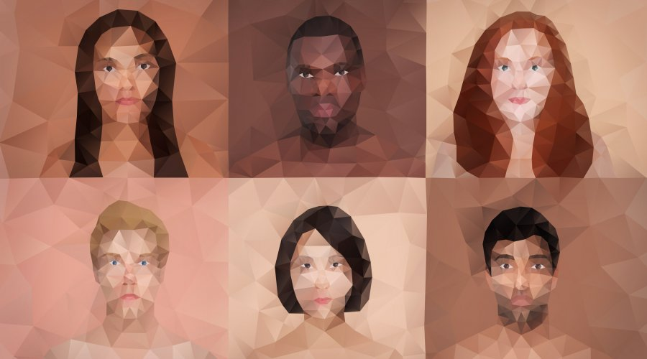
Evolution Needs Variation
How is variation produced?
Notes:
Sexual reproduction increases genetic variation in offspring, which in turn increases the genetic variability in species.

Slide 5
What is sex?
meiosis, then fertilization
meiosis has 3 phases
How is meiosis different from mitosis?

Slide 6
What is a homologous chromosome?

Slide 7
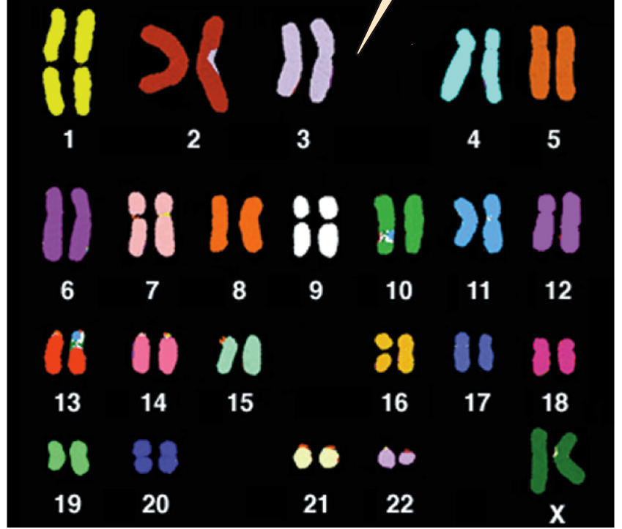
Homologous Chromosomes
Blood Type Gene
Type A Type O
What is the third allele for blood type?
Can a person have all three blood types?
Notes:
Homologous Chromosomes
Two chromosomes that are alike in structure and size
carry genetic information for the same set of hereditary characteristics.
One chromosome from female, the other from the male parent
Example - Each of us has two copies of the gene for blood type on chromosome pair number 9. One copy is inherited from our mother, the other from our father. There are three versions (called “alleles”) of this gene: A, B, and O. A person's blood type is determined by which allele he/she inherits from each parent
alleles – two forms of a gene

Slide 8
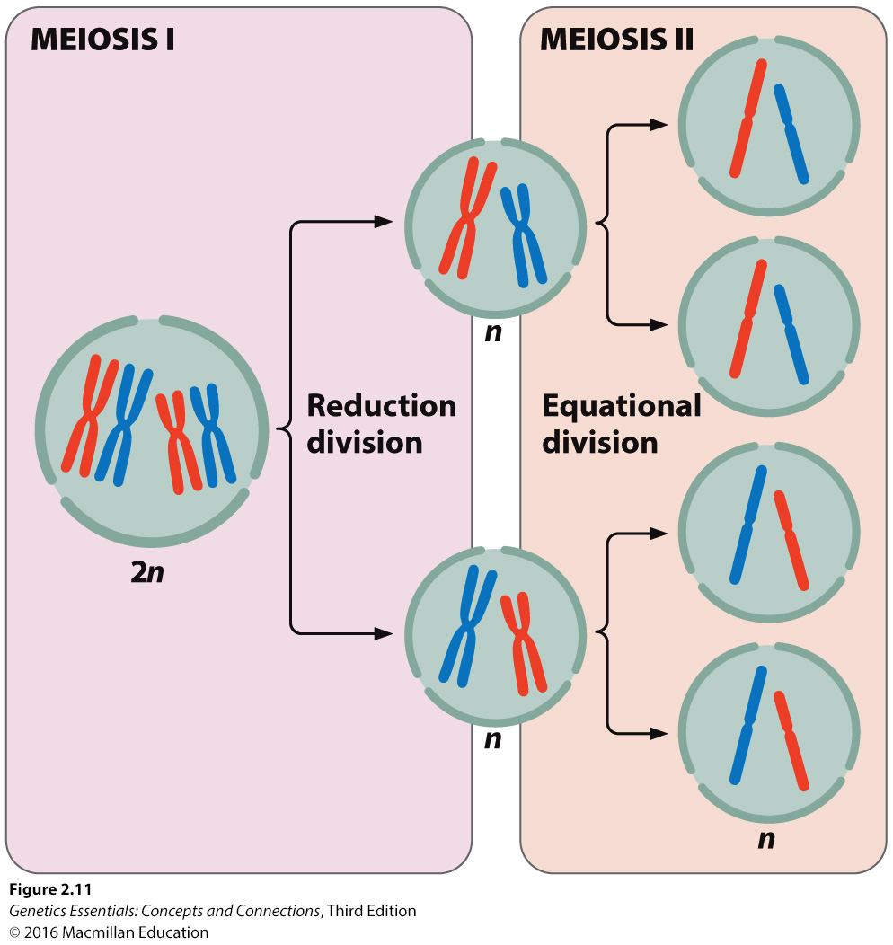
The Cell Life Cycle w/ Meiosis

Slide 9
Overview of meiosis
https://youtu.be/nMEyeKQClqI

Slide 10
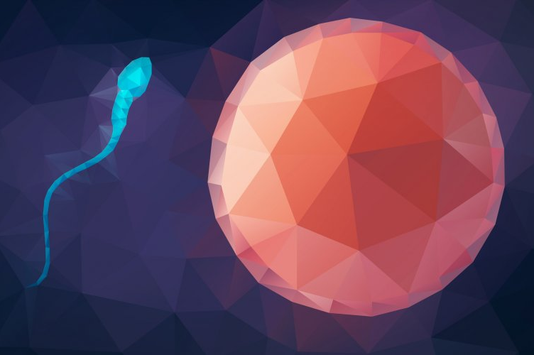
What are the consequences of meiosis?

Slide 11
How does meiosis produce gametes that are genetically different from the parent?
crossing over (recombination) -

Slide 12
Meiosis 1 – Prophase 1
Chromosome # 9 example
Blood Type Gene
Type A Type O

Slide 13
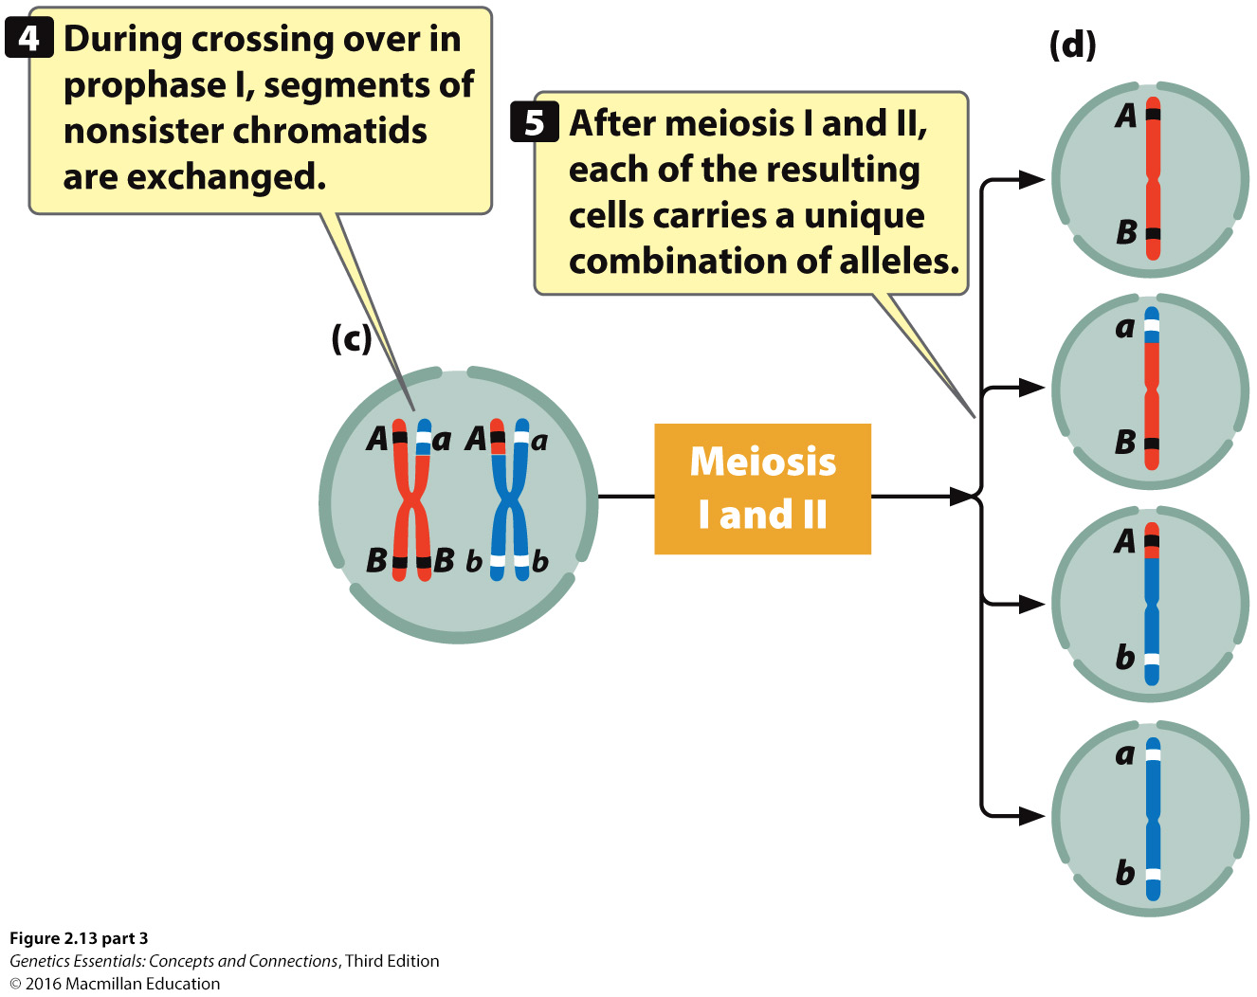
Unique Allele Combinations

Slide 14
Independent Assortment
Independent assortment of chromosomes and the genes they carry during meiosis 1.
sencond mechanism for generating variation

Slide 15
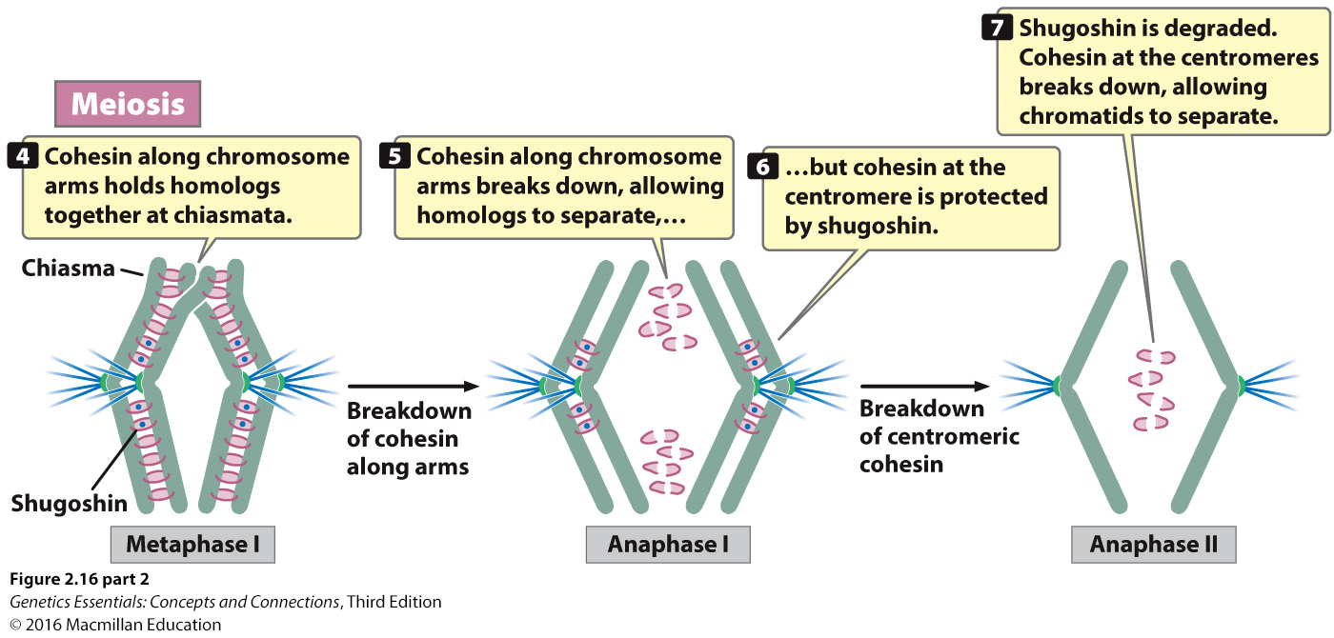

Slide 16
Telophase & Cytokinesis
Homologous chromosomes arrive at the centrosome poles.
Chromosomes uncoil
Nuclear membrane reforms around the DNA
Spindles break down and disappear
A cleavage furrow forms to pinch the cells into two
Plasma membrane around each cell

Slide 17
Meiosis II
Each stage in Meiosis II is identical to those of mitosis.
Anaphase II, sister chromatids are pulled apart as cohesin is broken at the centromeres.

Slide 19
Outcome of Meiosis II
Parent cell produces four daughter cells
Genetically different from each other and with the cell that gave rise to them.
Crossing over = chromatids with new alleles
Independent assortment = cells with different sets of chromosomes
2^{n} = possible combinations of chromosomes in each gamete
2²³ = 8 million
Random fertilization = 2²³ x 2²³ = 70 trillion
Newly formed cells have 1 set of chromosomes = haploid (n) cells

Slide 20
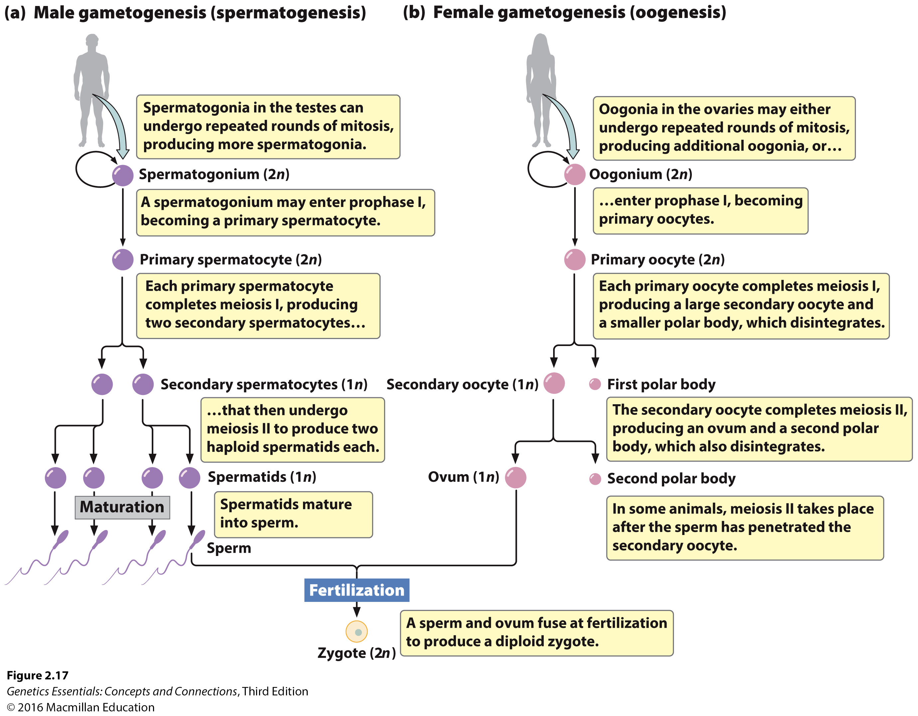

Slide 21
Mitosis vs. Meiosis

Slide 22
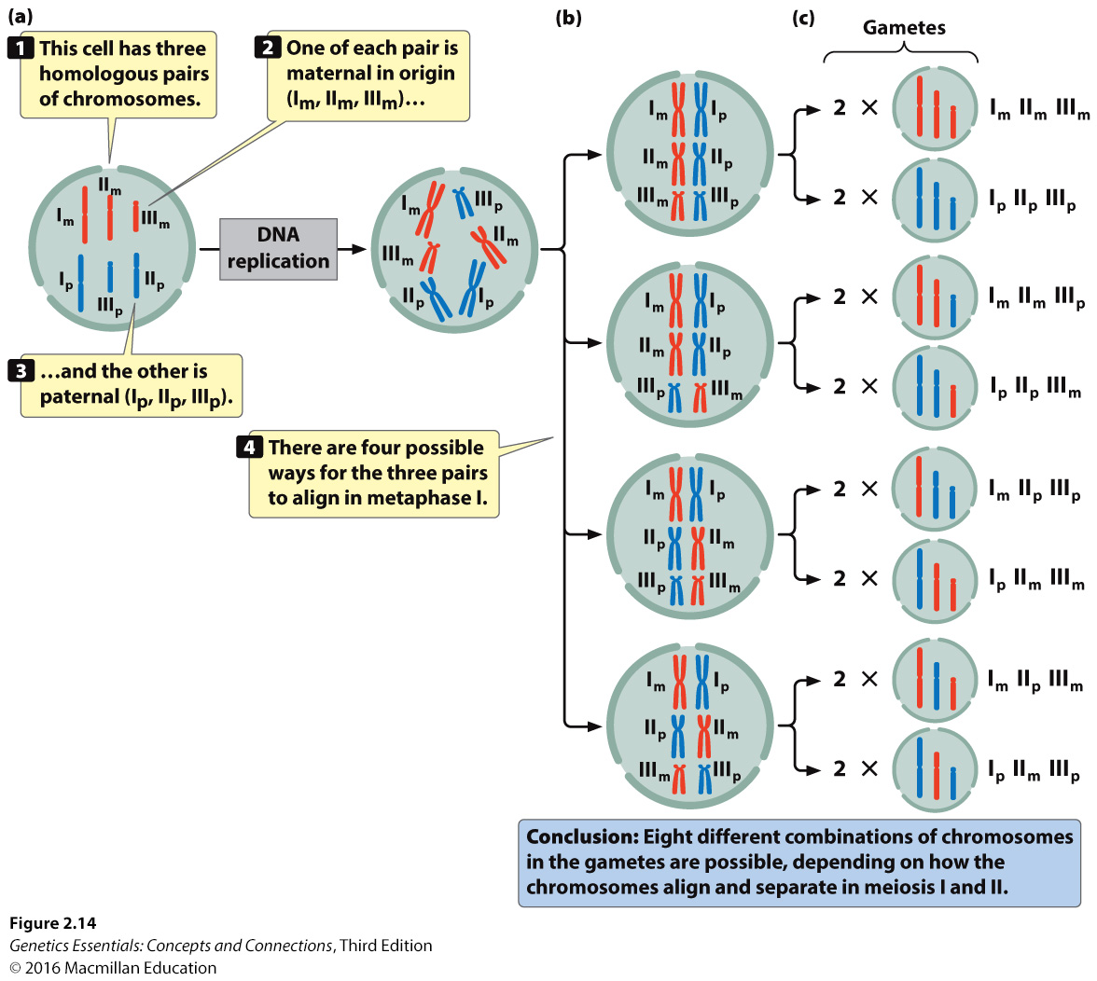
Independent assortment

Slide 23
Videos to start
https://youtu.be/nMEyeKQClqI

